Slide 1


Slide 2
Push factors and capital flows to EMs: Why knowing your lender matters more than fundamentals
Eugenio Cerutti, Stijn Claessens and Damien Puy
2016 Pacific Basin Research Conference
FRB San Francisco, November 18, 2016
Disclaimer! This presentation represents our own views and not necessarily those of the IMF, IMF policy, or the Federal Reserve Board of Governors or its staff.

Slide 3
MOTIVATION: “Common” Wisdom on Capital Flows
Capital inflows co-move, with EMs most affected, due, at least partly, to global factors
Calvo et al. (93, 1996), Chuhan, Claessens, and Mamingi (1998), Fratzscher (2012), Forbes and Warnock (2012), Rey (2013), etc. etc.
Main global factors: Advanced economies’ monetary policies; Supply of global liquidity (especially US$); International banks’ (US and EU) funding conditions; Global risk aversion. Although importance of each varies across studies
Impacts of these factors vary across countries, although research conflicts on how and why
Some say fundamentals matter (conditional on surge): Ghosh et al. (14)
Better macro fundamentals do reduce sensitivity: Prachi et al. (14), Ahmed et al. (14) versus Better macro fundamentals do not reduce sensitivity: Aizenman et al. (14), Eichengreen and Gupta (14)
Notes:
This slide has motion….answers are shown after all three questions are presented.

Slide 4
MOTIVATION: Three reasons to reexamine common wisdom
Some facts: “Counter-intuitive” capital movements, e.g., during the Taper Tantrum, with “better” countries more affected
Recent research: little (or counter-intuitive) discrimination across EMs by investors during global in- and outflows. Some evidence for global funds (Jotikastira et al, JF ‘12, Raddatz and Schmukler, JIE ‘12, IMF GFSR, ‘15) and global banks (Cetorelli & Goldberg ‘12, Cerutti & Claessens ’14, Bruno & Shin, ‘15)
Previous studies: focused mostly on dynamics of prices (rather than flows) to recipient markets and short-lived episodes of stress
Prices reflect many interactions. Our interest is non-resident (inflows) behavior
=> Revisit how common factors (differentially) impact countries, using BOP flows to 54 countries, 2001-2015
Notes:
This slide has motion….answers are shown after all three questions are presented.

Slide 5
KEY THREE QUESTIONS and RESULTS
Do we really observe co-movement in gross inflows? YES, BUT
Gross inflows to EMs do co-move, but gross inflows to ACs less so
And much heterogeneity across types of capital inflows
Equity, Bond and OI-Bank flows co-move - not FDI and OI-Non Bank
Which country is more sensitive? MUCH HETEROGENEITY
Some countries very sensitive across all types (e.g., Brazil, Turkey), others to particular types (e.g., India: Equity; Mexico: Bonds).
3. Why more sensitive? NOT FUNDAMENTALS, BUT MARKET FACTORS
Market characteristics rather than institutional/macro fundamentals
Liquidity and composition of foreign investor bases (reliance on international funds and global banks)
Notes:
This slide has motion….answers are shown after all three questions are presented.

Slide 6
KEY CONTRIBUTIONS
Estimates co-movement in flows across groups of countries and by type
Disaggregate gross inflows: not all co-move (respond differently to various global factors), with very heterogeneous effects across (even within) countries
Use of latent factors helps to better capture underlying co-movements
=> Qualifies generalizations about the drivers of capital inflows (to EMs)
Qualifies role of fundamentals in explaining response to global conditions
Episodes of surges/retrenchments can be at odds with “fundamentals” view
Recent literature on pro-cyclical behavior of international investors (funds, banks)
Knowing your lenders, and their mandate/incentives/constraints matters more
Adds to policy debate
Helps to identify which country is more sensitive to core global conditions (and through which BOP component) => Watch your lender
Notes:
This slide has motion….answers are shown after all three questions are presented.

Slide 7
How do we get there ? – 5 steps
Collect gross inflows from BOP (by type of flow)
Sample: 2001-2015, 54 countries, quarterly frequency
Flows: as a % GDP , 4 types: FDI, Portfolio Equity, Portfolio Bond, OI-Bank
(OI-Non Bank not used)
Estimate a (latent) factor model to decompose flows into global, regional and idiosyncratic components
Idea: Let the data tell what the commonality is, rather than presume/identify common factors to drive the flows
Kose et al. (IBC: world, regional and country-specific factors, AER 2003) - Bayesian Estimation

Slide 8
How do we get there – 5 steps
Recover the common factor (by type of flow)
=> Question 1 (1’)
Measure and explain factor sensitivities (β)
=> Question 2 (2’) and 3
3. Show the dispersion in sensitivity (β) across countries, types
4. Explain betas by running a horse race between characteristics: Fundamentals (Macro & Institutional) and
Market (Destination and Source)

Slide 9
Sample of countries

Slide 10
Aggregated Capital Inflow to ACs and EMs (% GDP)

Slide 11
Capital Inflows to Individual ACs and EMs (% GDP)

Slide 12
Methodology for extracting common factors
Estimate latent factor model for each type of flows:
Same methodology as in Kose et al. (2003, AER)
Key assumptions:
Factors follow AR processes => dynamic latent factor model
Factors are orthogonal to each other
Regional decomposition:
Global; Two “regions”: ACs (21 countries) and EMs (33)
Estimation:
Data augmentation to estimate parameters and factors (Gibbs sampling)
Same priors as Kose et al. (2003) – others yield almost identical results
Posterior distribution properties (parameters, factors) based on 300,000 Markov Chain Monte Carlo replications and 30,000 burn-in replications

Slide 13
ANSWER 1: Common factor reflects EMs’ flows better than ACs‘ (common factor for all vs. in each group)

Slide 14
ANSWER 1: Less so for bond flows, and FDI moves less in general

Slide 15
ANSWER 2: Common factor does not mean much for ACs' equity’s betas, much more for EMs’ betas

Slide 16
ANSWER 2: Common Factor Does Not Mean Much for ACs Banks’ Betas, Much More for EMs’ Betas

Slide 17
ANSWER 2: Common factor does reasonably well in terms of ACs and EMs bonds’ betas

Slide 18
ANSWER 2: Common factor does not mean much for ACs’ or EMs’ betas w.r.t. FDI

Slide 19
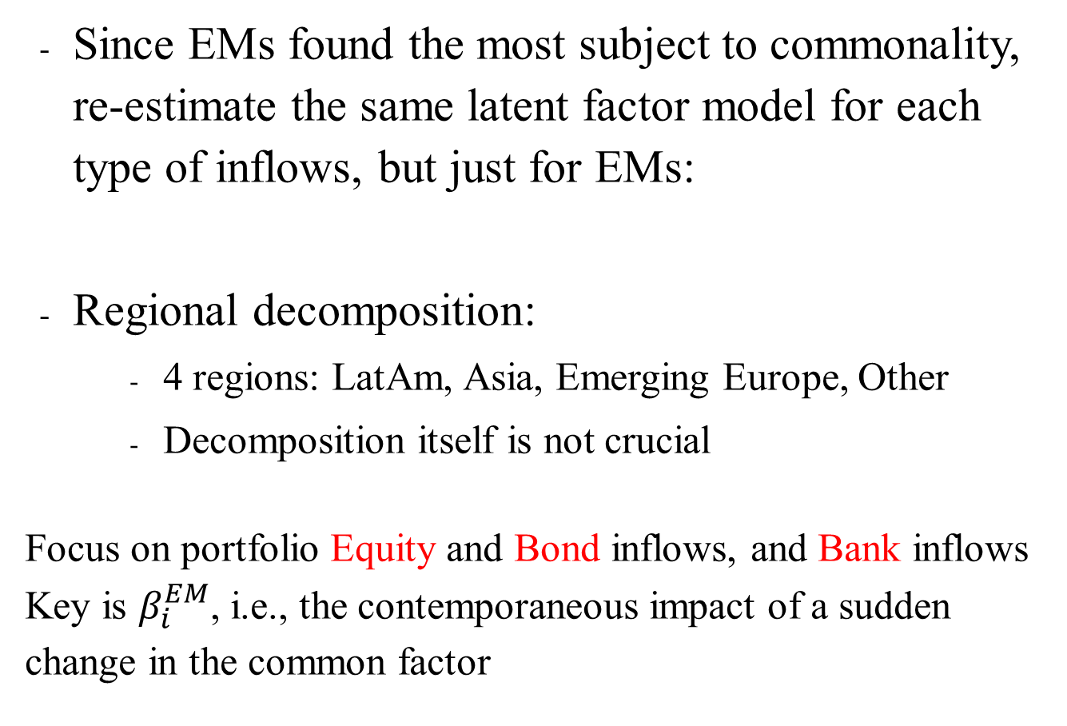

Methodology for EMs: similar as for flows to all
Since EMs found the most subject to commonality, re-estimate the same latent factor model for each type of inflows, but just for EMs:
Regional decomposition:
4 regions: LatAm, Asia, Emerging Europe, Other
Decomposition itself is not crucial
Focus on portfolio Equity and Bond inflows, and Bank inflows
Key is $β_{i}^{EM}$, i.e., the contemporaneous impact of a sudden change in the common factor
$$y_{i,t}=β_{i}^{EM}f_{t}^{EM}+β_{i}^{Region}f_{t}^{Region}+ε_{i,t}$$

Slide 20
ANSWER 1’: Co-Movement in inflows for EMs: Varies by type
Commonalities in Equity, Bond and Bank flows but not in FDI
Commonality in factors captures key events (Lehman, Euro, Taper Tantrum)
Estimated Common Factors – By type of inflows
corr equity-bond = 0.11
corr bank-bond = 0.61
corr equity-bank = 0.28

Slide 21
Answer 2’: WHO IS MORE SENSITIVE? Some countries more, as the equity betas vary a great deal…
Equity Beta on the common EM factor

Slide 22
Answer 2’: WHO IS MORE SENSITIVE? Some countries more, as the bond betas vary, but .. less than equity’s
Bond Beta on the common EM factor

Slide 23
Answer 2’: WHO IS MORE SENSITIVE? Some countries more, some less, as the bank betas vary a lot, positive , negative…
Bank Beta on the common EM factor

Slide 24
Answer 2’: WHO IS MORE SENSITIVE? A Summary
 | Equity | Bond | Bank
Argentina | 0.37 | 0.11 | 0.18
Belarus | -0.05 | 0.26 | 0.22
Brazil | 0.60 | 0.56 | 0.51
Bulgaria | 0.28 | 0.04 | 0.10
Chile | -0.02 | 0.19 | 0.18
China, | 0.39 | 0.01 | 0.53
Colombia | 0.13 | 0.03 | 0.16
Croatia | 0.23 | 0.09 | -0.30
Czech Republic | 0.14 | 0.14 | 0.31
Estonia | 0.26 | -0.20 | -0.12
Hungary | -0.12 | 0.46 | -0.18
India | 0.66 | NA | 0.21
Indonesia | 0.45 | 0.63 | 0.32
Israel | 0.10 | 0.38 | 0.04
Kazakhstan | 0.59 | 0.42 | -0.07
Korea | 0.45 | 0.21 | 0.48
Latvia | 0.10 | 0.17 | 0.04
Lithuania | -0.08 | 0.30 | -0.16
Beta: | β>0.4 | 0.2<β <.4 | β<0.2
Color:
 | Equity | Bond | Bank
Mexico | 0.31 | 0.40 | 0.35
Pakistan | 0.86 | 0.40 | 0.03
Peru | 0.24 | 0.26 | 0.38
Philippines | 0.52 | 0.42 | 0.22
Poland | 0.24 | 0.48 | -0.10
Romania | 0.36 | 0.33 | -0.10
Russia | 0.26 | 0.33 | 0.32
Slovak Republic | -0.04 | 0.44 | 0.15
Slovenia | 0.56 | 0.21 | 0.04
South Africa | 0.40 | 0.56 | 0.34
Thailand | 0.43 | 0.27 | 0.31
Turkey | 0.58 | 0.51 | 0.33
Ukraine | 0.13 | 0.23 | 0.14
Uruguay | -0.10 | 0.47 | -0.03
Venezuela | -0.06 | 0.29 | -0.01
Three Groups of EMs:
High sensitivity (Brazil, Korea, Turkey,.)
Varying by flows (China, Mexico,..)
Low Sensitivity (Chile, Estonia,..)

Slide 25
ANSWER 3: WHY MORE SENSITIVE? Fundamentals vs. Markets
Key question: Why do some countries always gain (or lose) more flows when global conditions change?
Approach: Regress the for each country, type on two variables:
Fundamentals
Macro: Public Debt, Growth, Trade openness, Reserves/GDP, FX-regime
Institutions: Law and order, Investor protection, Political risk
Market Structure Characteristics
Openness, Size, Liquidity, Foreign Investor Base Composition
Baseline regression for each cross section:

Slide 26
Data and Sources: Capital Flows, and Macroeconomic and Institutional Fundamentals

Slide 27
Data and Sources: Market Characteristics

Slide 28
Market Structure Data - Destination and Source
 | Foreign Openness | Size | Liquidity | Composition of Investor Base
Equity Market | Stock of Foreign Equity Funding/GDP | Local size: Stock Market Capitalization/GDP Relative to EMs: Stock of Foreign Equity/ Total Stock of Foreign Equity in EMs | - Stock Market turnover (as % of Market Cap) - Listed in MSCI benchmark (Emerging or Frontiers) | Share of Foreign Equity funding coming from AEs - Correlation of BOP equity flows with EPFR equity flows
Bond Market | Stock of Foreign Bond Funding/GDP | Local size: Bond market Capitalization/GDP Relative to EMs: Stock of Foreign Equity/ Total Stock of Foreign Equity in EMs | - Listed in EMBI benchmark | Share of Foreign Bond funding coming from AEs - Correlation of BOP bond flows with EPFR bond flows
Banking Sector | Stock of Foreign Bank Claims/GDP | Private credit /GDP |  | - Correlation of BOP bank flows with BIS global bank flows

Slide 29
Raw Statistics: Fundamentals and Equity Markets

Slide 30
Raw Statistics: Bond and Banking Markets

Slide 31
ANSWER 3: WHY MORE SENSITIVE? Fundamentals less than Markets
No role for Growth, Institutional Quality, Reserves, Openness
Some Role for public debt and FX regime in Bonds, Banks
 | Equity Beta |  |  |  | Bond Beta |  |  |  | Bank Beta
 | (1) | (2) | (3) |  | (4) | (5) | (6) |  | (7) | (8) | (9)
Fundamentals
Trade Openness | -0.002 |  |  |  | 0.001 |  |  |  | -0.001
Public Debt | 0.001 |  |  |  | 0.004** |  | 0.002* |  | -0.002
Reserves | -0.002 |  |  |  | -0.005 |  |  |  | 0.004
FX Regime | 0.012 |  |  |  | 0.03** |  | 0.018** |  | 0.03** |  | 0.011
Real GDP Growth | 0.038 |  |  |  | 0.022 |  |  |  | 0.029
Law and Order | 0.018 |  |  |  | -0.027 |  |  |  | -0.038
Investor Protection | -0.013 |  |  |  | -0.003 |  |  |  | -0.017
Market Characteristics
Foreign Openness |  | -0.003 |  |  |  | 0.002 |  |  |  | -0.011*** | -0.01**
Local Market Size (%GDP) |  | 0.001 |  |  |  | -0.003 |  |  |  | 0.002*** | 0.002**
Relative Market Size (% Stock) |  | -0.001 |  |  |  | 0.005
MSCI EM |  | 0.006
MSCI Frontier Market |  | 0.24* | 0.23**
EMBI EM |  |  |  |  |  | -0.019
Stock Turnover Ratio |  | 0.002*** | 0.002***
Share of Funding from AE |  | 0.002 |  |  |  | 0.002
Correlation with EPFR (or BIS) flows |  | 0.512*** | 0.538*** |  |  | 0.47*** | 0.298** |  |  | 0.29* | 0.285*
constant | 0.24 | -0.138 | 0.008 |  | -0.05 | 0.057 | -0.013 |  | 0.13 | 0.11 | 0.02
R-sq | 0.25 | 0.61 | 0.59 |  | 0.46 | 0.40 | 0.48 |  | 0.36 | 0.43 | 0.45
Standard errors in parentheses
="* p<0.10 | ** p<0.05 | *** p<0.01"
Equity: Inclusion, Liquidity and Investor Base
Bond: Only Investor base
Bank: Openness, Size, Lender base

Slide 32
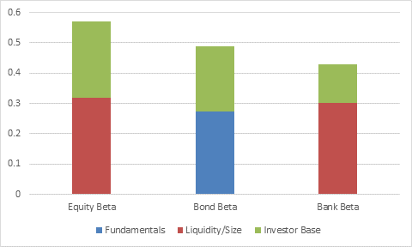
Answer 3: Why MORE SENSITIVE? Fundamentals less than Markets
Macro Fundamentals have little explanatory power (except for bond flows) – No role for institutional quality
Liquidity and Investor Base proxy account for most of the cross country variation and have quantitatively most impacts
R- Square Decomposition

Slide 33
Answer 3 – WHY MORE SENSITIVE? Robustness: Bayesian Averaging
Bayesian averaging exercise confirms sensitivity determinants
Macroeconomic and Institutional fundamentals themselves do not drive importance of global investors (fund or bank)
Equity- Bayesian Averaging |  |  |  |  | Bond- Bayesian Averaging |  |  |  |  | Bank - Bayesian Averaging
 | Coef. | t-Stat | PIP |  |  | Coef. | t-Stat | PIP |  |  | Coef. | t-Stat | PIP
Trade Openness | -0.001 | -0.57 | 0.31 |  | Trade Openness | 0.000 | 0.22 | 0.12 |  | Trade Openness | 0.000 | -0.3 | 0.17
Public debt | 0.000 | 0.05 | 0.07 |  | Public debt | 0.001 | 0.54 | 0.3 |  | Public debt | 0.000 | -0.37 | 0.2
Reserves | -0.001 | -0.33 | 0.15 |  | Reserves | -0.002 | -0.53 | 0.29 |  | Reserves | 0.000 | 0.15 | 0.11
FX regime | 0.001 | 0.19 | 0.1 |  | FX regime | 0.012 | 0.81 | 0.48 |  | FX regime | 0.004 | 0.45 | 0.25
Real GDP Growth | 0.007 | 0.4 | 0.2 |  | Real GDP Growth | 0.000 | -0.06 | 0.08 |  | Real GDP Growth | 0.004 | 0.33 | 0.17
Rule of Law | -0.006 | -0.27 | 0.13 |  | Rule of Law | -0.002 | -0.18 | 0.1 |  | Rule of Law | -0.003 | -0.2 | 0.12
Investor Protection | -0.002 | -0.22 | 0.11 |  | Investor Protection | 0.001 | 0.11 | 0.1 |  | Investor Protection | 0.000 | -0.04 | 0.11
Foreign Equity Stock/GDP | 0.00 | 0.1 | 0.08 |  | Foreign Bond Stock/GDP | 0.000 | 0.11 | 0.08 |  | Foreign BIS Claims Stock/GDP | -0.009 | -1.48 | 0.77
Stock Market Capitalization (%GDP) | 0.00 | 0.08 | 0.07 |  | Bond Market Capitalization (%GDP) | 0.000 | 0.04 | 0.09 |  | Private credit/GDP | 0.001 | 0.83 | 0.49
Relative Equity Size | 0.00 | 0.04 | 0.07 |  | Relative Market Size | 0.000 | 0.12 | 0.08
MSCI EM Benchmark | -0.01 | -0.16 | 0.12 |  | EMBI Benchmark (dummy) | 0.001 | 0.06 | 0.08
MSCI Frontier Market Benchmark | 0.13 | 1.01 | 0.59
Stock Turnover Ratio | 0.00 | 1.62 | 0.81
Share of Funding from AE | 0.00 | 0.14 | 0.08 |  | Share of Funding from AE | 0.000 | 0.19 | 0.1
Correlation with EPFR Equity flows | 0.32 | 1.2 | 0.68 |  | Correlation with EPFR Bond flows | 0.333 | 1.62 | 0.81 |  | Correlation w/ BIS flows | 0.133 | 0.67 | 0.4

Slide 34
Answer 3 – WHY MORE SENSITIVE? Robustness: Pre-GFC
 | Equity Beta |  |  |  | Bond Beta |  |  |  | Bank Beta
 | (1) | (2) | (3) |  | (4) | (5) | (6) |  | (7) | (8) | (9)
Fundamentals
Trade Openness | 0.003 |  |  |  | -0.001 |  |  |  | 0.000
Public Debt | 0.007 |  |  |  | 0.010*** |  | 0.005 |  | 0.000
Reserves | 0.029 |  |  |  | -0.010 |  |  |  | -0.0002
FX Regime | 0.050 |  |  |  | 0.003 |  |  |  | -0.004*** |  | -0.0019**
Real GDP Growth | 0.044 |  |  |  | 0.038 |  |  |  | -0.001
Law and Order | -0.012 |  |  |  | -0.063 |  |  |  | 0.009* |  | 0.007**
Investor Protection | -0.099 |  |  |  | 0.000 |  |  |  | 0.002
Market Characteristics
Foreign Openness |  | 0.012 |  |  |  | 0.000 |  |  |  | 0.001* | 0.0005
Local Market Size (%GDP) |  | 0.000 |  |  |  | -0.002 |  |  |  | 0.000 | -0.000**
Relative Market Size (% Stock) |  | -0.027 |  |  |  | 0.013** | 0.008
MSCI EM |  | 0.108
MSCI Frontier Market |  | 0.717*** | 0.656***
EMBI EM |  |  |  |  |  | 0.098
Stock Turnover Ratio |  | 0.006*** | 0.005***
Share of Funding from AE |  | 0.003 |  |  |  | -0.003
Correlation with EPFR (or BIS) flows |  | 0.66** | 0.705** |  |  | 0.640*** | 0.474*** |  |  | 0.011 | 0.003
constant | -0.247 | -0.372 | -0.57 |  | 0.04 | 0.268 | -0.070 |  | 0.01 | 0.06 | 0.007
R-sq | 0.23 | 0.55 | 0.5 |  | 0.55 | 0.62 | 0.63 |  | 0.4 | 0.24 | 0.42
Standard errors in parentheses
="* p<0.10 | ** p<0.05 | *** p<0.01"
No role for Growth, Institutional Quality, Reserves, Openness
Some Role for public debt in Bonds; FX, Law in Banks
Equity: Inclusion, Liquidity and Investor Base
Bond: Size and Investor base significant
Bank: Openness, Size

Slide 35
Answer 3 – WHY MORE SENSITIVE? Robustness: Post-GFC
No role for Institutional Quality, Reserves, Openness
Some Role for Growth, in Equity, FX regime in Bonds
 | Equity Beta |  |  |  | Bond Beta |  |  |  | Bank Beta
 | (1) | (2) | (3) |  | (4) | (5) | (6) |  | (7) | (8) | (9)
Fundamentals
Trade Openness | -0.001 |  |  |  | 0.000 |  |  |  | 0.000
Public Debt | 0.005 |  |  |  | -0.001 |  |  |  | 0.000
Reserves | -0.001 |  |  |  | -0.001 |  |  |  | -0.001
FX Regime | 0.049 |  |  |  | 0.011** |  | 0.002 |  | -0.001
Real GDP Growth | 0.073* |  | 0.024 |  | -0.007 |  |  |  | 0.005
Law and Order | -0.044 |  |  |  | -0.020 |  |  |  | -0.006
Investor Protection | -0.009 |  |  |  | -0.008 |  |  |  | -0.005
Market Characteristics
Foreign Openness |  | 0.003 |  |  |  | 0.010 |  |  |  | -0.001
Local Market Size (%GDP) |  | 0.001 |  |  |  | 0.025 |  |  |  | 0.000
Relative Market Size (% Stock) |  | 0.015 |  |  |  | 0.020
MSCI EM |  | -0.081
MSCI Frontier Market |  | -0.035
EMBI EM |  |  |  |  |  | 0.226
Stock Turnover Ratio |  | 0.003 | 0.004***
Share of Funding from AE |  | -0.003 |  |  |  | 0.007
Correlation with EPFR (or BIS) flows |  | 1.17*** | 1.10*** |  |  | 0.041** | 0.088* |  |  | -0.019
constant | -0.210 | 0.150 | -0.19 |  | 0.166 | 0.460 | -0.023 |  | 0.09** | 0.020
R-sq | 0.340 | 0.75 | 0.73 |  | 0.31 | 0.33 | 0.23 |  | 0.36 | 0.14
Standard errors in parentheses
="* p<0.10 | ** p<0.05 | *** p<0.01"
Equity: Liquidity and Investor Base
Bond: Investor base
Bank: none

Slide 36
Summary of Results: Sensitivities vary by market, not fundamentals
Sensitivity of flows more about market characteristics and conditions than (institutional) fundamentals
Consistent with recent literature on investors, lenders’ behavior, both international and domestic
Micro-based evidence on mutual funds (Raddatz and Schmukler, ‘12)
Banking flows evidence (Bruno and Shin, ‘15)
Country-specific evidence (Timmer, ’16, and Domanski, Shin and Sushko ‘15 for Germany; Goldstein et al., ’15 for US mutual funds)
Qualifies other literature
The general global financial cycle (Rey, 13): not universal
The role of fundamentals in EMs’ exposure to ACs’: some countries more sensitive through some flows because of investor/lender bases

Slide 37
Policy Implications: Watching your lender, investor, or manager is crucial
Need to monitor, know mandates, incentives, constraints of lenders/investors/managers as these greatly matter
Good macroeconomic, institutional, etc. fundamentals alone do not ensure insulation from global shocks, However:
Cannot choose lenders/investors/managers
Macroprudential, capital flow management policies cannot (easily) discriminate by lenders/investors/managers
Need more systematic and reliable information on composition of foreign holdings by type of investors, building on recent efforts (e.g., Arslanalp&Tsuda, 2014, Global FoF)
P.S. sensitivity does not necessarily mean level or macro risks
Level vs. variance: high sensitivity problem if flows macro-relevant
Other factors might amplify (or dampen) effects of a high sensitivity (e.g., Chile, Malaysia could mitigate shocks with outflows)

