Slide 1


Text Slide with Image
Budgeting Basics
  Sed diam nonumy eirmod
  tempor invidunt ut labore.
    Dolore magna aliqueyam erat

Slide 2

What is a Budget?
A plan that you write down to decide how you will spend and save your money each month.

Slide 3
Why Create a Budget?
Creating a budget helps you…
understand how you are spending your money.
find uses for your money that will increase your wealth.
plan for unexpected events or emergencies.
      ensure that you always have money for the things you need.

Slide 4

WHAT IS INCOME?
1.) Money spent
2.) Money earned
3.) Both
4.) None of the above
Notes:
Now we’re going to have a quick poll to define income and expenses

Slide 5



WHAT IS AN EXPENSE?
1.) Allowance
2.) Food
3.) Entertainment
4.) Wages

Slide 6

WHAT WAS THE LAST THING YOU PAID FOR?
1.) Food
2.) Gas
3.) Clothes
4.) Movie
5.) Cell phone
6.) Games
7.) Other
Notes:
Discuss responses – highlighting similarities: “wow, we have quite a few Foodies” in the group.
Questions:
Do you like new or vintage clothes?
What movie did you see?
What’s your favorite game?
Tell me more about “other” what didn’t fit in these categories?

Slide 7

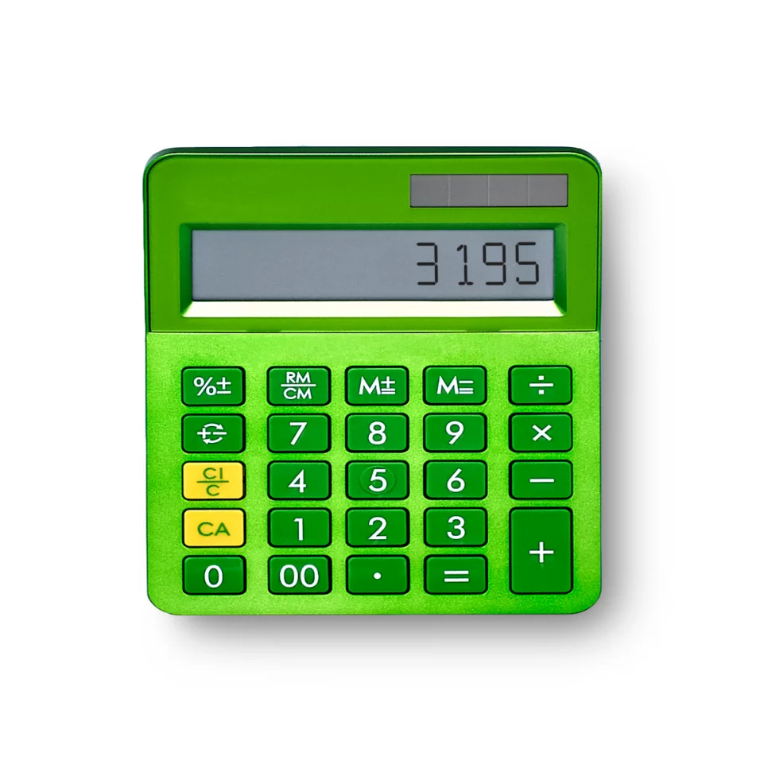
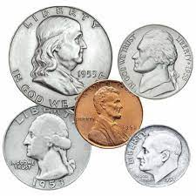
What you’ll need:
  Budget worksheet
  Pencil
  Coin (just one!)
Notes:
You’re going to need three items: budget work sheet, a pencil (with an eraser!), a calculator and a coin, any denomination.

Slide 8


Choose a career
Select a career that interests you – then enter the monthly income, taxes and any student loan repayments on your budget worksheet.
Notes:
To get started, you’ll need to choose a career.
On the next slide there’s 3 career choices per education level. Don’t worry if none of the options interest you, for the sake of the game, just select a career that interests you the most.

Slide 9
High School Diploma
Bachelor’s Degree
Commercial Truck Driver
Photographer
Plumber
Graphic Designer
Writer
Computer Engineer
Income:
$48,000/yr
$3,333/mth
Taxes: $480/mth
Income:
$49,000/yr
$2,830/mth
Taxes: $490/mth
Income:
$50,000/yr
$4,166/mth
Taxes: $500/mth
Income:
$65,000/yr
$5,416/mth
Taxes: $812/mth
Student Loan Repayment: $310/month
Income:
$75,000/yr
$6,250/mth
Taxes: $937/mth
Student Loan Repayment: $310/month
Income:
$80,000/yr
$6,666/mth
Taxes: $1,000/mth
Student Loan Repayment: $310/month
Associate’s Degree
Master’s Degree
Real Estate Agent
Web Developer
Dental Hygienist
Librarian
Principal
Occupational Therapist
Income:
$59,000/yr
$4,916/mth
Taxes: $590/mth
Student Loan Repayment: $180/month
Income:
$66,000/yr
$5,500/mth
Taxes: $660/mth
Student Loan Repayment: $180/month
Income:
$79,000/yr
$6,583/mth
Taxes: $790/mth
Student Loan Repayment: $180/month
Income:
$80,000/yr
$6,666/mth
Taxes: $1,000/mth
Student Loan Repayment: $440/month
Income:
$93,000/yr
$7,750/mth
Taxes: $1,162mth
Student Loan Repayment: $440/month
Income:
$101,000/yr
$7,833/mth
Taxes: $1,175/mth
Student Loan Repayment: $440/month
Notes:
So, there’s 3 options per education level:
high school
associates degree (2-year community college)
Bachelor’s – or undergraduate degree –
Masters.
You’ll see that each career option lists income, taxes, and if you have a degree – you have a monthly student loan payment due.
Walk students through career choices, ensuring everyone understands specific job duties.
Does anything jump out at you?
Responses:
+ the degrees require student loan repayments
+ the higher the education level, the more expensive the student loan totals
+ the higher the income the more you pay in taxes

Slide 10



Don‘t forget to pay yourself!
Simple Saver
Saving Rate = 5%/month
Calculation = Divide monthly income by 20
Savvy Saver
Saving Rate = 10%/month
Calculation = Divide monthly income by 10
Super Saver
Saving Rate = 20%/month
Calculations = Divide monthly income by 5
Notes:
My Dad used to say, “Pay Yourself First”. I always thought that was a ridiculous comment – well, of course I'm going to 'pay myself first!'
But then as an adult, I realized what he meant: you must make saving a priority. Bills are going to come and go every month; however, you deserve to pay yourself first…don’t let the money just slip through your fingers and vanish – it’s fun to have a savings goal and see your account grow!

Slide 11

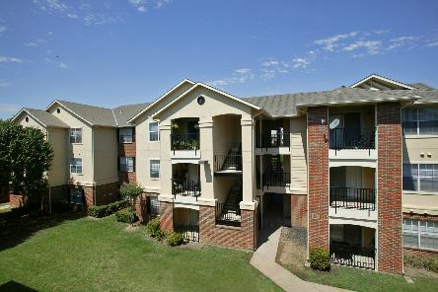
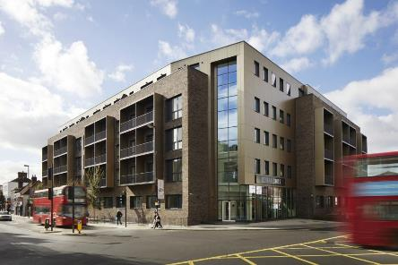

Choose your home
Home with the Folks
Monthly Payment = $0.00!
Utilities = $350
Close Quarters
Monthly Payment = $1,900
Utilities = $390
Upscale High Life
Monthly Payment = $3,200
Utilities = $530
Suburban Oasis
Monthly Payment = $4,300
Utilities = $600
Notes:
Here’s your living options:

Slide 12


TAKE A CHANCE
Life brings unexpected events; some bring money, others add expense.
FLIP A COIN
to reveal your fate.
HEADS
Your laptop is stolen, and you must spend $1,320 to replace it. You can pay in monthly (12) installments.
TAILS
To help build your savings, a relative deposits $25 each month into your savings account.
Notes:
Heads:
Pay $110 per month
Tails:
Receive $25 per month / $300 per year

Slide 13




Choose your ride
Stop & Go
Monthly Payment = $200
Fuel = $0/month
Putt-Putt
Monthly Payment = $300
Fuel Expense = $150/month
Safe & Steady
Monthly Payment = $450
Fuel Expense = $250
Zoom-Zoom
Monthly Payment = $800
Fuel Expense = $400

Slide 14

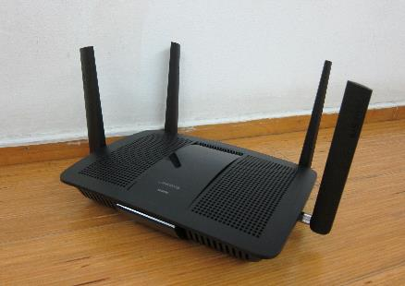


How Connected are you?
(You can select as many options as you want)
Streaming
Expense = $50/month
High Speed Internet
Expense = $70/month
Phone
Expense = $80/month
Cable
Expense = $130/month
Notes:
Choose your monthly internet and phone costs.
Tip: if you’re on a tight budget, how could you save the most money while still being connected?
Suggestion: rather than pay for cable and high speed, tether your phone to a web-ready tv and access streaming services.
Phone = $80
Streaming = $50
Total = $130

Slide 15



What‘s on the menu?
Basic Basket
Expense = $400/month
Description = Just the necessities, all store brands
Common Basket
Expense = $600/month
Description = Mixture of basic goods, name brand & restaurant meals
Royal Feast
Expense = $700/month
Description = Mixture of organic, gourmet, name brand, and restaurant meals

Slide 16


TAKE A CHANCE
Life brings unexpected events;
some bring money, others add expense.
FLIP A COIN
to reveal your fate.
TAILS
Last year you made a mistake on your taxes. You now must repay the $1,200 you owe over the course of a year.
HEADS
You win $600 from a radio contest paid in monthly installments for one year.
Notes:
Heads:
Receive $50 per month
Tails:
Pay $100 per month

Slide 17




What to wear, what to wear?
The Lounger
Expense = $60/month
The Trendsetter
Expense = $120/month
The Sophisticate
Expense = $250/month
The Glamour Guru
Expense = $500/month

Slide 18



What will you do for fun?
Stay at Home
Expense = $100/month
Description = Watching/streaming movies, have friends over, relax
The Weekender
Expense = $250/month
Description = Bowling, going to a movie, shopping
The Big Spender
Expense = $400/month
Description = Going to live shows, fancy dinner, sports games

Slide 19
$6,250
$937
$5,313
$310
$625
$4,378
$2,290
$400
$120
$450
$250
$130
$398
-$110
-$100
$188
Notes:
As you plan for your future, you’ll need to check that your budget balances (balance=0).
If your budget is balanced, you’ve put aside money as savings and planned for your expenses. You’ll also be better prepared to handle unexpected events!
If you end the month in the positive, you have a “surplus”; however, if you’re “in the red” – or in the negative – you’ll have a shortfall. You’ll need to use some of your savings or reduce your expenses.
You’ll see that healthcare is static, assuming the average monthly healthcare cost of $340 for a healthy adult.
So, for my budget, I’m a:
Writer, earning $75k annually/$6,250 per month
Taxes = $937 month
Leaving a disposal income of $5,313
I then subtract my student loan payment ($310)
I’m a Savvy Saver, saving 10% a month before taxes
After subtracting taxes, student loan, and savings I end up with $4,378 for living expenses.
Let’s see where we end up:
I live in a suburban apartment, paying $1900 for rent and $390 in utilities, for a monthly total of $2,290
For food I’m on the lowest plan @ $400 per month
On clothing I’m in the middle of the road as a Trendsetter: some vintage resale and Ross/TJ Maxx, spending $120 per month
I have an economical car, costing $450 including gas and insurance
For entertainment, I entertain at home and go out once a week, costing $250 per month
Connectivity: a cell phone and streaming service totaling $130 monthly
Subtracting the flat $340 per month for healthcare leaves me at $398
I didn’t do so well on my chances…I got a heads on the first go: had to replace my lost laptop, costing me $110 per month for the next year
And on my second toss I got tails, so I had to repay the tax error of $1200 – costing me $100 per month for the next year.
The grand total…drum roll…even with the bad luck chances, I ended up “in the black” at $188.
What are some things I could do with the $188?
Pay towards my student loan
Pop it into my savings account towards for one of my long (house?), medium (vacation?) or short-range (new tv?) savings goals
Treat myself: spending on an item, an experience, a charity?
I hope you enjoyed our discussion – and yes, I said “enjoyed”. Financial planning is an active, intentional process – there are lots of options, choices and adjustments that need to be made.
Life is unpredictable – and you need to be flexible and able to quickly adjust your budget. Whether it’s an unexpected car repair, a concert that you have to go to, or a dream vacation…budgeting allows you to manage your money: where it must go (rent, food, clothing) and where you’d like to go (college, vacation, new car, etc.)
A budget is not a one-and-done…you should revisit it frequently and should evolve to meet your needs and goals!
Now that you know how to plan and budget…what are your financial goals?
If you’re comfortable sharing with the group – please do, and if not – please discuss your financial goals with a family member, teacher, or trusted advisor.
And remember, always pay yourself FIRST! ☺

