Slide 1
Recent Economic and Financial Developments
Conference on Teaching and Research in Economic Education (CTREE)
Portland, Oregon
May 31, 2023
Sylvain Leduc
Executive Vice President & Director of Research
Views expressed are those of the presenter and not necessarily those of the Federal Reserve Bank of San Francisco or the Federal Reserve System

Slide 2
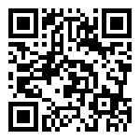
Join the Presentation Survey
Please scan the QR code
slido.com
#2486 013

Slide 3
The Fed has two mandates
Maximum Employment
Price Stability
Everyone who wants a job has a job
Dollar holds its value

Slide 4
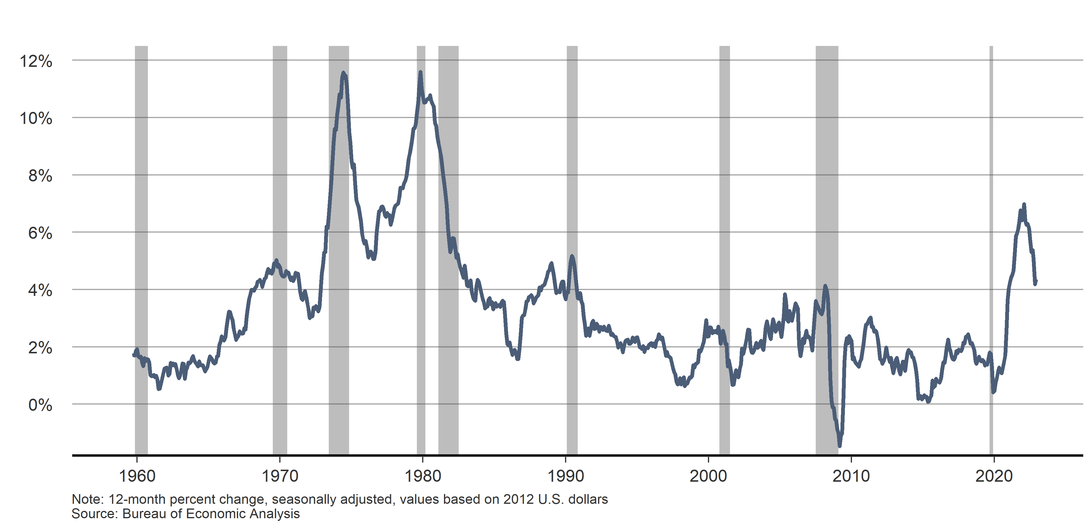
Despite cooling signs, inflation remains much too high
Headline personal consumption expenditures (PCE) inflation

Slide 5
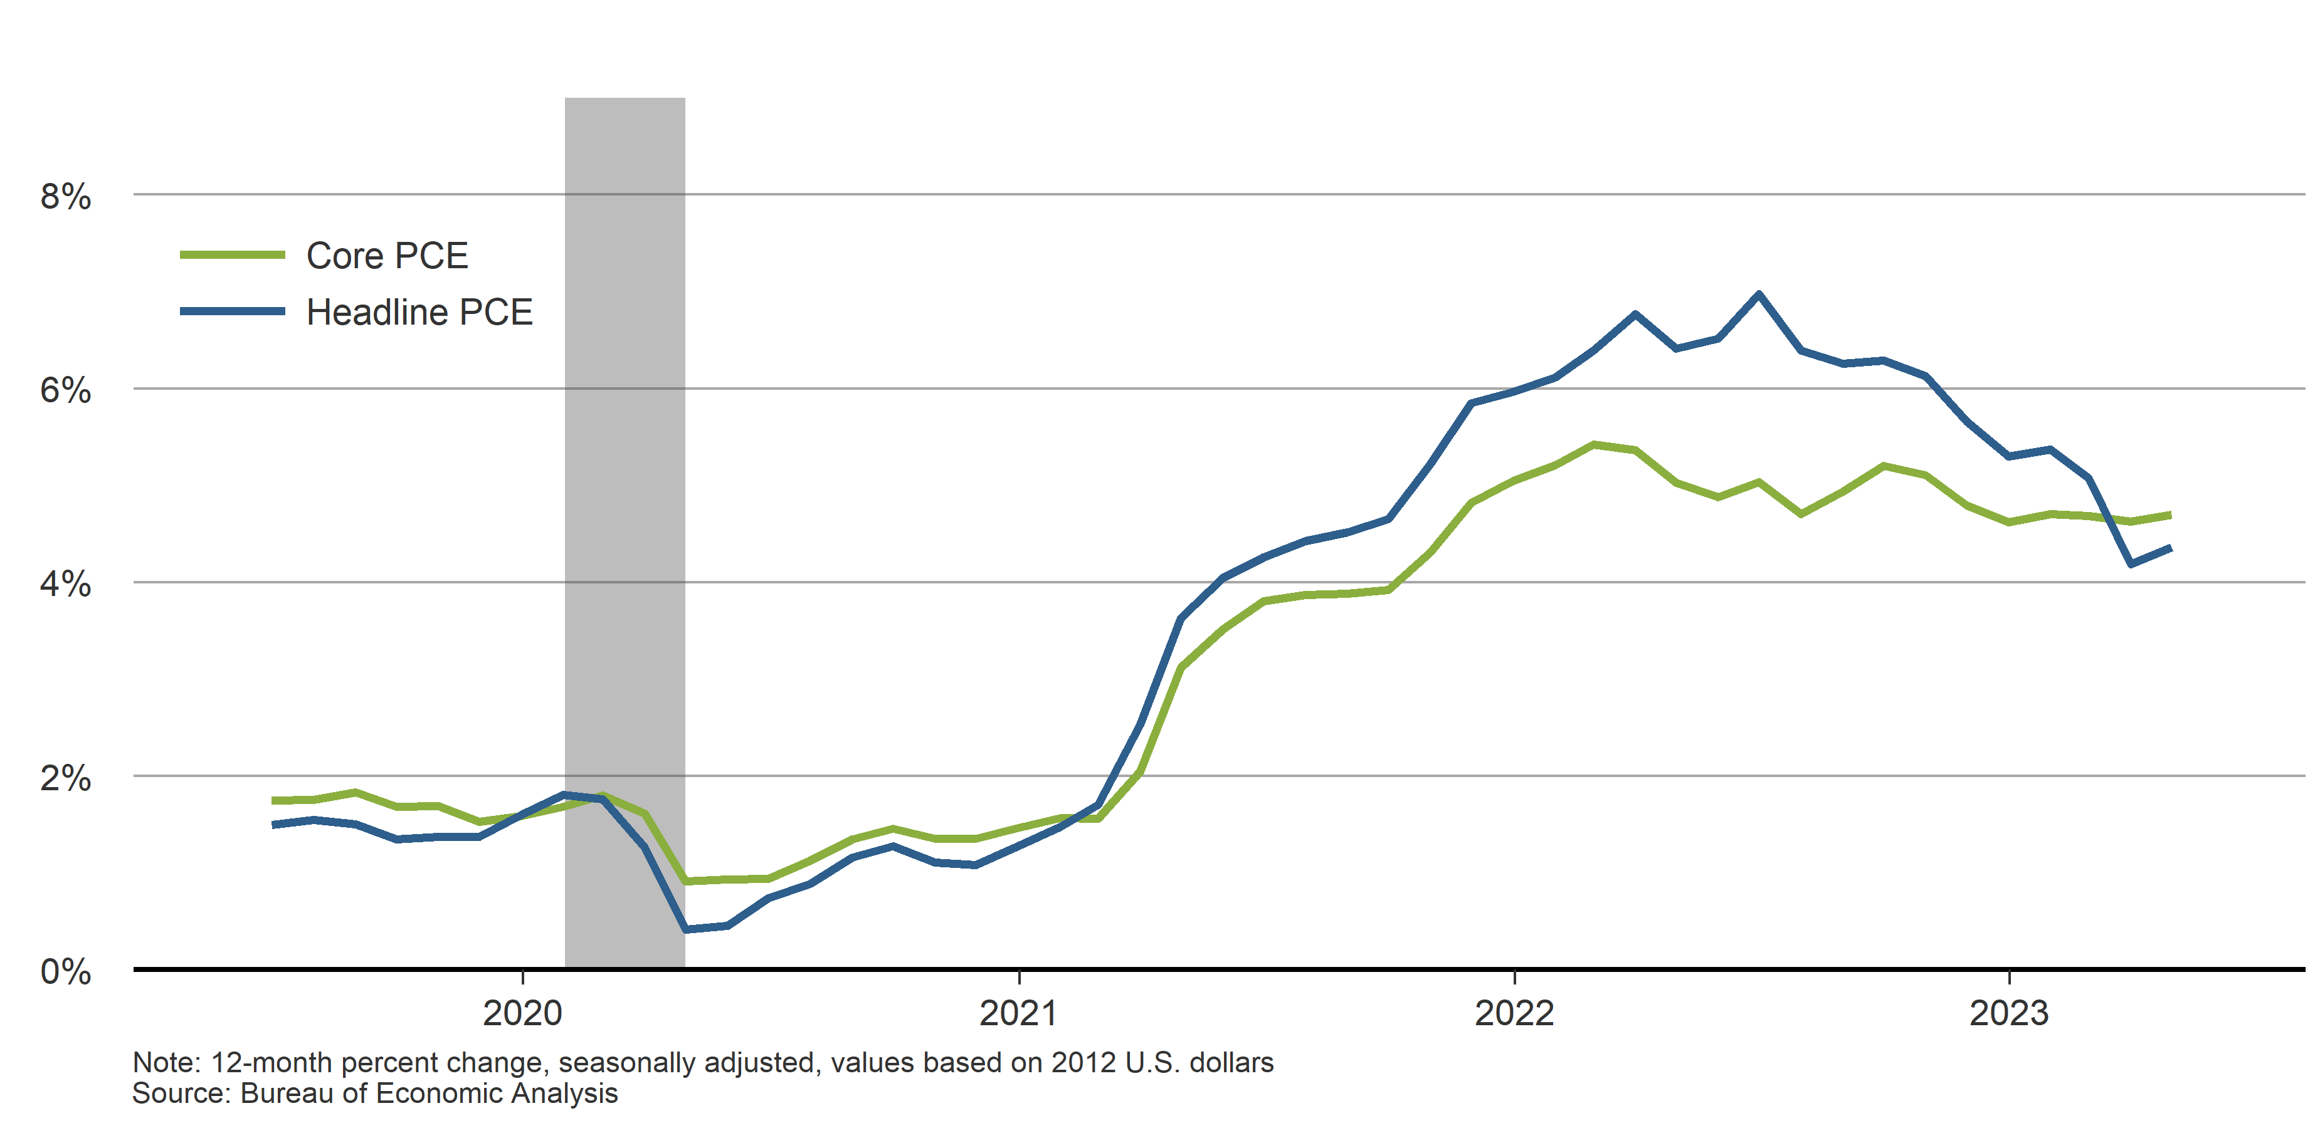
Inflation remains much too high
Core and headline personal consumption expenditures (PCE) inflation

Slide 6
Examining channels of inflation
INFLATION
Sectoral Factors
Demand
Factors
Expectations

Slide 7
Sectoral Factors

Slide 8
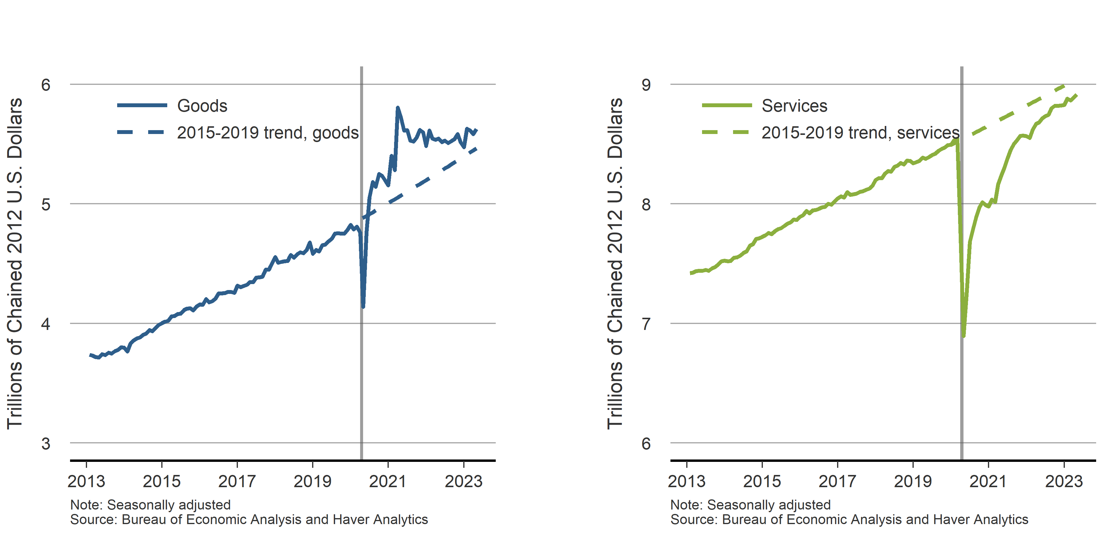
Spending patterns are normalizing
Inflation-adjusted PCE for goods and services (trillions of chained 2012 U.S. dollars)

Slide 9
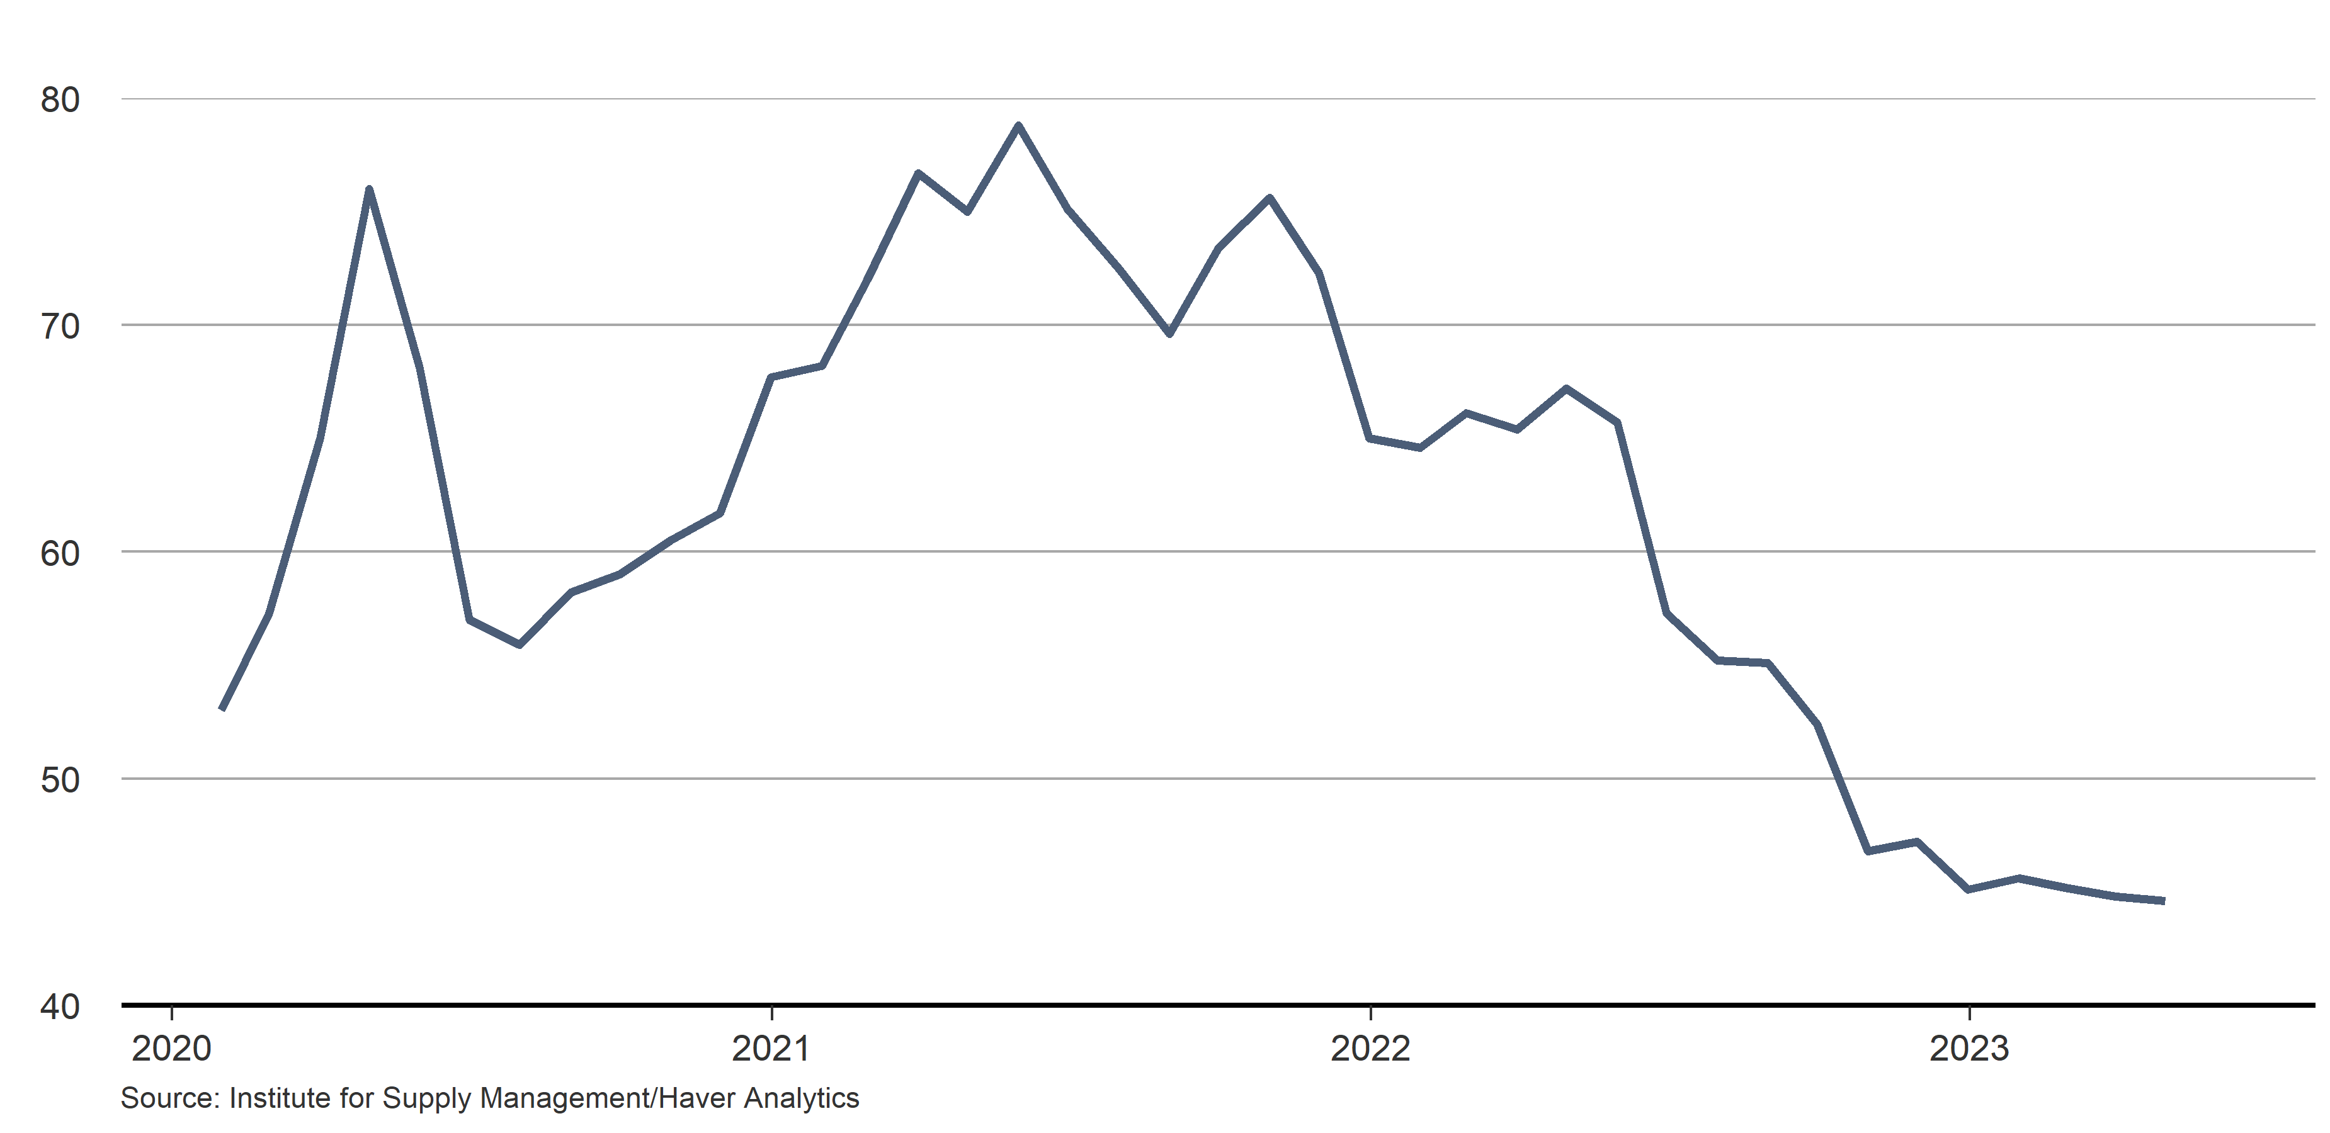
Supply delivery times are getting shorter
Seasonally adjusted, 50+ = slower

Slide 10
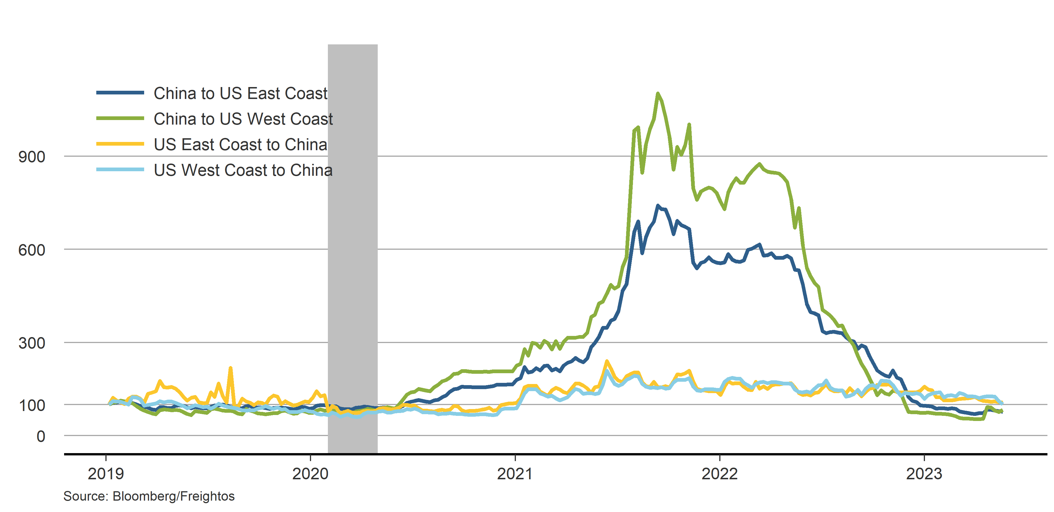
Shipping costs back to pre-pandemic levels
Freight cost indices (2019 = 100)

Slide 11
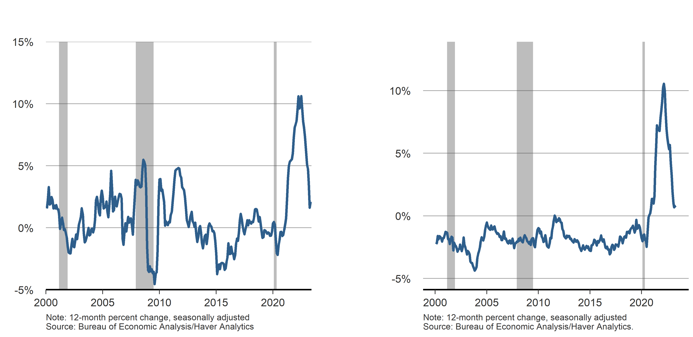
Goods price inflation is rapidly falling
PCE goods price inflation
PCE durable goods price inflation

Slide 12
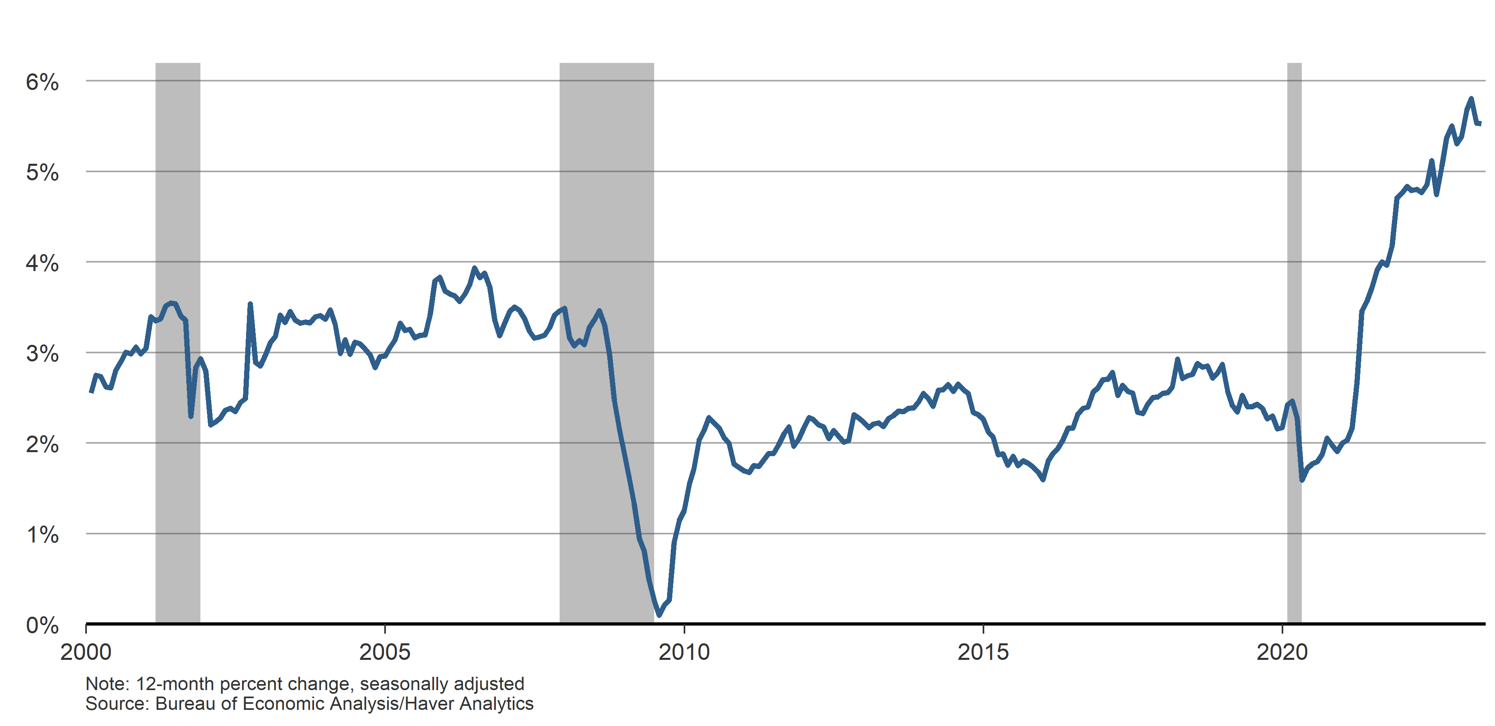
Inflation in the services sector still rising
PCE services price inflation

Slide 13
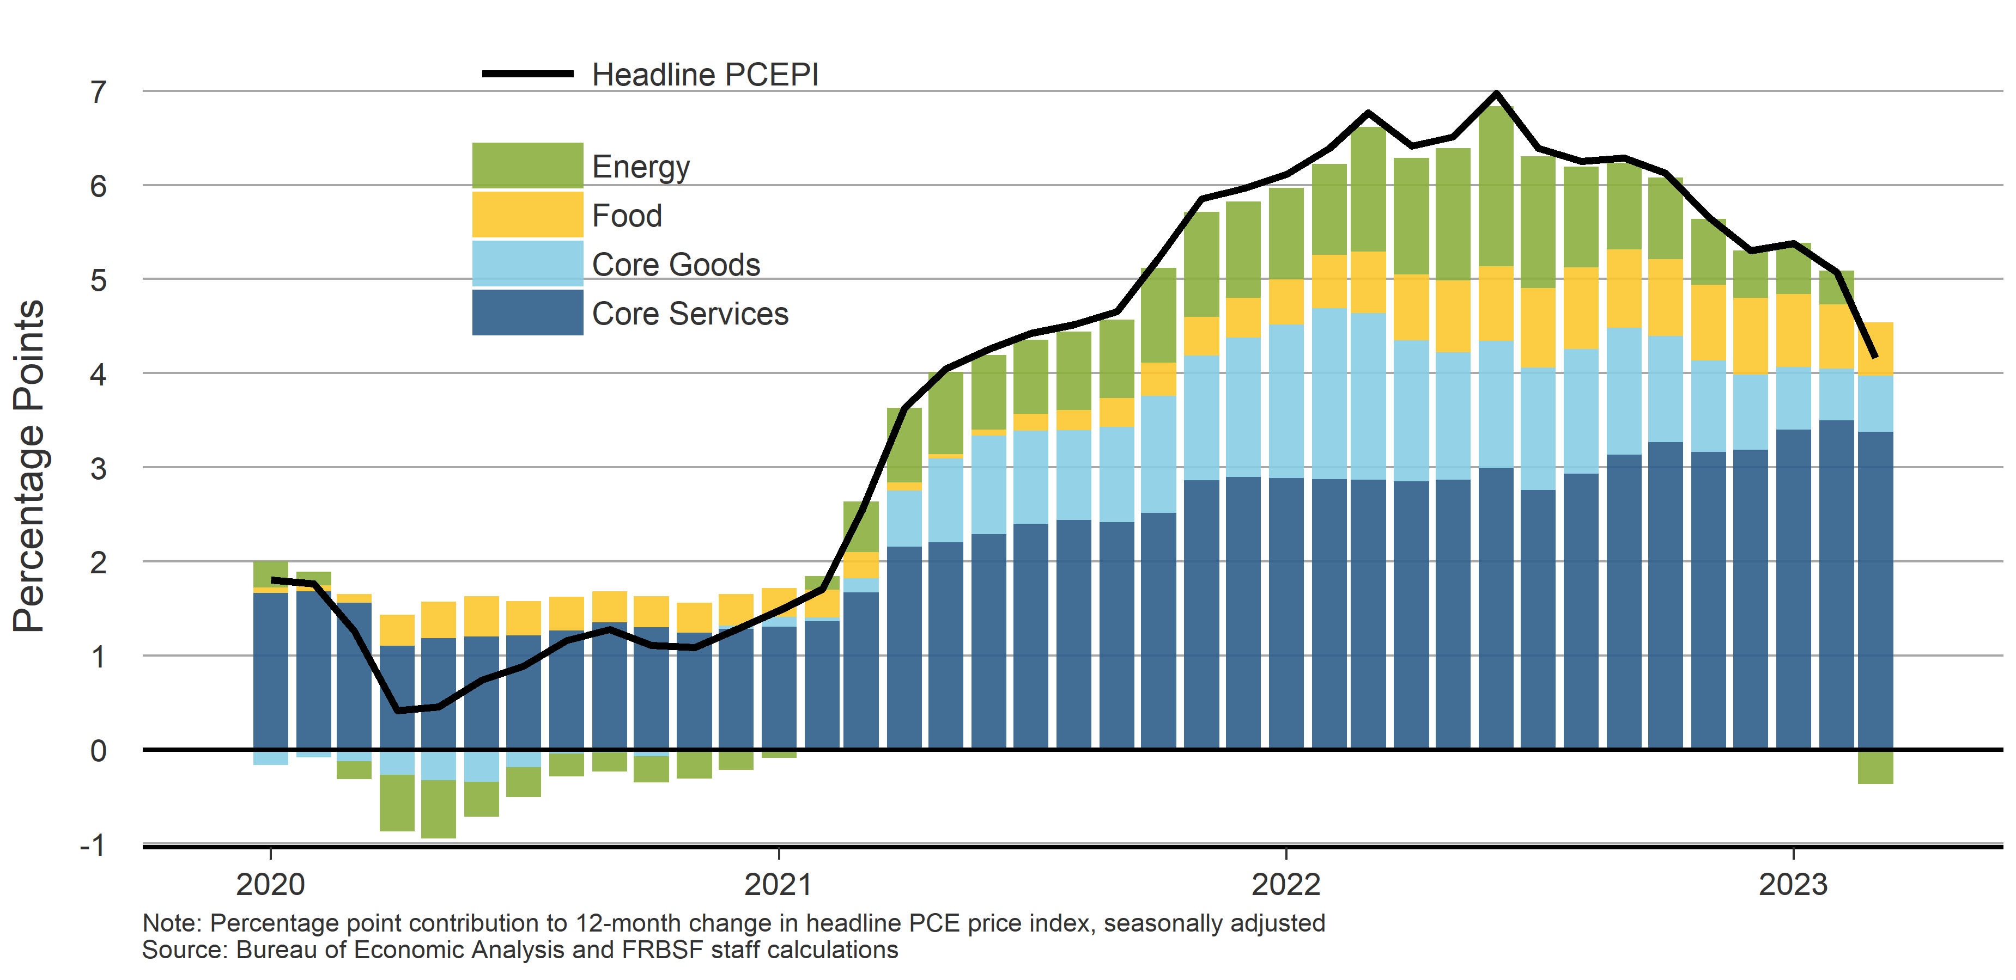
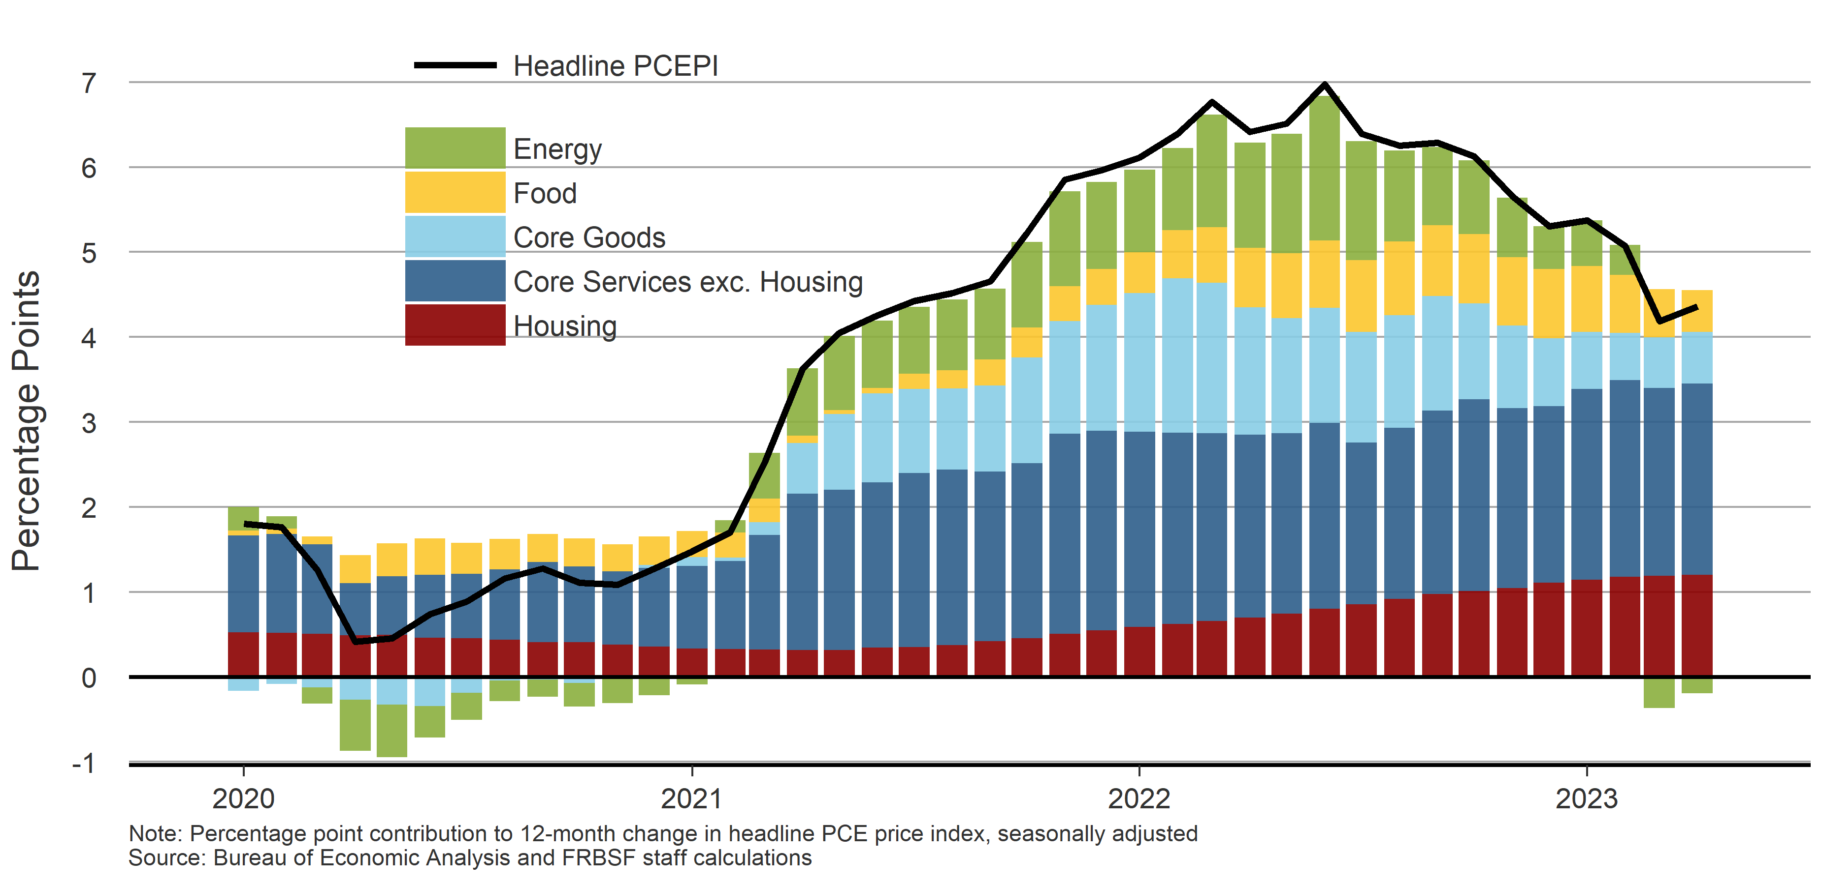
Watching core nonhousing services inflation
Contribution to headline PCE inflation

Slide 14
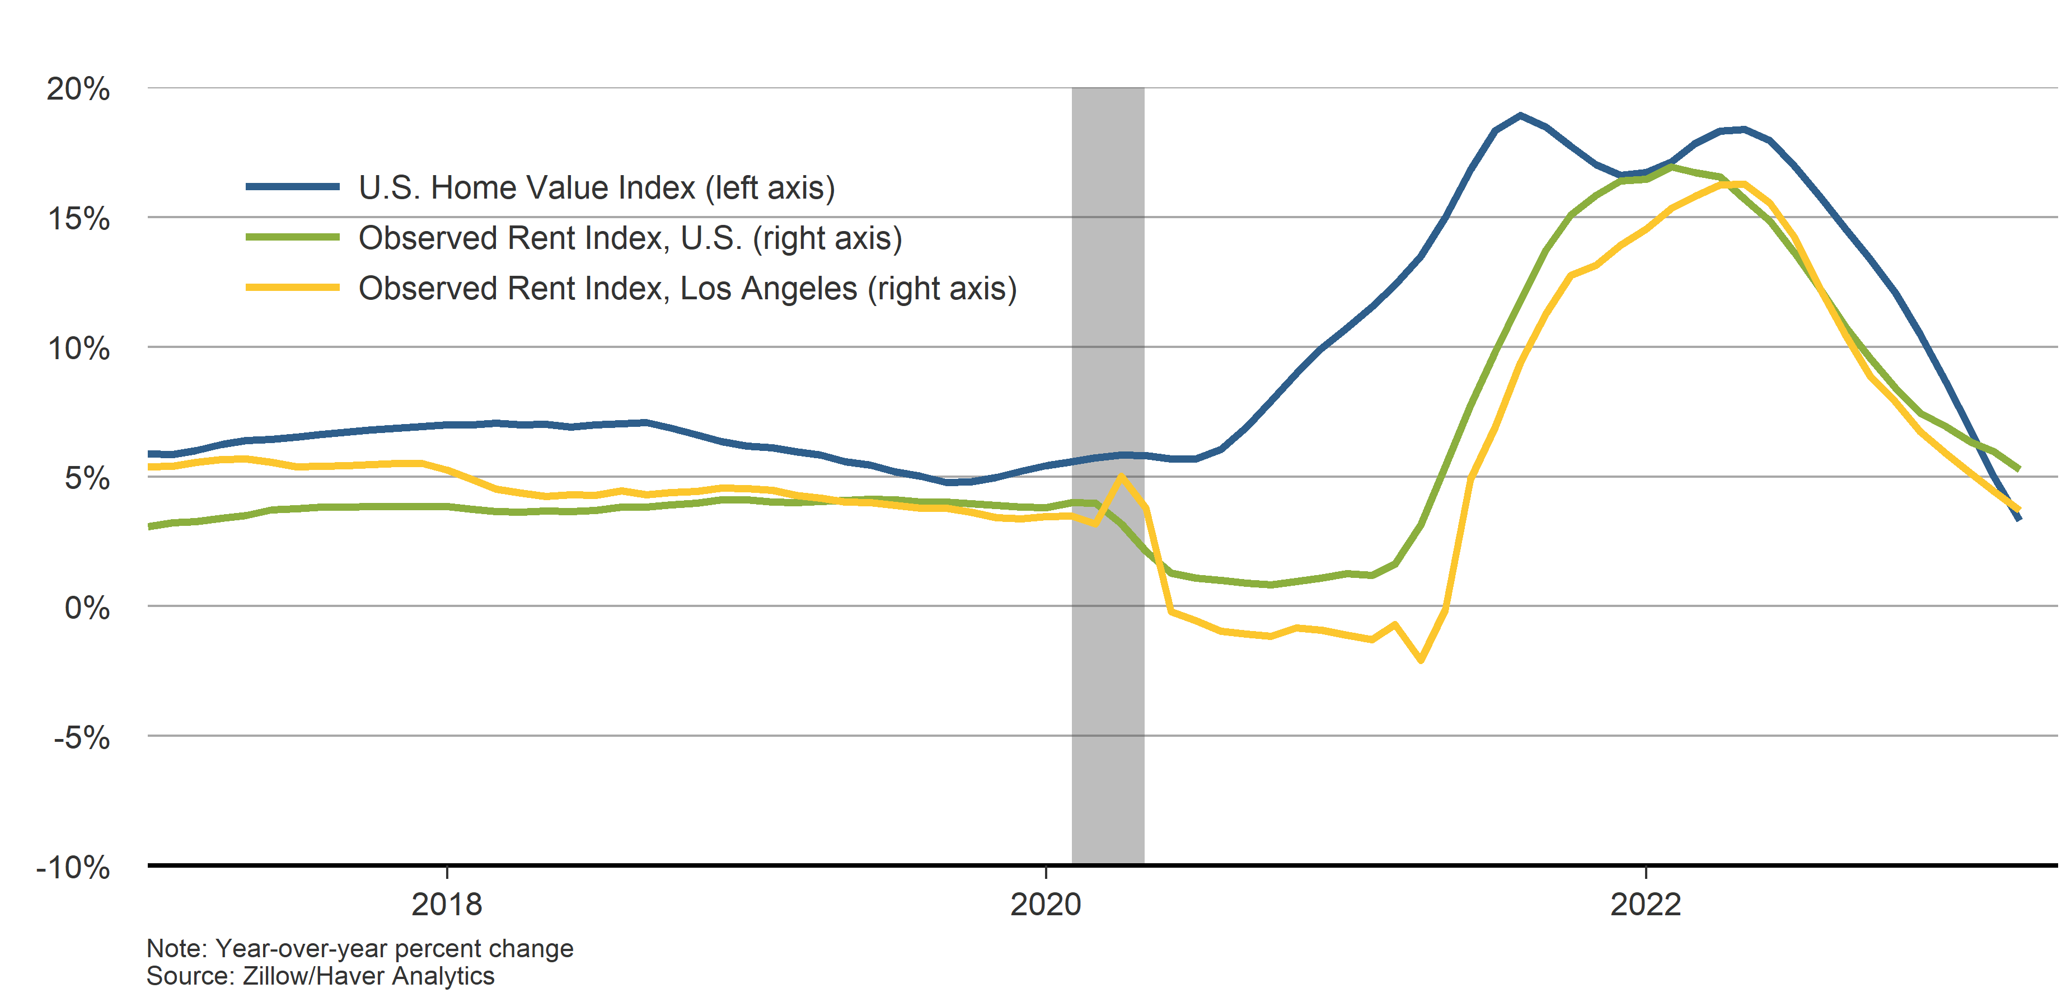
Housing market is rapidly cooling
12-month percent change in house prices and rents

Slide 15
Demand Factors

Slide 16
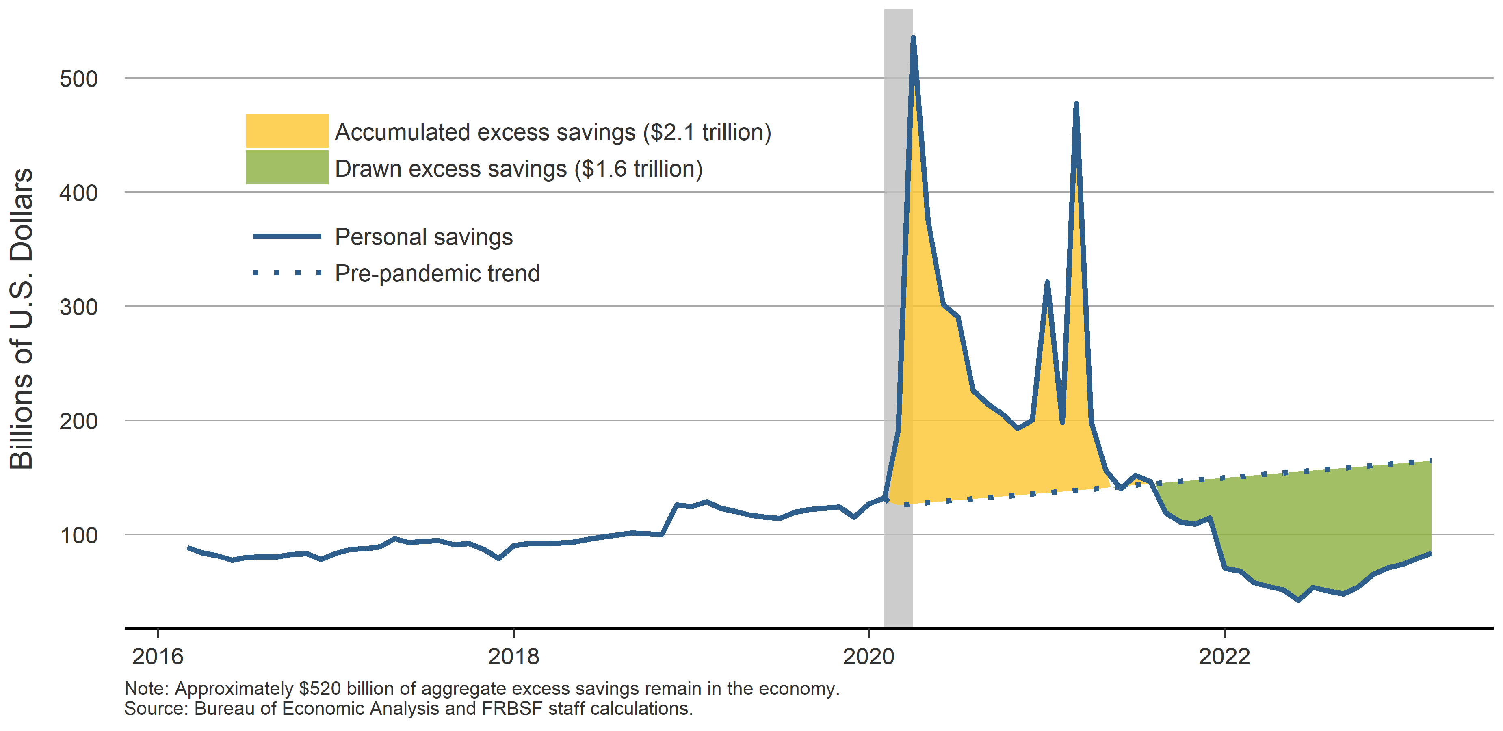
Households still have “excess savings”
Accumulated and drawn excess savings relative to pre-pandemic trend

Slide 17
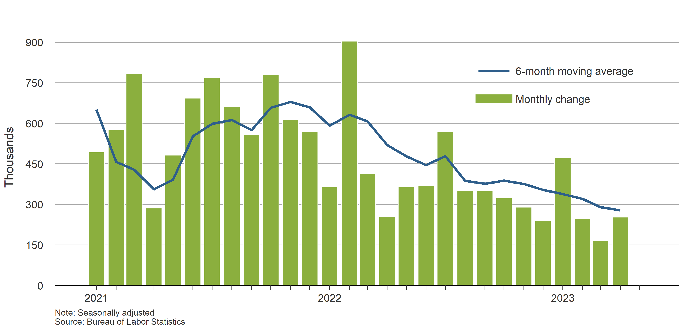
Job gains are moderating, but remain strong
Nonfarm payroll employment (thousands)

Slide 18
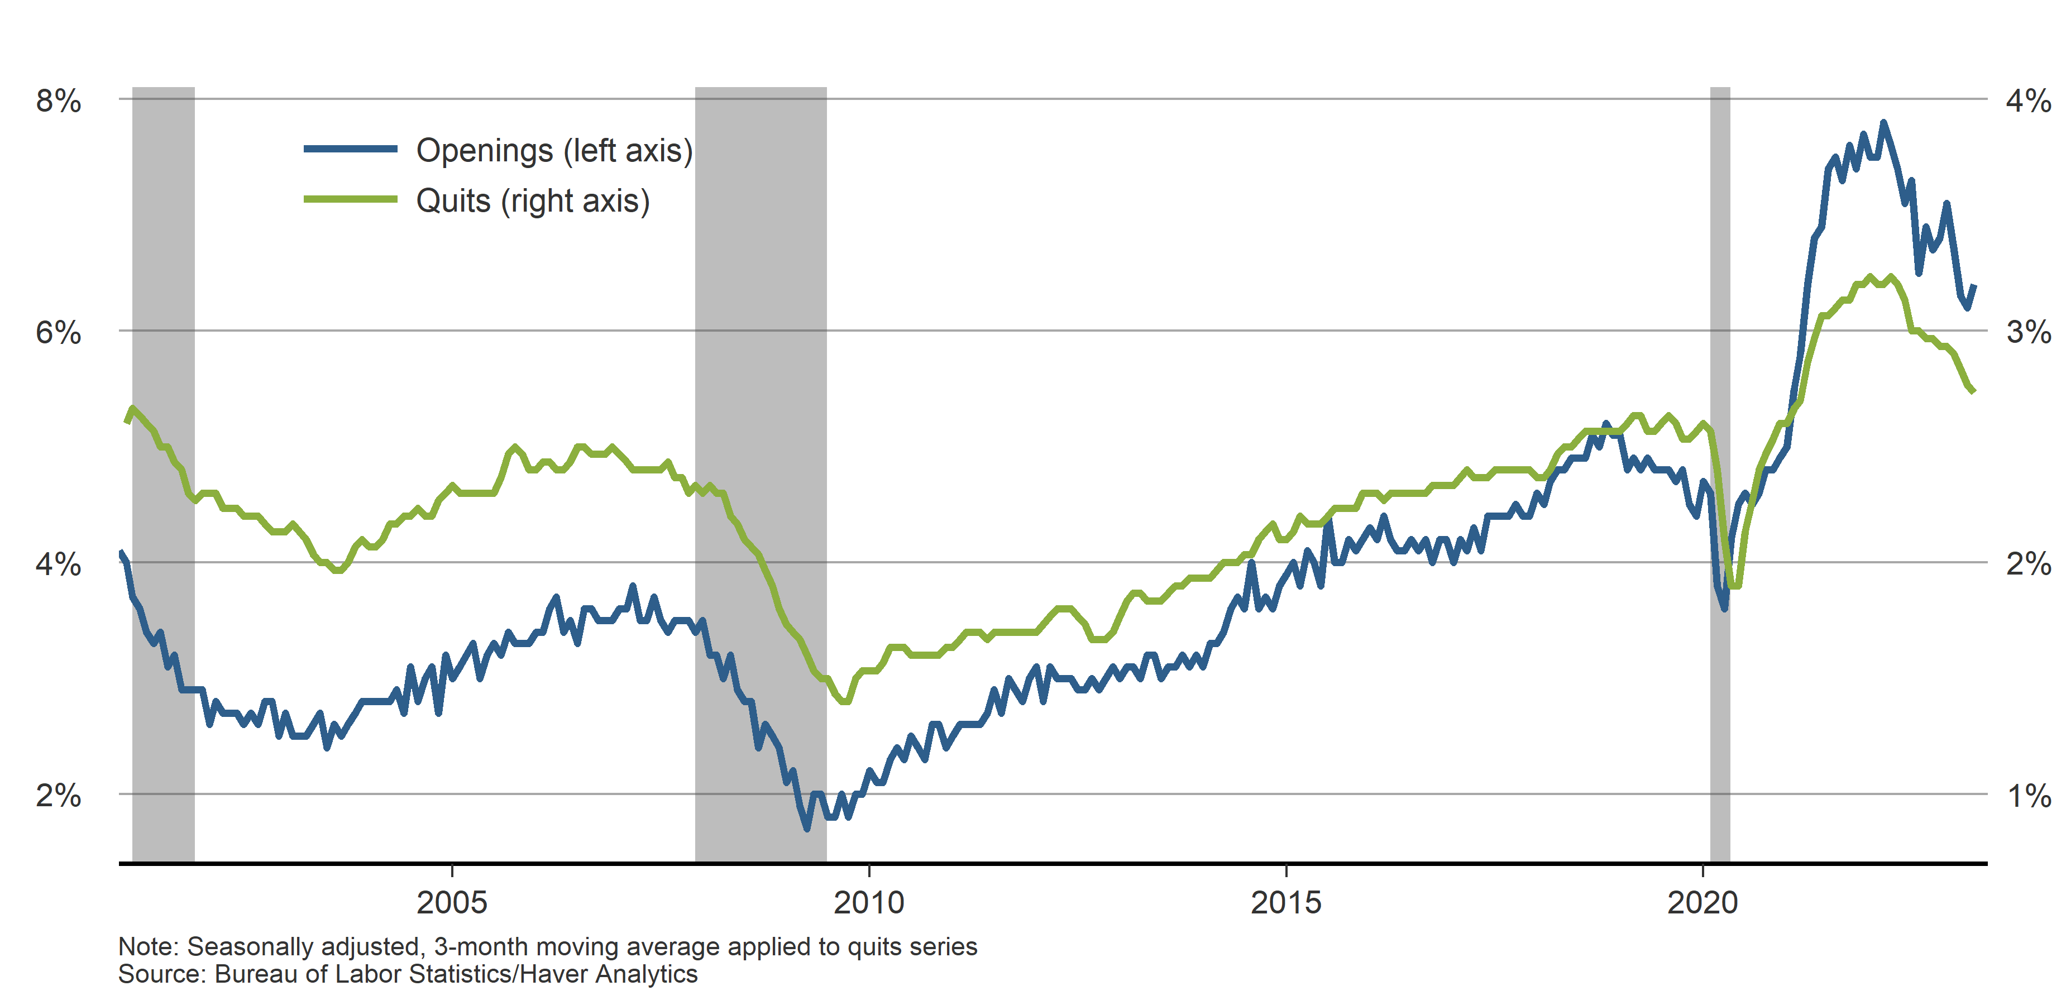
Fewer vacancies and workers quitting
JOLTS: Quits and jobs openings rates

Slide 19
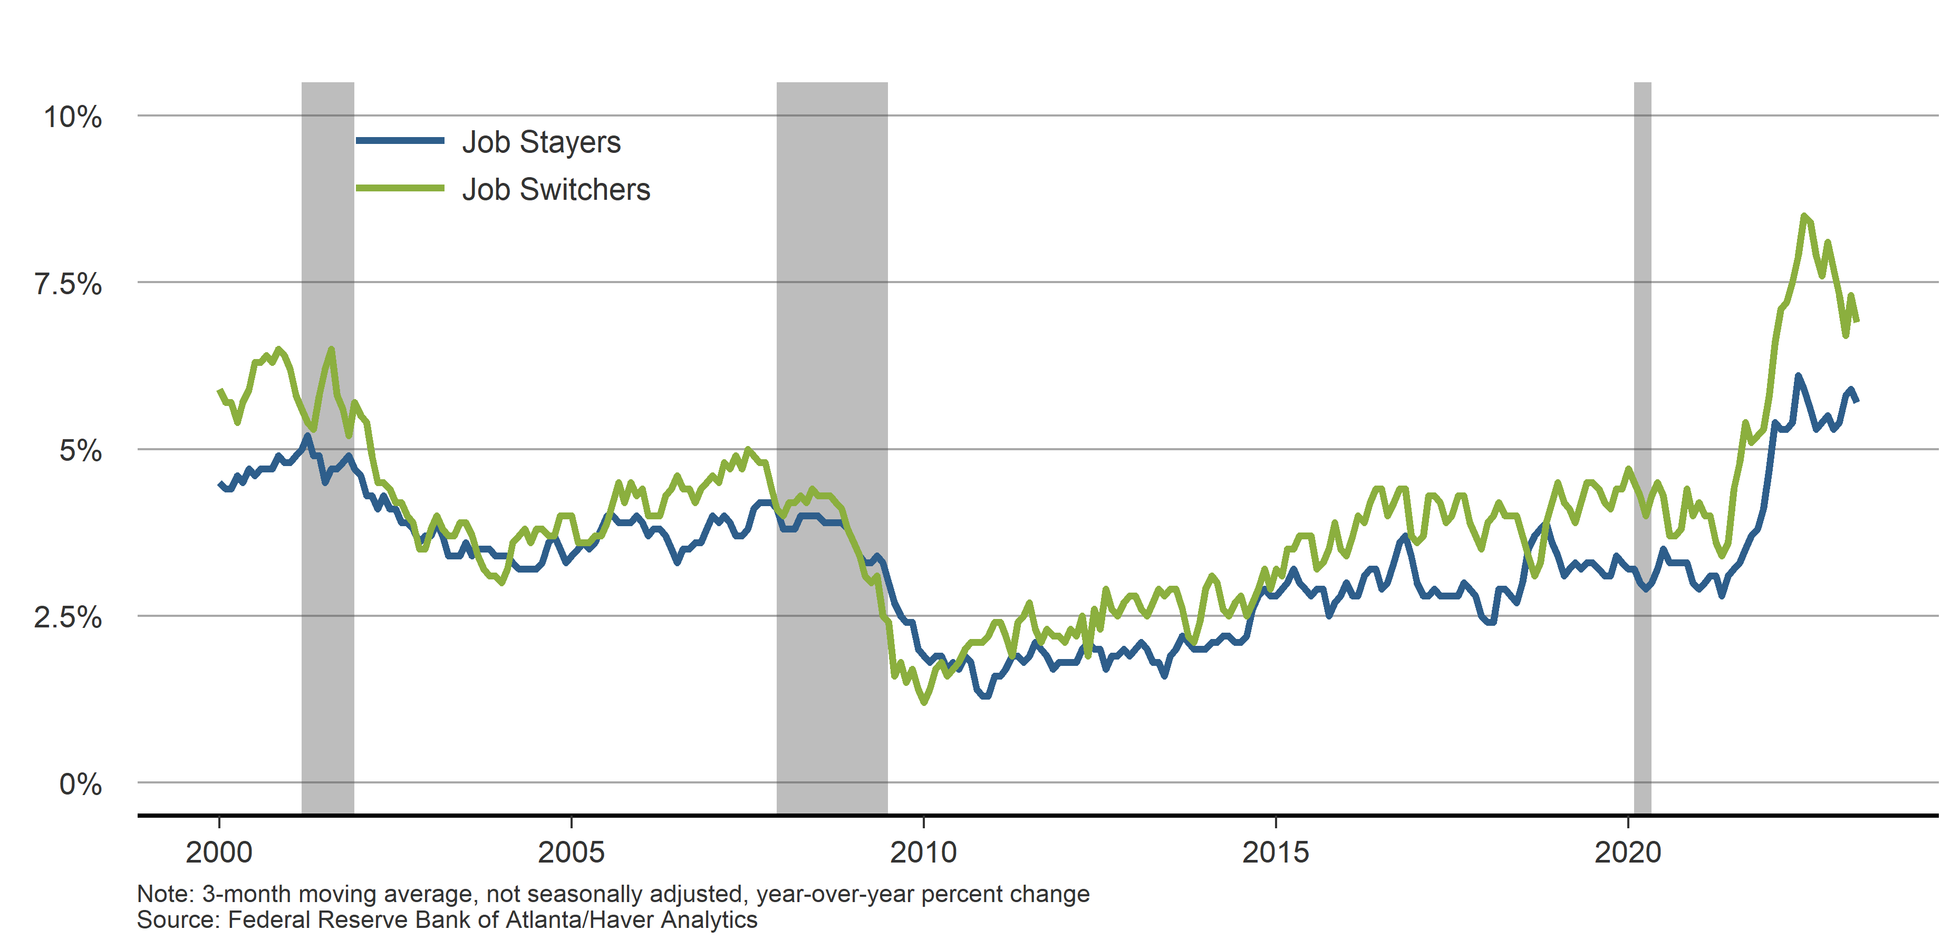
Fewer quits should lower wage growth
Median wage growth for job stayers and job switchers

Slide 20
Expectations

Slide 21
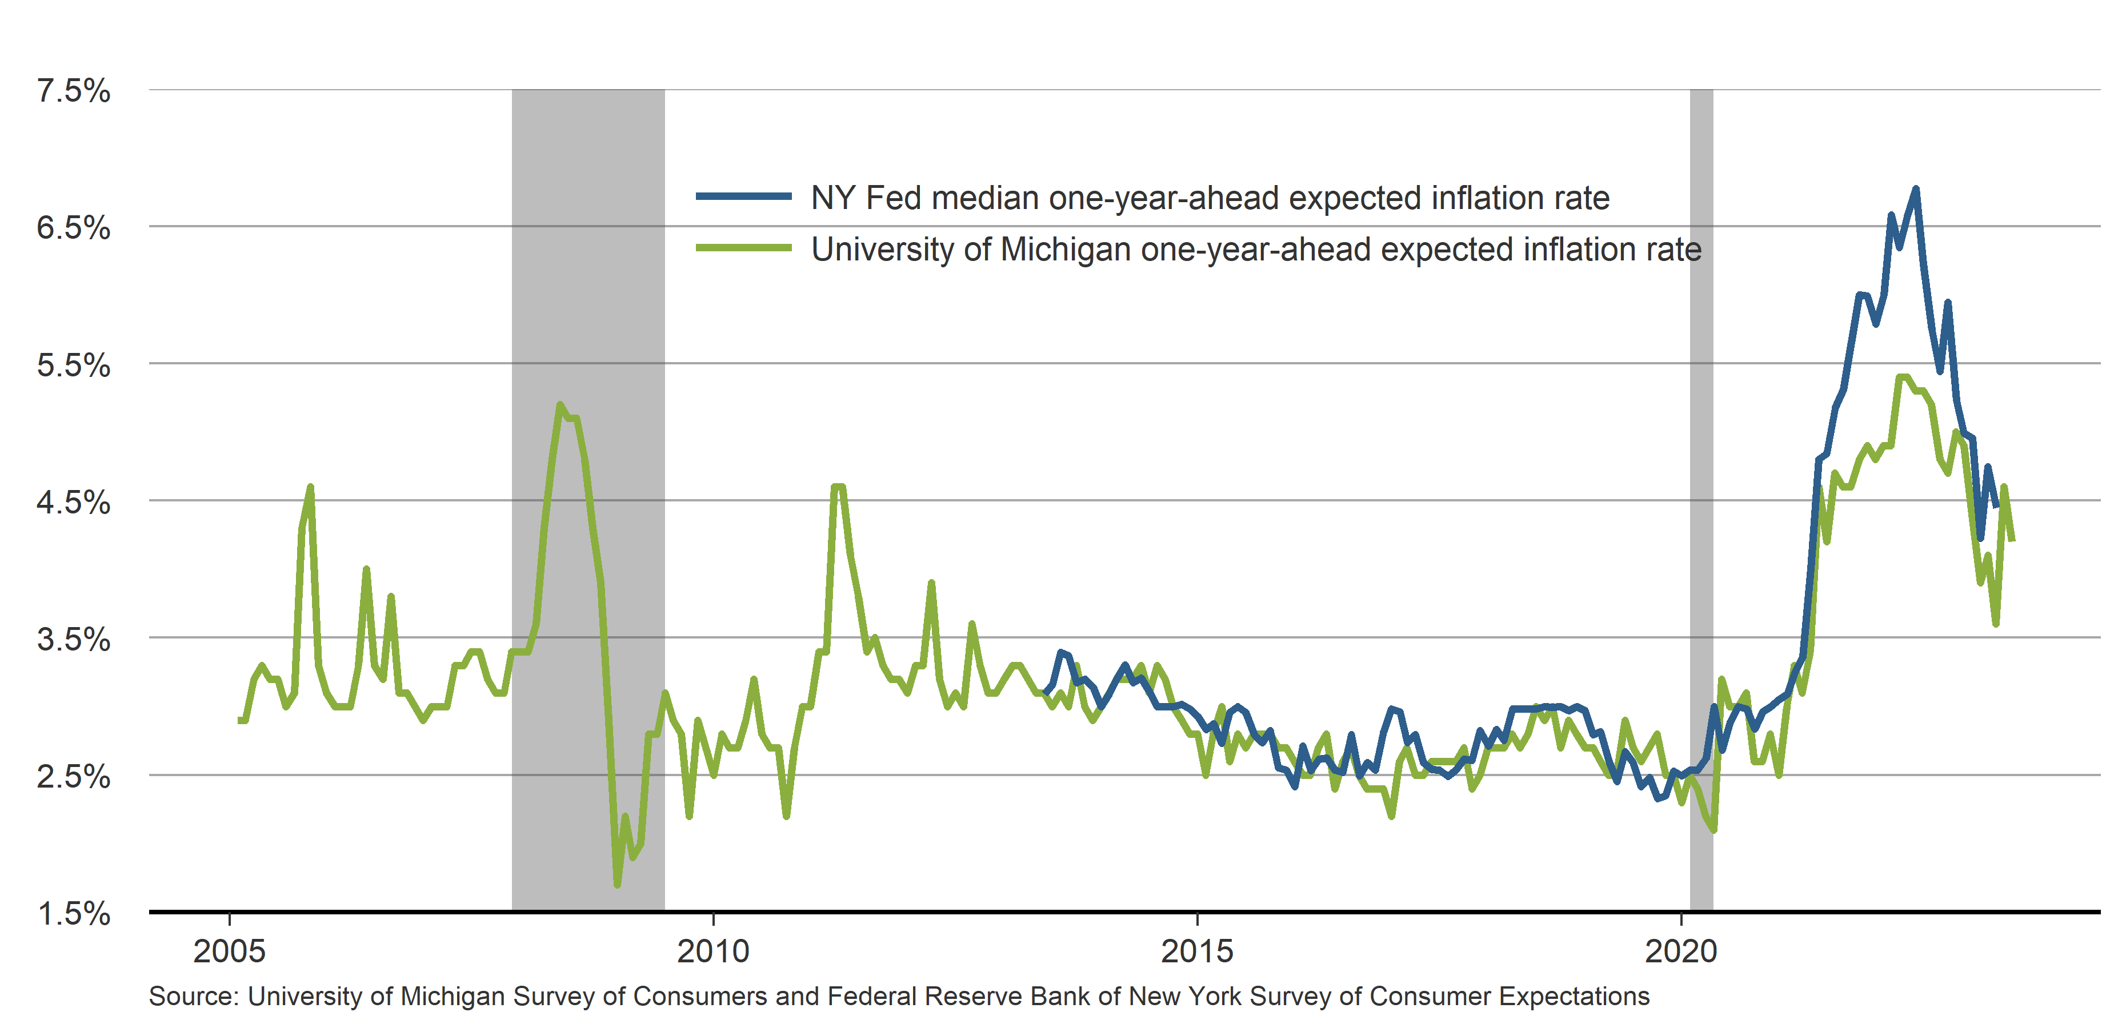
Households & firms expect higher inflation
Household and business inflation expectations 1-year-ahead

Slide 22
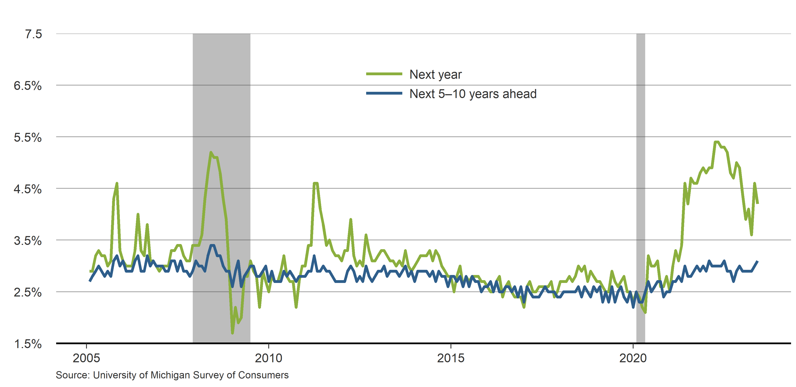
Households expect low inflation in the long run
Expected inflation rates from Michigan Survey of Consumers

Slide 23
Outlook & Monetary Policy

Slide 24
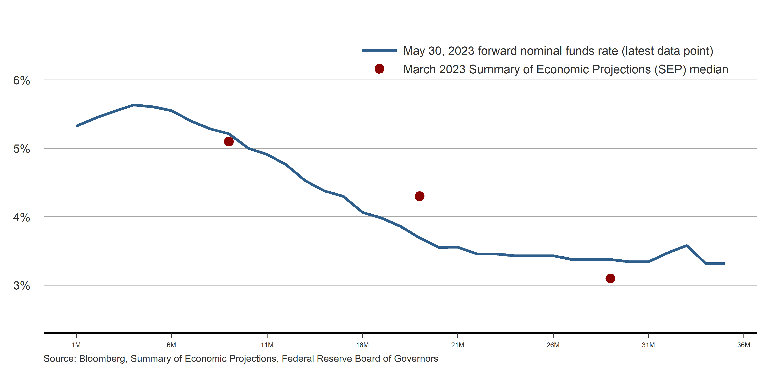
Policymakers see higher rates than markets expect
Forward nominal funds rate and SEP median

Slide 25
It will take some time for inflation to fall to 2%
Unemployment and personal consumption expenditures inflation
 | 2022 | 2023 | 2024 | 2025
Unemployment Rate | 3.6 | 4.0 | 4.3 | 4.3
Headline PCE Inflation | 5.7 | 3.4 | 2.9 | 2.2
Core PCE Inflation | 4.8 | 4.0 | 2.9 | 2.2
Note: Values shown are Q4/Q4 percent; FRBSF forecasts are in bold.

Slide 26
Risks

Slide 27
1. Credit contraction

Slide 28
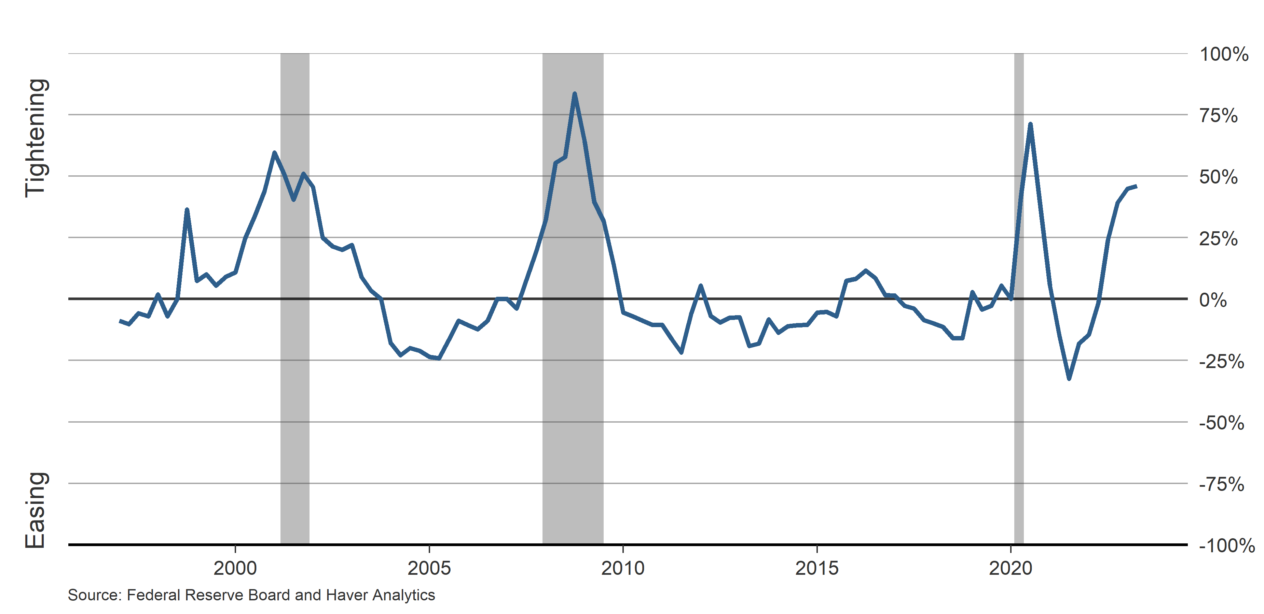
Banks are tightening lending standards
Net percentage of banks reporting tightening or easing

Slide 29
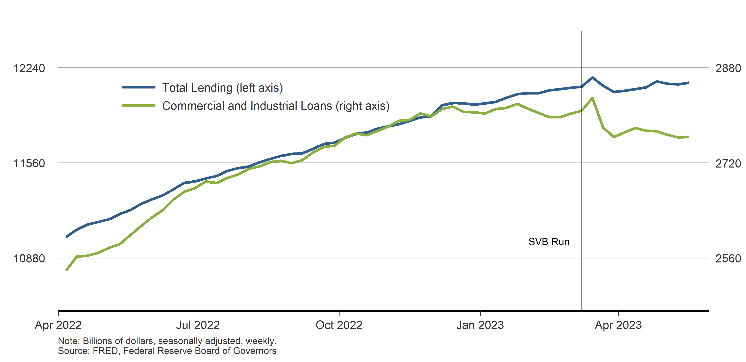
Bank lending on slowing trend
Total and C&I bank lending

Slide 30
2. Recession risk

Slide 31
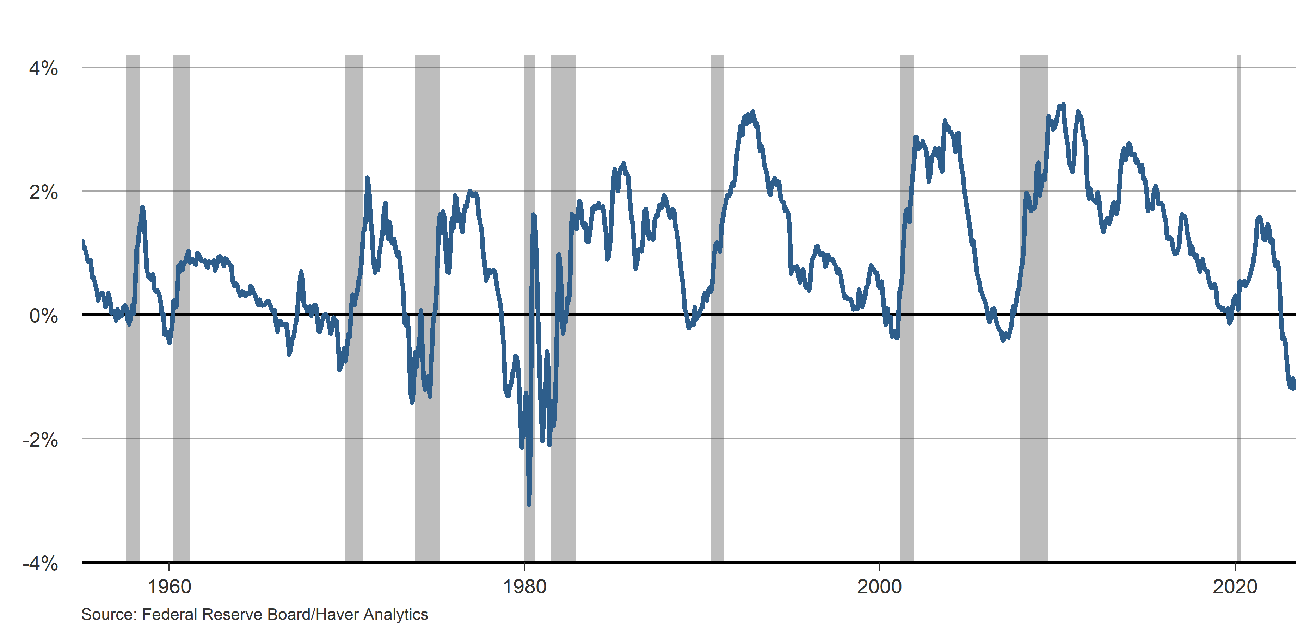
Yield curve inversion highlighting recession risk
10Y-1Y Treasury bond yield curve

Slide 32
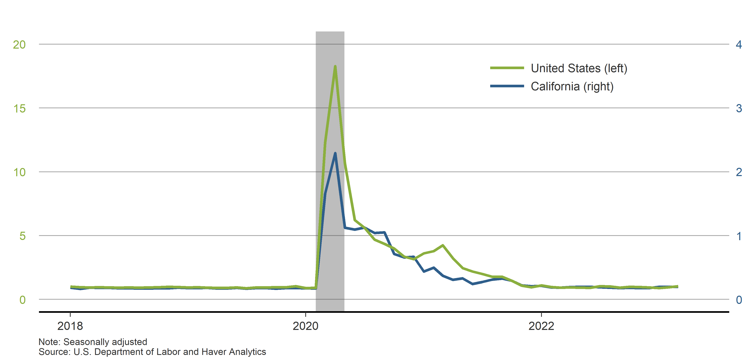
Despite tech layoffs, jobless claims remain low
Initial unemployment insurance claims, millions (monthly)

