Slide 1
Discussion of
“Global Imbalances and Currency Wars at the ZLB”
Arvind Krishnamurthy
Stanford University
2016 Pacific Basin Research Conference
Federal Reserve Bank of San Francisco, 11/18/2016

Slide 2
Outline
Review of the model’s mechanism
  Interest rates and asset shortage
  ZLB and currency wars
Safe asset shortage

Slide 3
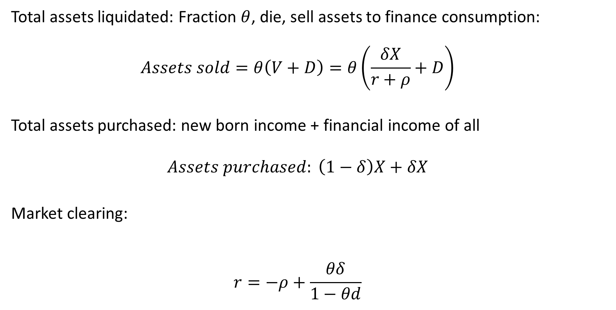
Interest rate determination
Total assets liquidated: Fraction $θ$, die, sell assets to finance consumption:
  $$Assets sold=θ\left(V+D\right)=θ\left(\frac{δX}{r+ρ}+D\right)$$
Total assets purchased: new born income + financial income of all
  $$Assets purchased: \left(1−δ\right)X+δX$$
Market clearing:
  $$r=−ρ+\frac{θδ}{1−θd}$$
Notes:
Model is centrally about determination of interest rates. So lets focus on that market clearing

Slide 4
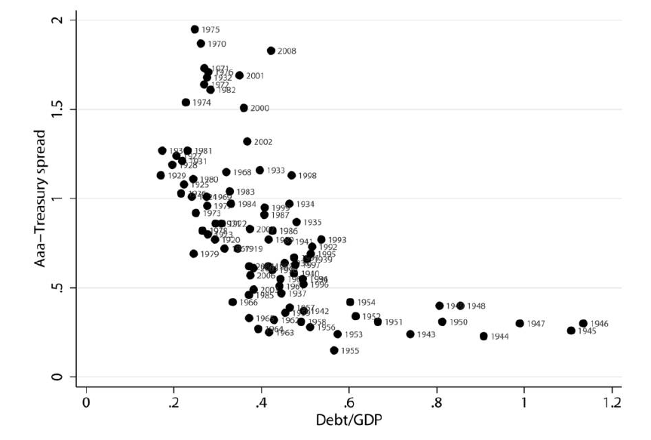

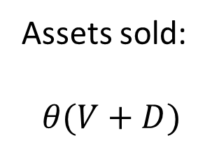
Assets sold:
$$θ(V+D)$$
Krishnamurthy-Vissing-Jorgensen (JPE 2012)
r
Assets purchased:
$$X$$
“Asset shortage” supply and demand driving interest rates, rather than consumption growth

Slide 5
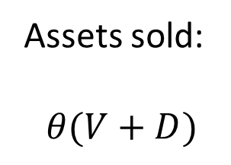


Assets sold:
$$θ(V+D)$$
r
Assets purchased:
$$X$$
0
$$ξX$$
Notes:
Output falls to clear the market at the 0 interest rate. Common recipe by now in the ZLB literature

Slide 6

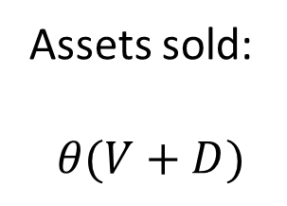

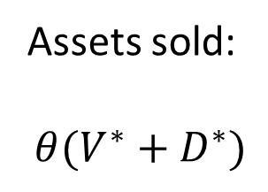


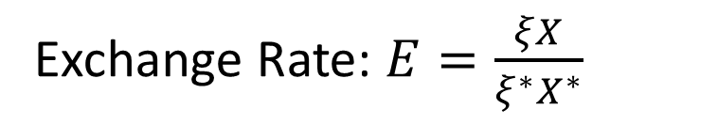
Financial Autarchy
Assets sold:
$$θ(V+D)$$
Assets sold:
$$θ(V^{∗}+D^{∗})$$
$r^{∗}$
$$r$$
0
0
$$ξX$$
$$ξ^{∗}X^{∗}$$
Exchange Rate: $E=\frac{ξX}{ξ^{∗}X^{∗}}$
Intratemporal consumption FOC…
Notes:
There is the odd feature that the recession in foreign leads to an appreciation in foreign. Is that obviously a good feature of a model?

Slide 7
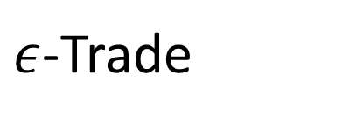

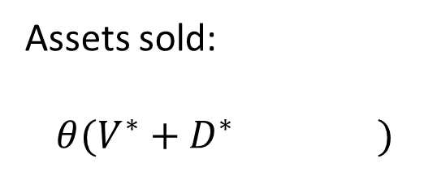



$ε$-Trade
Financial Autarchy
Assets sold:
$$θ(V+D )$$
Assets sold:
$$θ(V^{∗}+D^{∗} )$$
$$−εD$$
$$+εD/E$$
$r^{∗}$
r
0
0
$$ξX$$
$$ξ^{∗}X^{∗}$$
Home is a debtor country. Leads to a CA deficit
Notes:
Contagion through asset scarcity

Slide 8
A story of the mechanism
Nominal spending is driven by quantity of assets (“aggregate liquidity”?) of consumers
Demand-driven NK model → Decline in output and income
If not at ZLB, central bank can lower rates to offset (“boost asset values”)
Contagion story is that foreign investors buy up US debt, reducing private US liquidity…

Slide 9
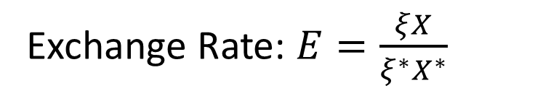
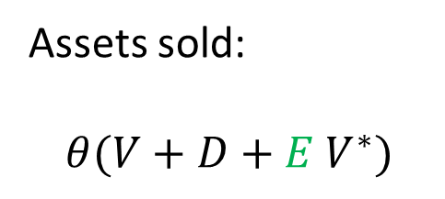


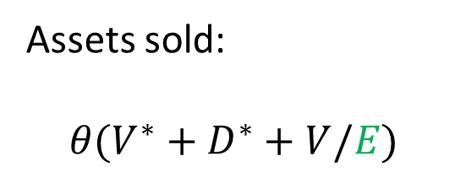


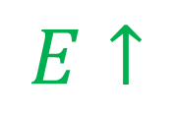
Financial Integration and indeterminacy
Assets sold:
$$θ(V+D+E V^{∗})$$
$$E↑$$
Assets sold:
$$θ(V^{∗}+D^{∗}+V/E)$$
$$↑$$
$$↓$$
$r^{∗}$
r
0
0
$$ξX$$
$$ξ^{∗}X^{∗}$$
Exchange Rate: $E=\frac{ξX}{ξ^{∗}X^{∗}}$
$$↑$$
Notes:
Indeterminacy as currency wars, or as multiple equilibria and reserve currency appreciation in bad times

Slide 10
Safe asset shortage and ZLB
Suppose safe asset demand is large-money institutional demand
  China, Japan,…
  Corporate cash pools (Apple, …)
  Security lenders
Is ZLB a constraint on safe asset rates?
  Yes IF cash is an alternative safe asset investment for the large-money buyers
Suppose a set of investors love Apple stock so much that the expected return on Apple fell below zero
  No interaction with ZLB

Slide 11
Safe asset shortage and output
Suppose safe assets were private liquidity
  Collateral
Quantity reduction in private liquidity could be expected to reduce output
  With or without a ZLB

Slide 12
Summary
When ZLB binds, countries may choose to opt for a currency war
  Zero-sum game
  Scope for coordination to increase (a) asset supply; (b) government spending

