Slide 1
Leaning against household debt:
The Swedish experience
Lars E.O. Svensson
Stockholm School of Economics
Web: larseosvensson.se
Conference of Housing and Monetary Policy,
Federal Reserve Bank of San Francisco,
UCLA Ziman Center for Real Estate,
San Francisco, September 4-5, 2014

Slide 2
Outline
Should standard flexible inflation targeting be combined with some leaning against the wind, in order to promote financial stability?
Leaning promoted by BIS
Skepticism elsewhere, but debate continues
Sweden a case study: Quite aggressive leaning since summer 2010
Outcome: Very low inflation, very high unemployment, probably higher real debt
Was Riksbank leaning justified?

Slide 3
Leaning against the wind
Tighter monetary policy than justified by stabilizing inflation and unemployment
Purpose is to moderate financial “imbalances” and threats to financial stability
Presumes (Smets 2013):
  Macroprudential instruments or policies are ineffective
  A higher policy rate has a significant negative impact on threats to financial stability
My view:
  varies from country to country
  has little theoretical and empirical support, although the latter may vary depending on the structure of the financial sector (competitive/oligopolistic, shadow banking…)

Slide 4
Case study: Sweden
Riksbank has been leaning against the wind since summer of 2010, referring to concerns about household debt
This has led to inflation far below the target and unemployment far above a long-run sustainable rate
With inflation much below expectations, it arguably also led to higher real debt than expected and planned for

Slide 5
Why lean? What is the problem?
Household debt is high relative to disposable income
But debt ratio has been stable since LTV cap of 85 % in Oct 2010

Slide 6
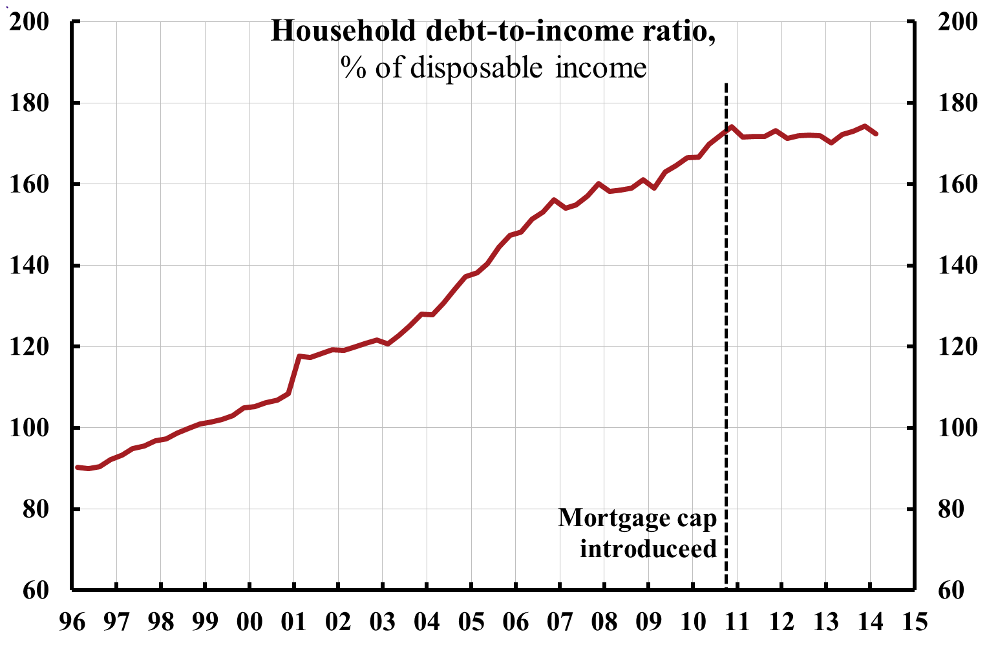
Household debt-to-income ratio
(% of disposable income)

Slide 7
Why lean? What is the problem?
Household debt is high relative to disposable income
But debt ratio is stable since LTV cap of 85 % in Oct 2010
And debt is normal relative to assets

Slide 8
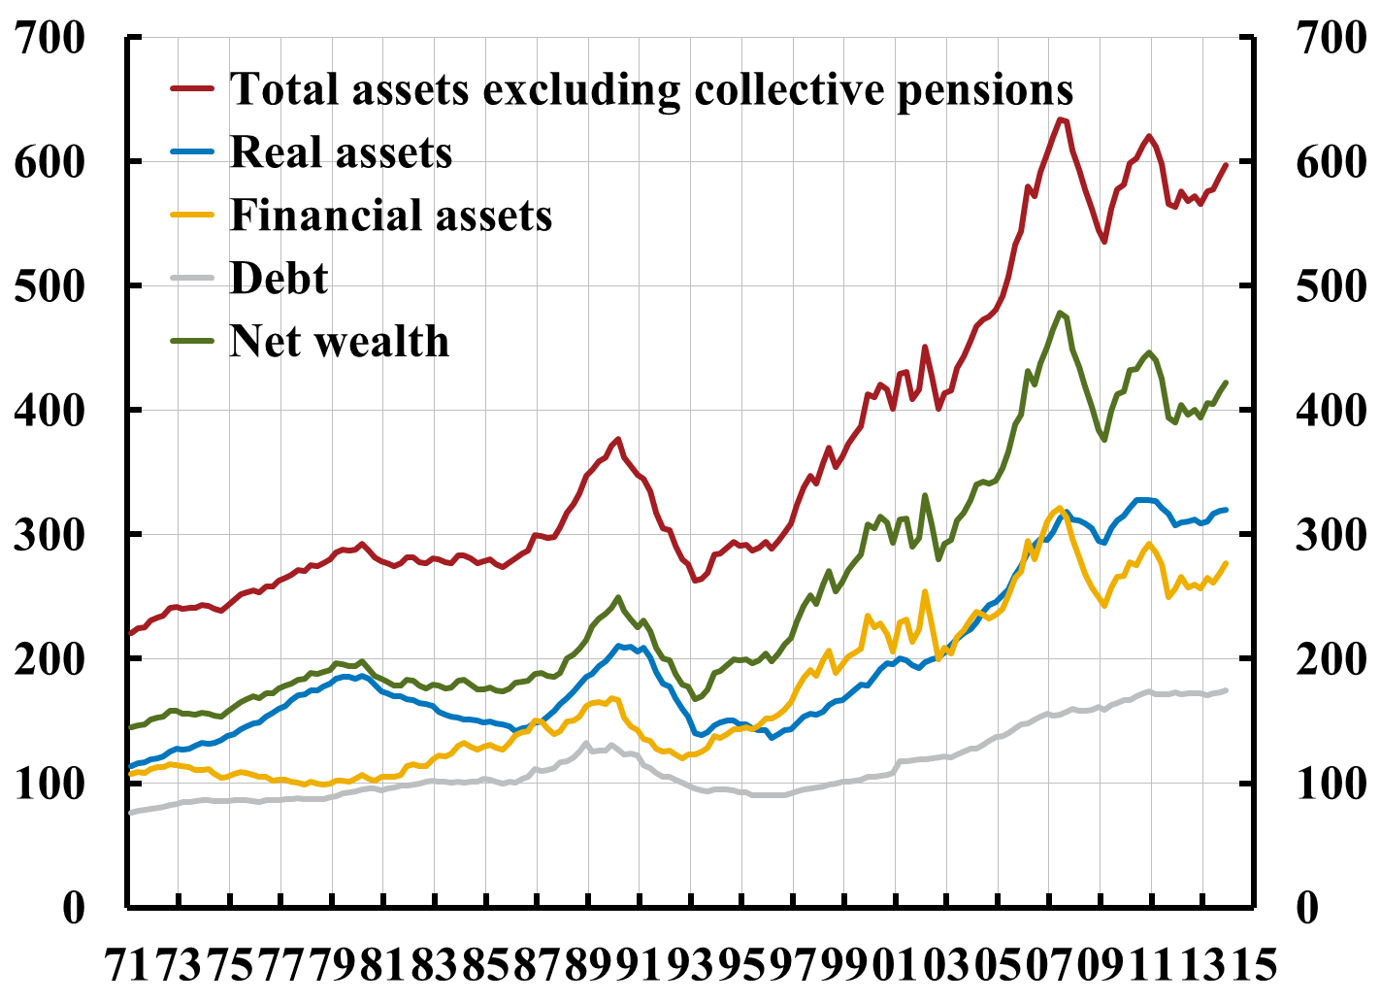
Household debt and assets (excluding collective pensions), % of disposable income

Slide 9
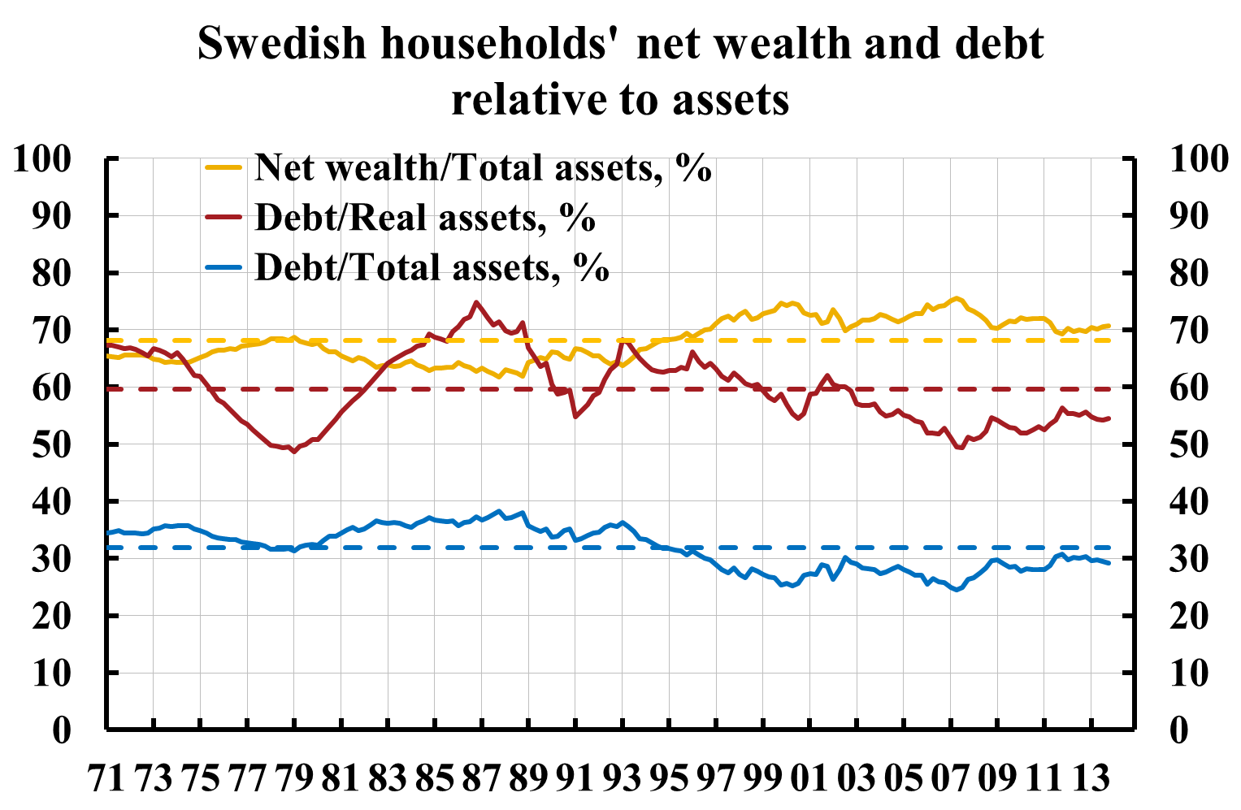

Slide 10
Why lean? What is the problem?
Household debt is high relative to disposable income
But debt ratio is stable since LTV cap of 85 % in Oct 2010
And debt is normal relative to assets
Housing expenditure is not high

Slide 11
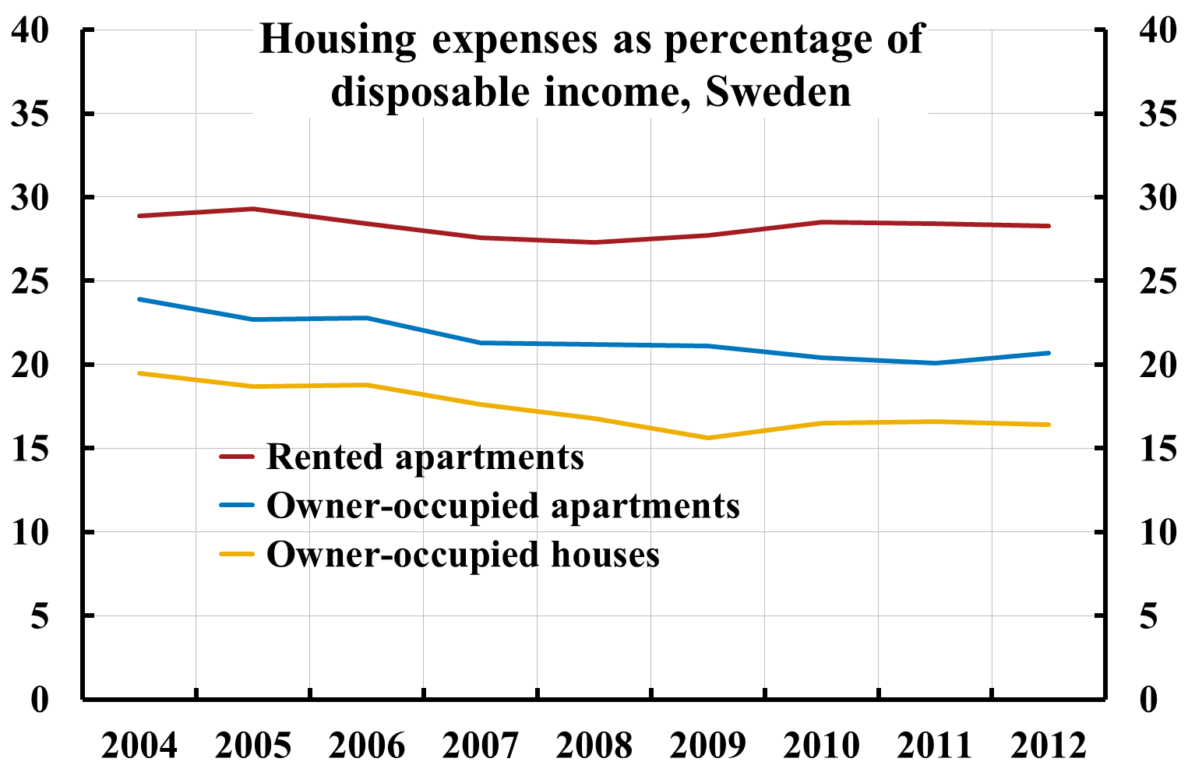

Slide 12
Why lean? What is the problem?
Household debt is high relative to disposable income
But debt ratio is stable since LTV cap of 85 % in Oct 2010
And debt is normal relative to assets
Housing expenditure is not high
Average LTV for new mortgages has stabilized around 70 %

Slide 13
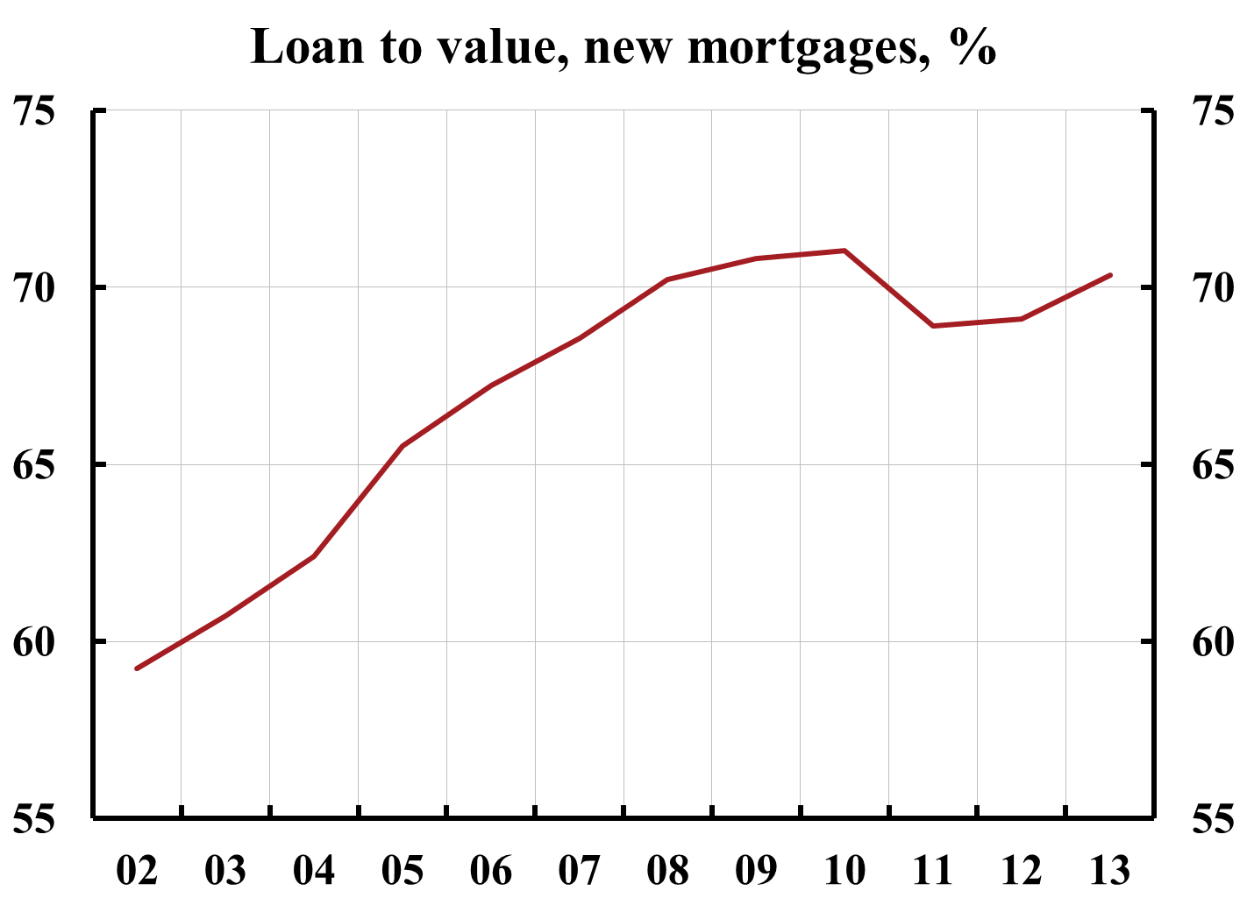

Slide 14
Why lean? What is the problem?
Household debt is high relative to disposable income
But debt ratio is stable since LTV cap of 85 % in Oct 2010
And debt is normal relative to assets
Housing expenditure is not high
Average LTV for new mortgages has stabilized around 70 %
Housing prices have not increased faster than disposable income since 2007

Slide 15
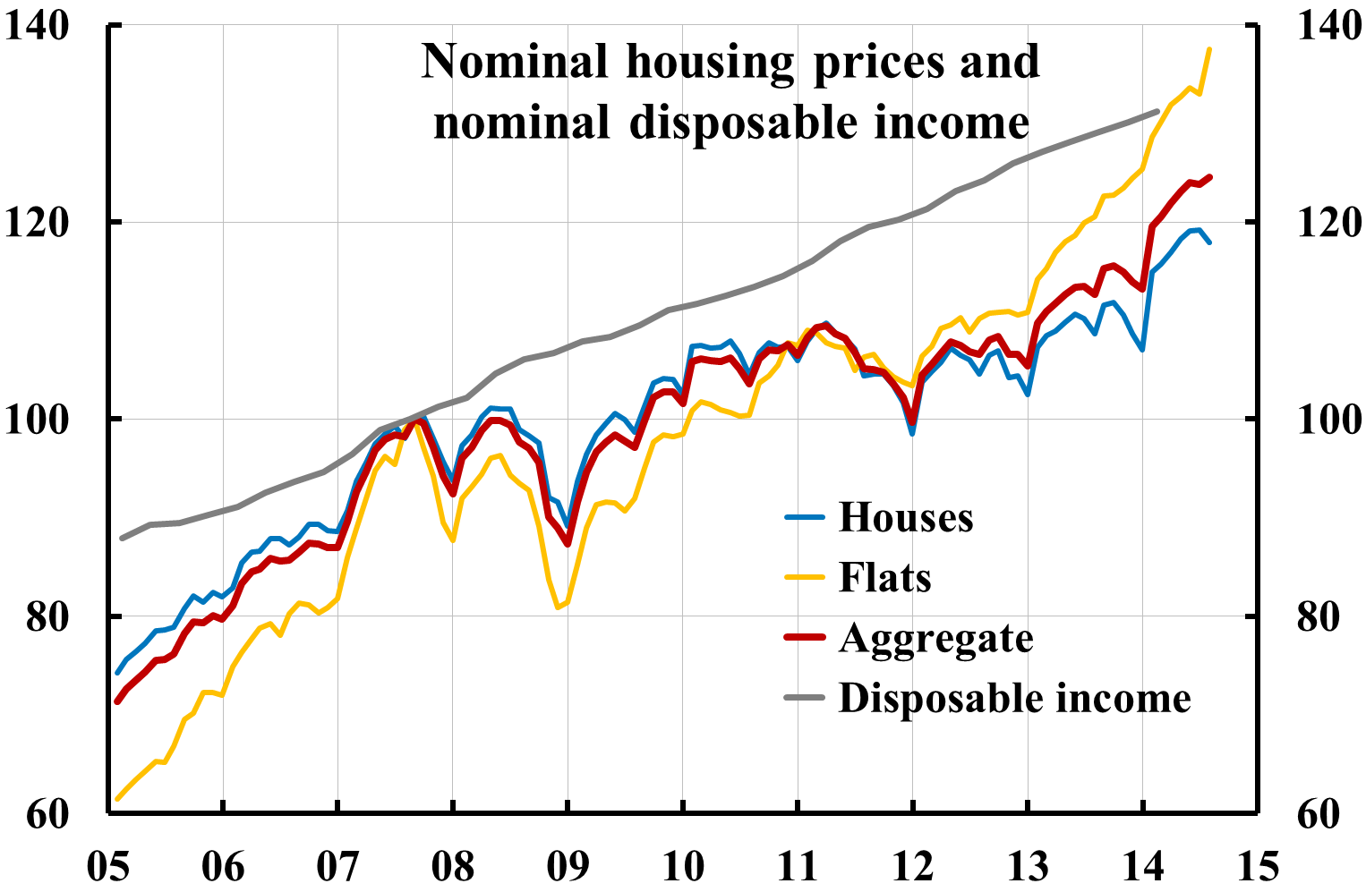

Slide 16
Why lean? What is the problem?
Household debt is high relative to disposable income
But debt ratio is stable since LTV cap of 85 % in Oct 2010
And debt is normal relative to assets
Housing expenditure is not high
Average LTV for new mortgages has stabilized around 70 %
Housing prices have not increased faster than disposable income since 2007
Housing prices are in line with fundamentals (disposable income, mortgage rates, tax changes, urbanization, construction…)

Slide 17
Why lean? What is the problem?
And, the FSA has:
  introduced an LTV cap of 85 %
  introduced higher risk weights on mortgages (25 %)
  introduced higher capital requirements (16 % CET1)
  proposed individual amortization plans for borrowers
  produces an annual mortgage market report, according to which
    lending standards are high
    households’ repayment capacity is good
    households’ resilience to disturbances in the form of mortgage rate increases, housing price falls, and income falls due to unemployment is good
Macroprudential tools and policy are arguably effective in Sweden

Slide 18
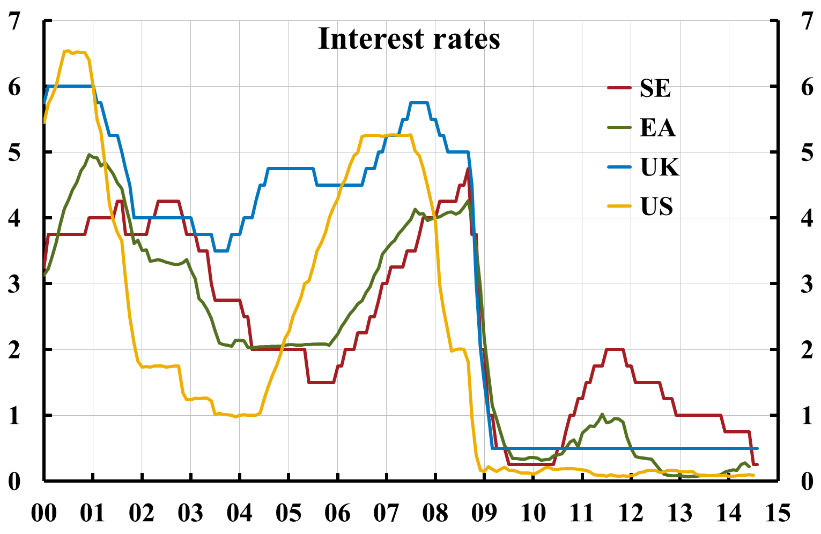
The leaning: Policy rates in Sweden, UK, and US;
Eonia rate in euro area

Slide 19
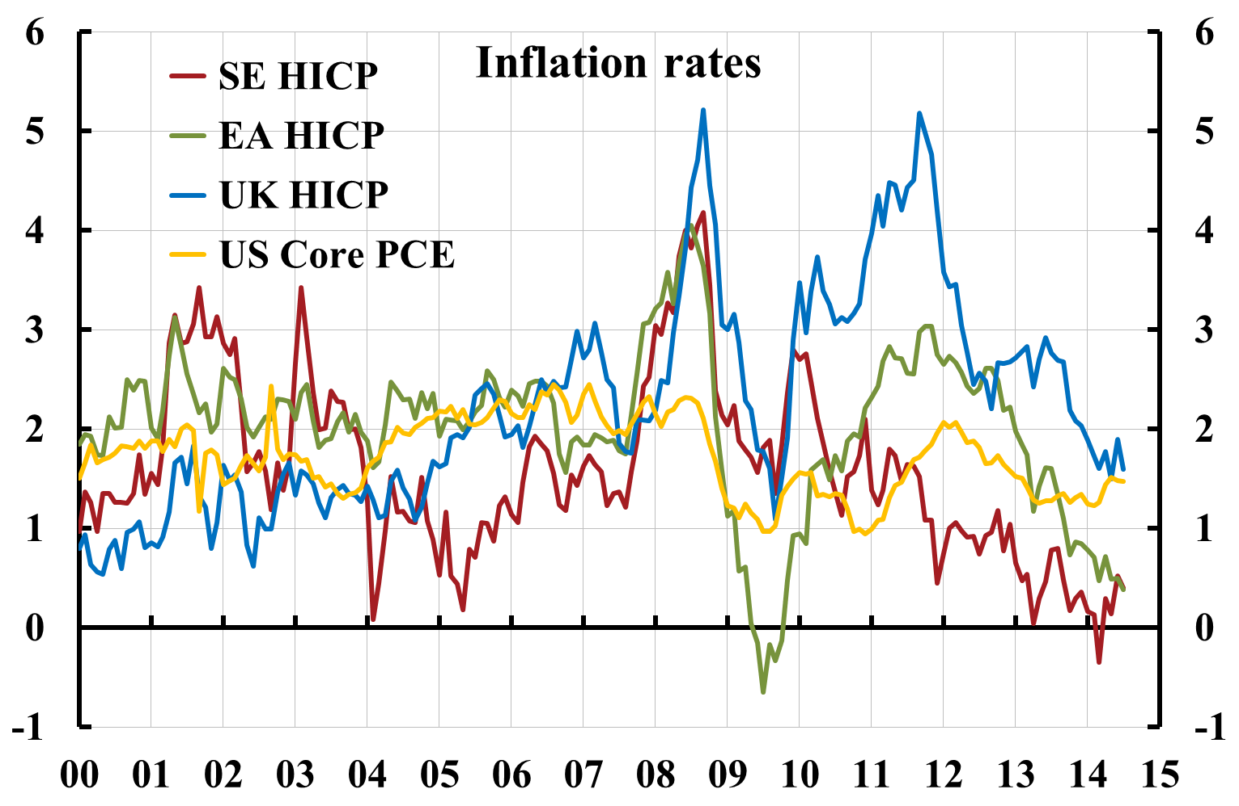
The leaning: Inflation in Sweden, euro area, UK, and US

Slide 20
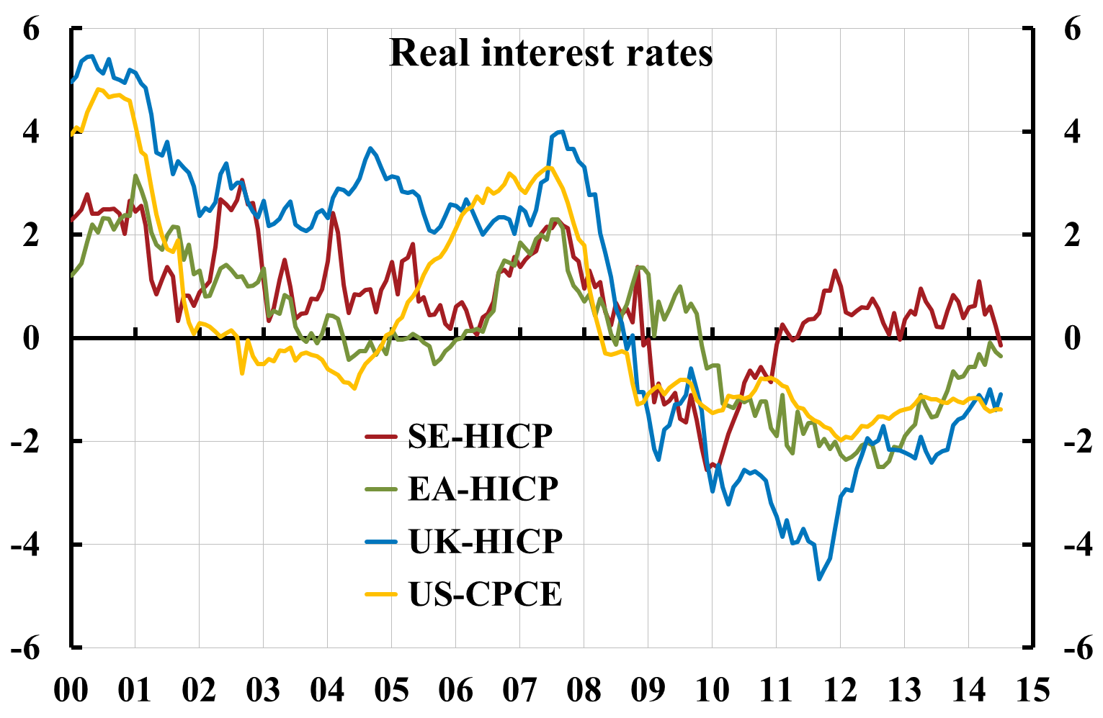
The leaning: Real policy rate in Sweden, UK, and US, real Eonia rate in euro area

Slide 21
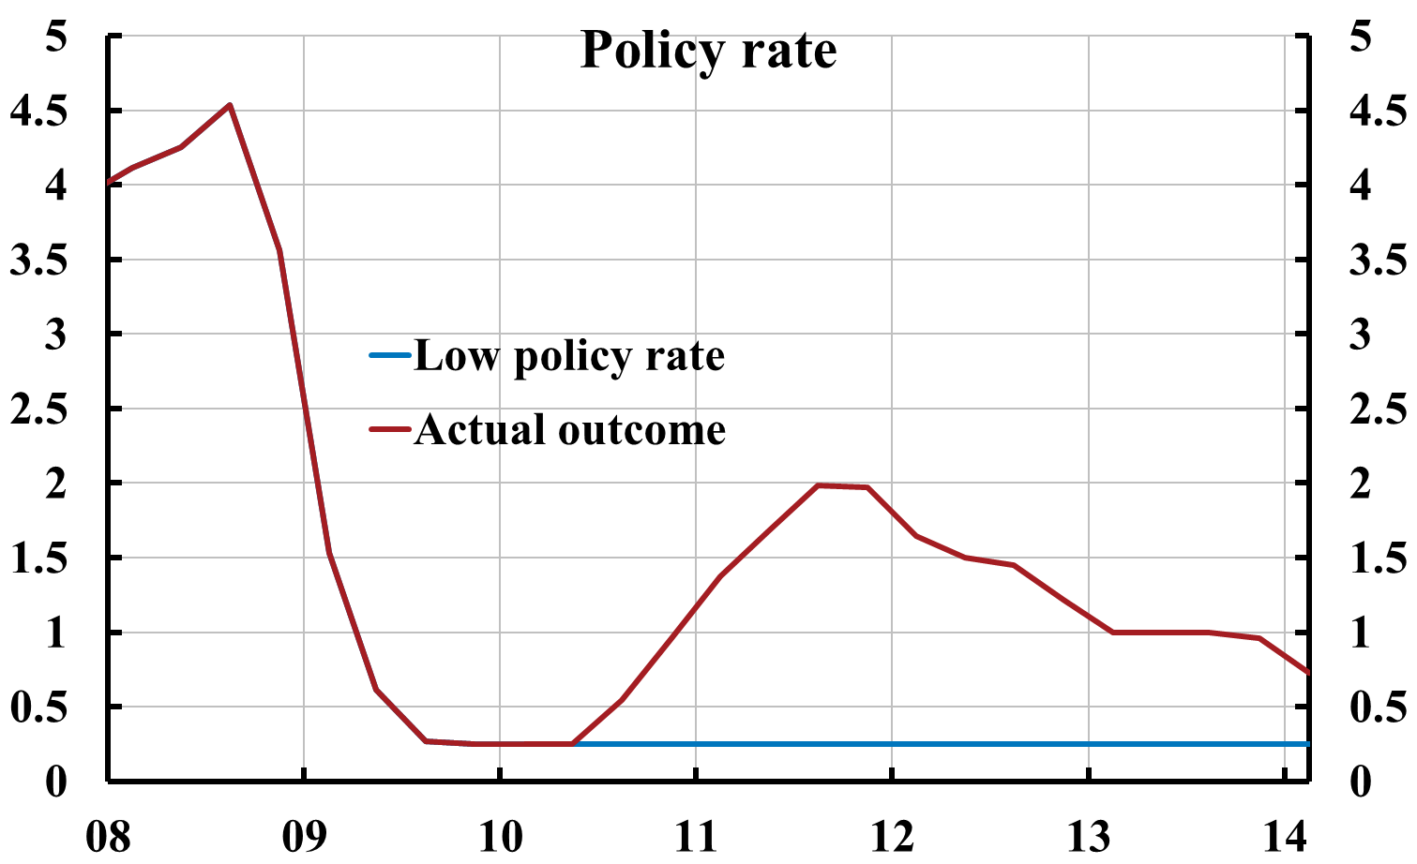
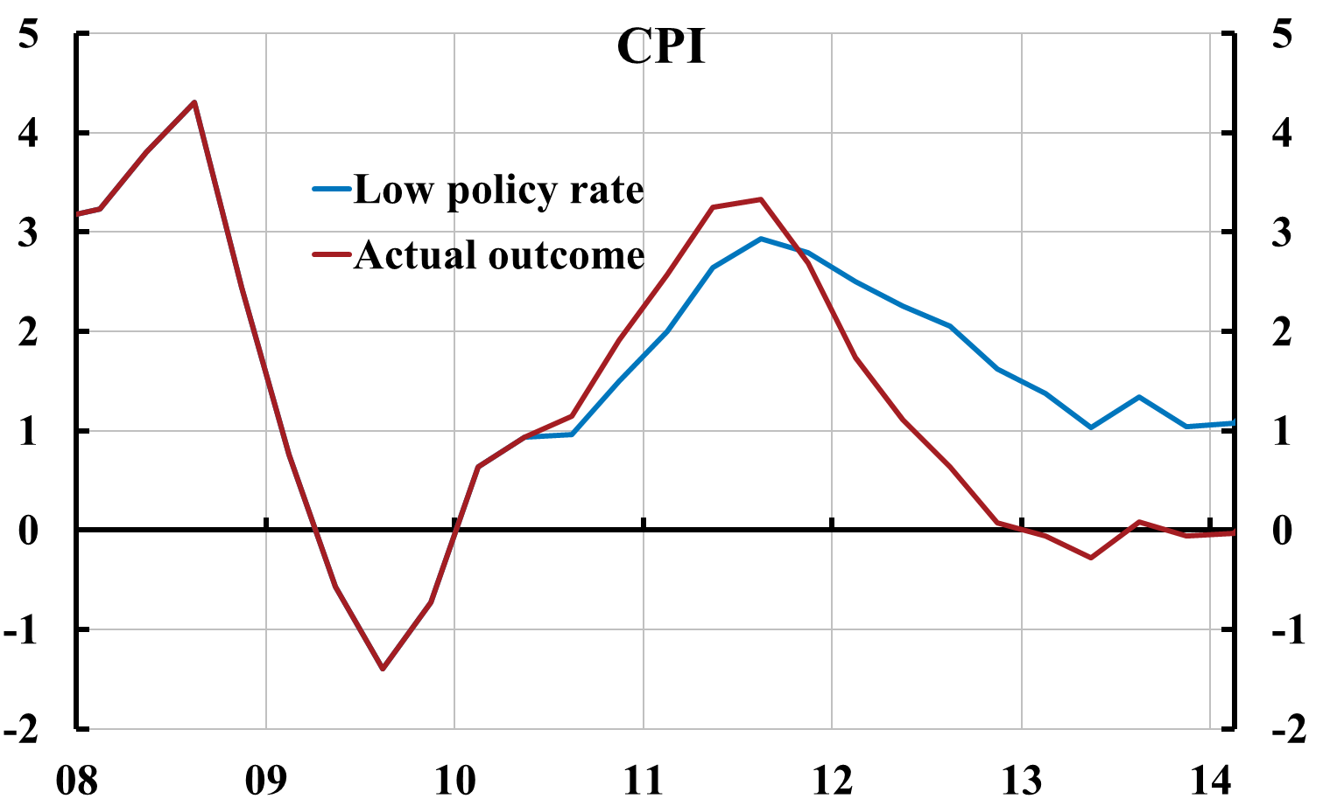
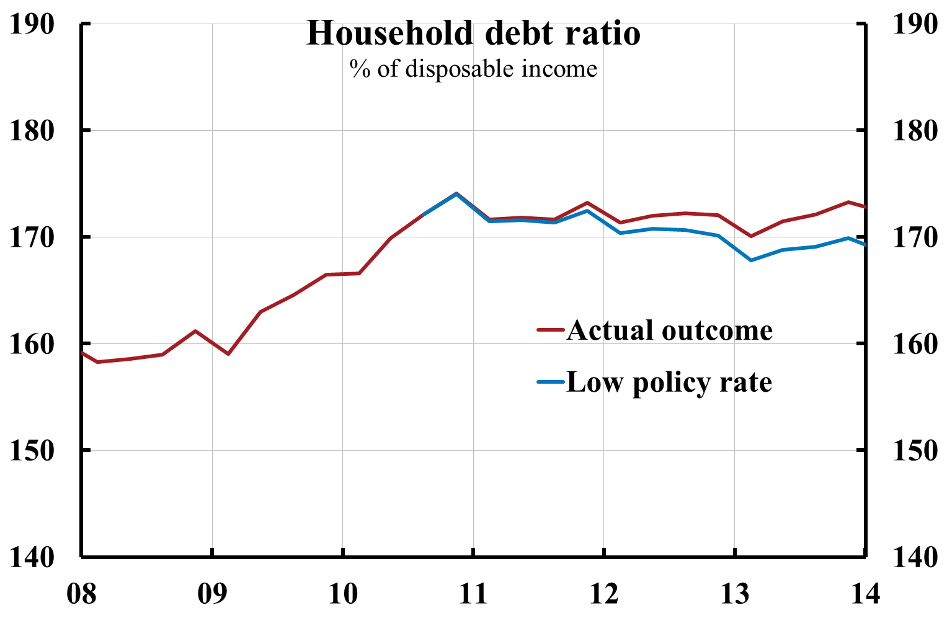
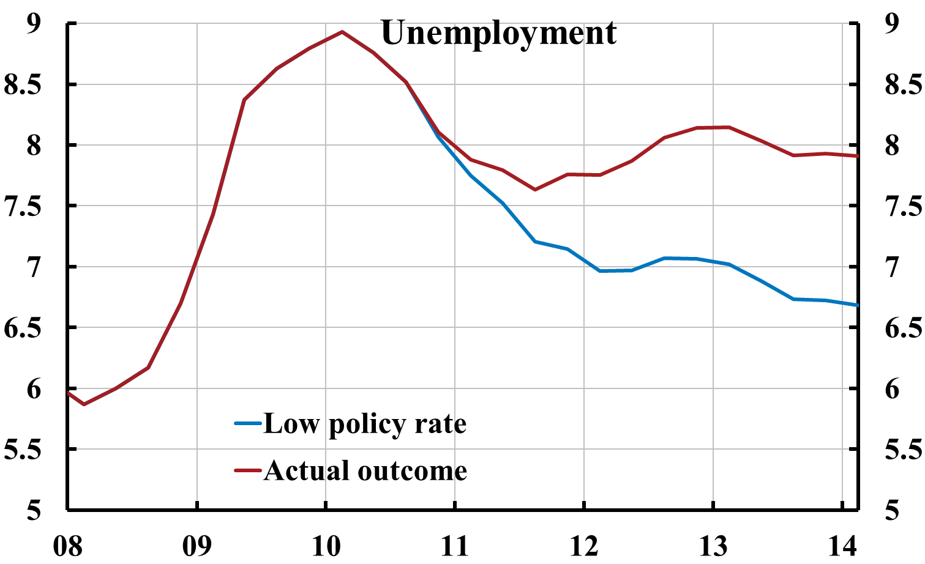
The leaning: Policy-rate increases from summer of 2010 have led to inflation below target and higher unemployment (and probably a higher debt ratio)
LTV cap
Cont.
Source: Svensson (2013), “Unemployment and monetary policy – update for the year 2013,”
Svensson (2013), “Leaning against the wind increase (not reduces) the household debt-to-GDP ratio”,
posts on larseosvensson.se.

Slide 22
Riksbank’s case for leaning against the wind
Higher debt could imply a higher probability of a future crisis, or a deeper crisis if it occurs
Hence, a tradeoff between (1) tighter policy now with worse outcome now and (2) worse expected outcome in the future
Worse outcome now is an insurance premium worth paying
Is that true?
The answer can be found in the Riksbank’s own boxes in MPR July 2013 and February 2014, plus Schularick and Taylor (2012) and Flodén (2014)

Slide 23
Three issues in Williams (2014)
Williams (Bundesbank conference, 2014), “Financial stability and monetary policy: Happy marriage or untenable union”
What are the costs of using monetary policy actions to address perceived and potential risks to financial stability
How do monetary policy actions affect financial stability risks?
Can monetary policy policy be designed to improve these tradeoffs?

Slide 24
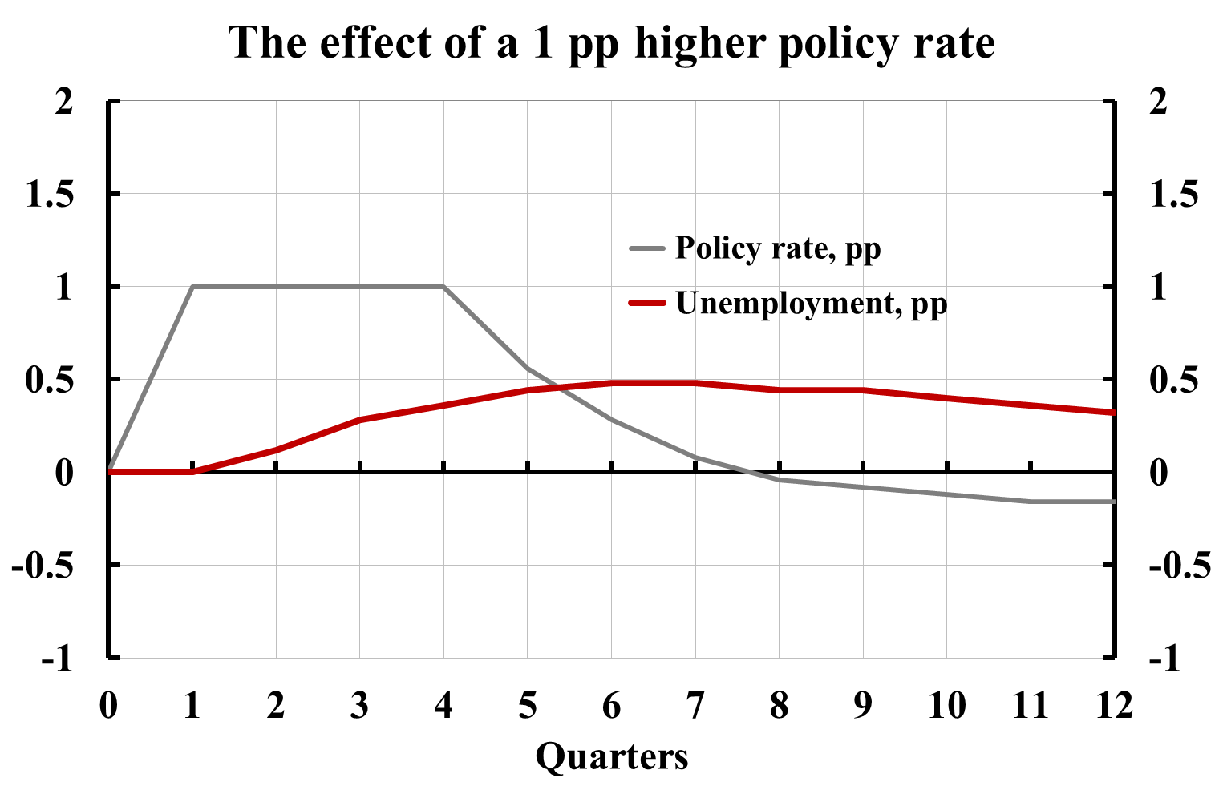
Williams issue (1): Cost of 1 pp higher policy rate:
0.5 pp higher unemployment rate
Source: MPR July 2013, chapt. 2; Svensson, post on
larseosvensson.se, March 31, 2014.

Slide 25
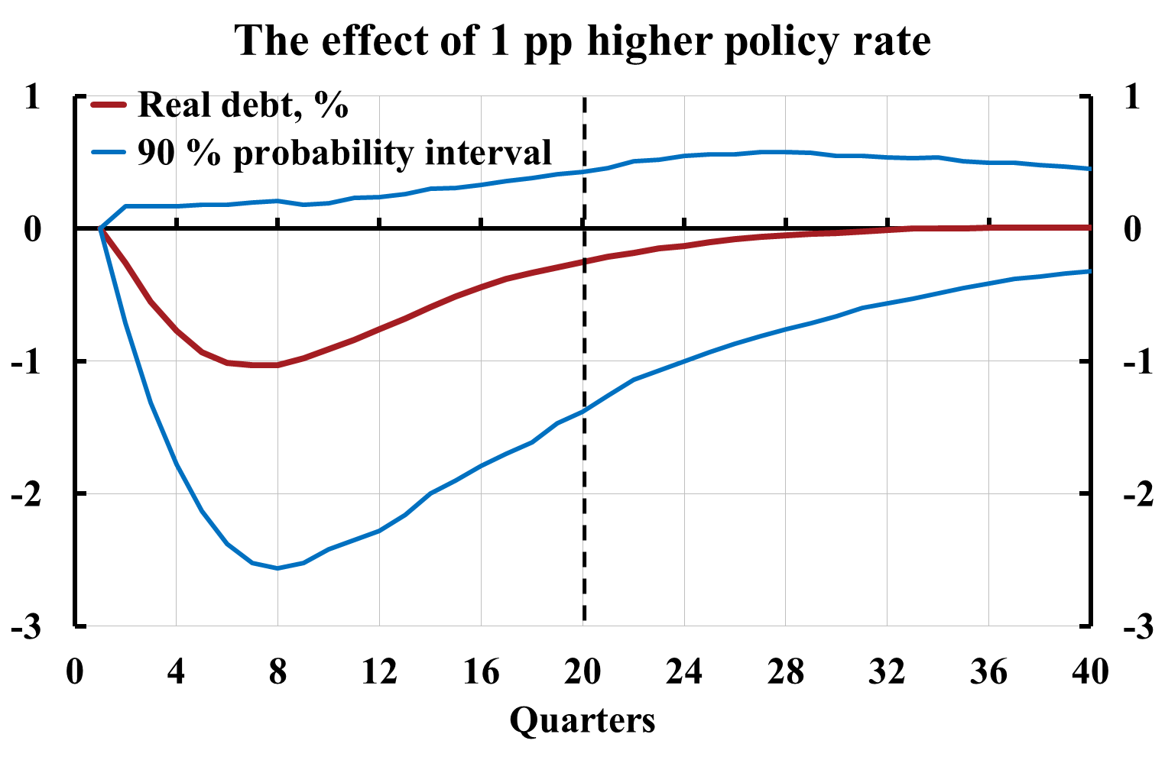
Williams issue (2): Benefit of 1 pp higher policy rate:
Lower probability of a crisis
Schularick and Taylor (2012):
5 % lower real debt in 5 yrs implies 0.4 pp lower probability of crisis
(average probability of crises about 4 %)
Riksbank, MPR Feb 2014, box:
1 pp higher policy rate leads to 0.25 % lower real debt in 5 years
Lowers probability of crises by 0.25*0.4/5 = 0.02 pp
Assume 5 pp higher unemployment in crisis (Riksbank crisis scenario, MPR July 2013, box):
Benefit:
Expected lower future unemployment:
0,0002*5 = 0.001 pp
Compare to cost: Higher unemployment rate now: 0.5 pp
Source: Svensson, post on larseosvensson.se, March 31, 2014.

Slide 26
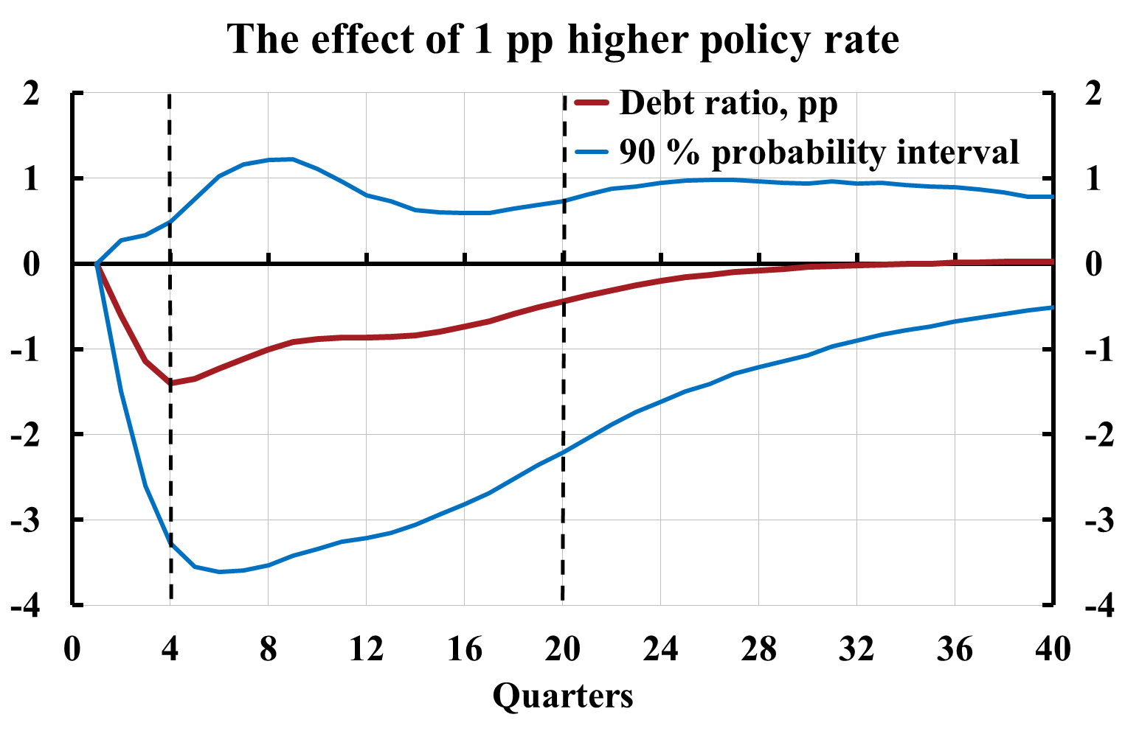
Williams issue (2): Benefit of 1 pp higher policy rate:
Smaller increase in unemployment if crisis
1 pp lower debt ratio may imply 0.02 pp smaller increase in unemployment rate in crisis (Flodén 2014)
(Riksbank, MPR Feb 2014, box)
1 pp higher policy rate leads to 0.44 pp lower debt ratio in 5 yrs
Smaller increase in unemployment in crisis:
0.44*0.02 = 0.009 pp
With probability of crisis as high as 10 %, divide by 10 (Shularick & Taylor: 4 %)
Benefit: Expected lower future unemployment:
0.0009 pp
Compare to cost: Higher unemployment now: 0.5 pp
Source: Svensson, post on larseosvensson.se, March 31, 2014.

Slide 27
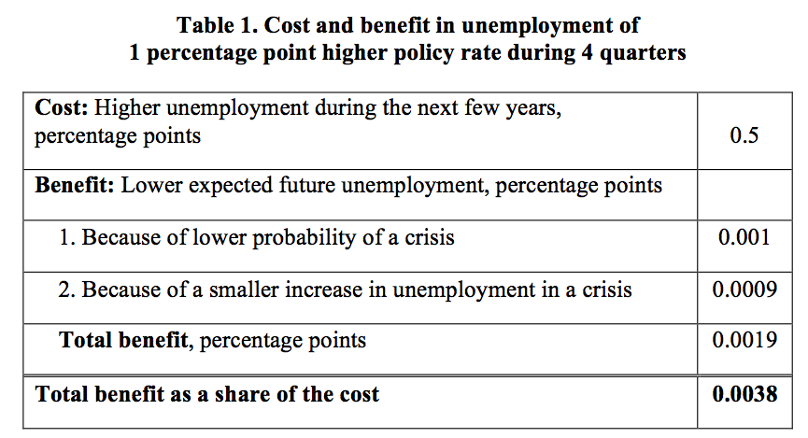
Williams issue (1) and (2):
Summarize cost and benefit of 1 pp higher policy rate
Should have been > 1!
Riksbank case does not stand up to scrutiny

Slide 28
More costs: Inherent flaw in leaning against the wind:
Inflation below credible target causes negative real effects
Inflation expectations anchored at target
Lower average inflation than expected causes real effects
Higher unemployment
Higher real debt for households (additional cost of leaning against the wind)

Slide 29
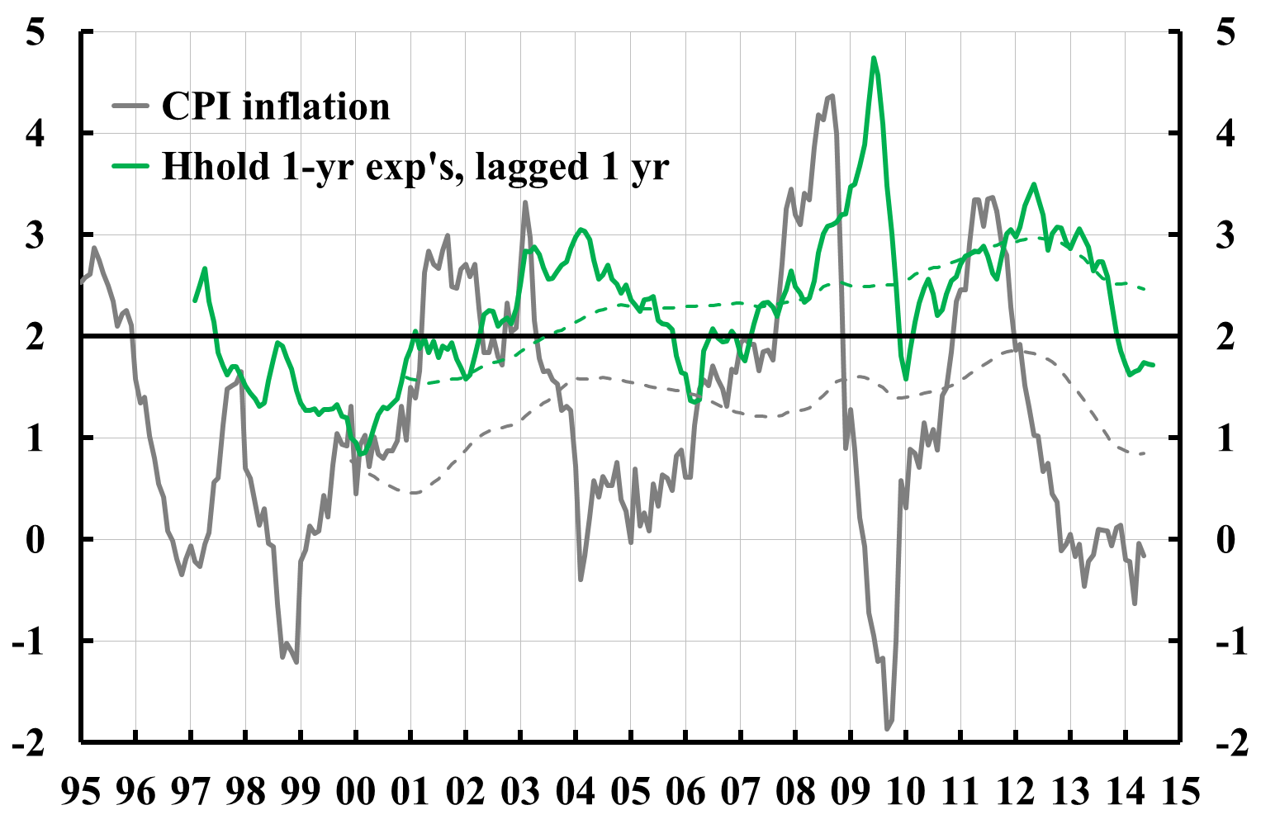
CPI inflation and household inflation expectations

Slide 30
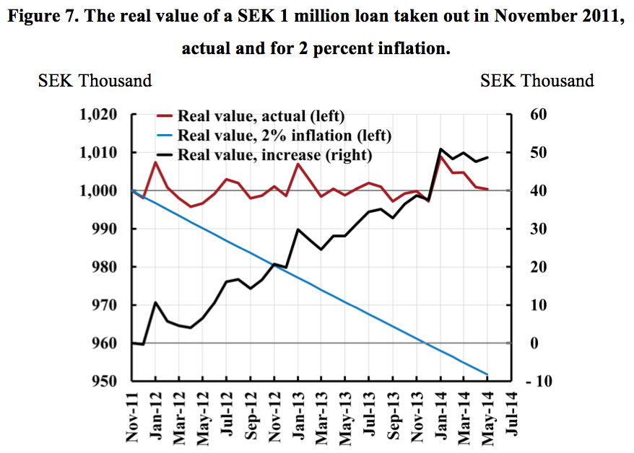
The real value of an SEK 1 million loan taken out in Nov 2011, actual and for 2 percent inflation

Slide 31
Sum up:
Leaning against the wind and household debt
”Leaning against the wind” is counter-productive in Sweden
Leaning generally involves undershooting (credible) inflation targets
Leads to lower inflation than expected
Leads to higher unemployment and higher real debt
May increase debt ratio by affecting disposable income faster than nominal debt (Svensson 2013)
Also, may undermine the credibility of the inflation target
Not the best way to handle any debt problem

Slide 32
Sum up:
Leaning against the wind and household debt
Q: What is monetary policy’s best contribution to debt issue (at least in Sweden)?
A: Inflation on target, stable growth, and lowest long-run sustainable unemployment
2 % real growth, 2 % inflation = 4 % nominal growth
Doubling of disp. income and housing prices in 18 years
Debt ratio and LTV ratio for any given nominal debt halved in 18 years
Provides an answer to Williams issue (3): improved design of MP?
Financial stability and any problems with debt are better handled with other means than monetary policy:
macro- and microprudential tools (lending standards, LTV cap, higher capital, risk weights…), taxes, deduction rules…

Slide 34
Flexible inflation targeting
Stabilize inflation around inflation target and resource utilization around long-run sustainable rate (employment/unemployment around a long-run sustainable rate)
Same as Fed’s dual mandate

Slide 35
The monetary policy mandate
Sveriges Riksbank Act
  "The objective for monetary policy shall be to maintain price stability"
Government bill
  "In addition, as an authority under the Riksdag, the Riksbank, without prejudice to the price stability target, is to support the goals of general economic policy with the aim to achieve sustainable growth and high employment".
  High employment = highest sustainable rate of employment
Price stability and the highest sustainable rate of employment
  Highest sustainable rate of employment = the lowest sustainable rate of unemployment
  Stabilize inflation around the inflation target and unemployment around a long-run sustainable rate

Slide 36
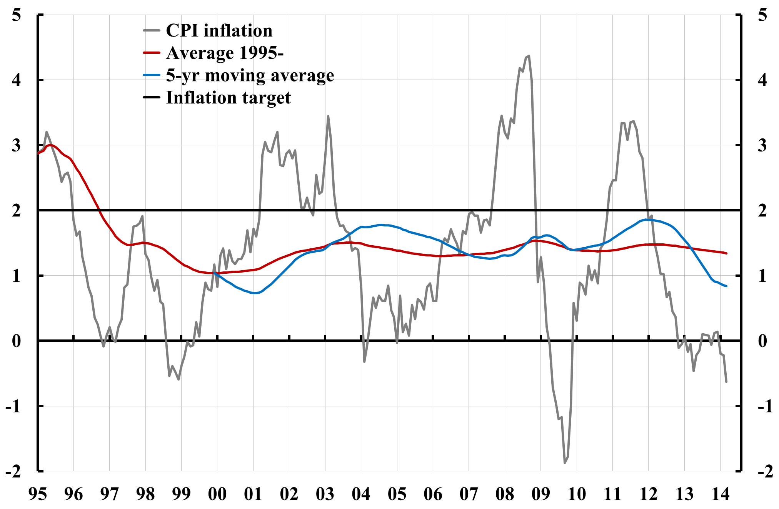
Target achievement:
Average inflation significantly below target

Slide 37
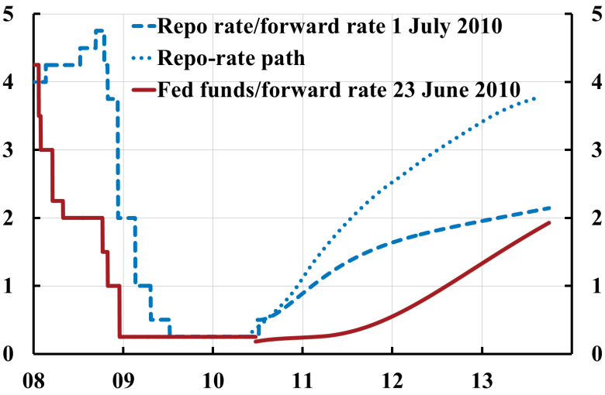
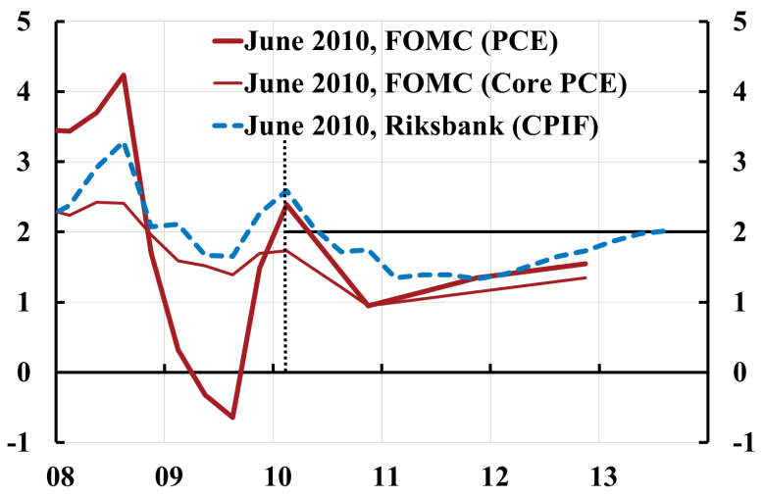
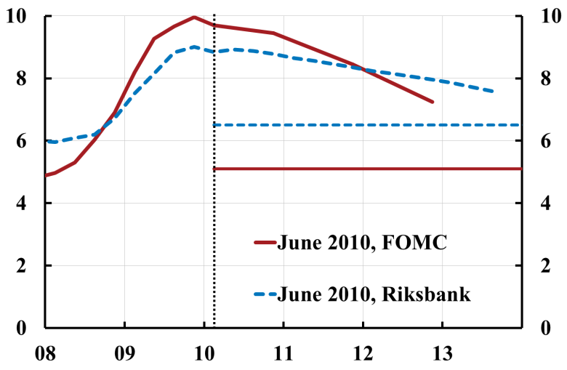
Fed and Riksbank, June/July 2010
Similar forecasts, very different policies
Policy rate
Inflation
Unemployment

Slide 38
Lowflation/deflation and debt:
A negative involuntary amortization
Chair Yellen: “[W]ith longer-term inflation expectations anchored near 2 percent in recent years, persistent inflation well below this expected value increases the real burden of debt for households and firms, which may put a drag on economic activity.”
Governor Ingves, in reply to a question if low inflation increases indebtedness: ”Interest rates are low and then it is easy to borrow… But in this context, the inflation rate is not a particularly significant issue.”

Slide 39
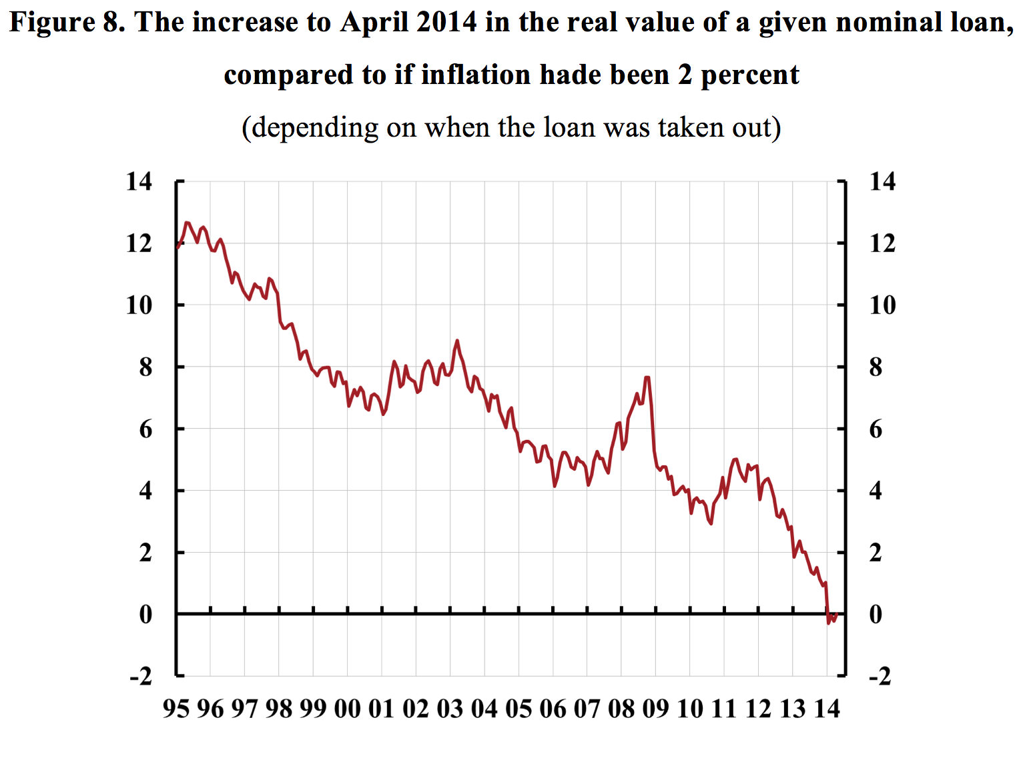

Slide 40
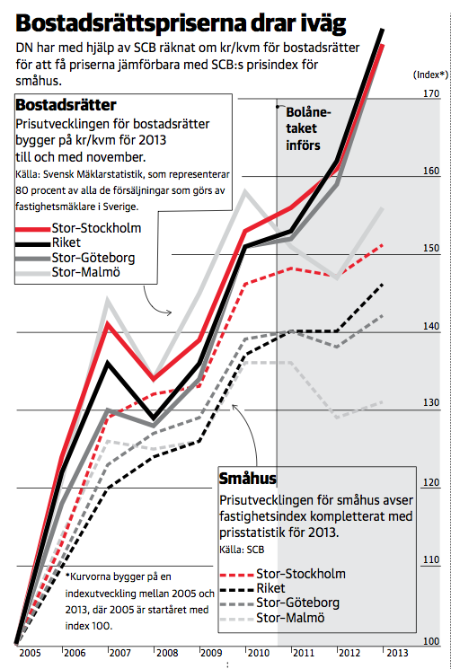
Scaremongering? Dagens Nyheter, January 15, 2013

Slide 41
Riksbank I
Governor Ingves: ”When interest rates are low, people borrow more. If you borrow too much, sooner or later there are problems.”
Riksbank: Probably no direct credit losses from mortgages
But housing price fall and doubts about the Swedish housing market might create problems for banks’ funding through covered housing bonds
  But actually liquidity problem, not solidity problem: Solved by lending of last resort from the Riksbank and the National Debt Office (and information) (Posts on Ekonomistas and larseosvensson.se, Feb 10, 2014)

Slide 42
Riksbank III: Households’ mortgage-rate expectations are too low
Households’ expectations of mortgage rates in 5 years are low compared to a normal policy rate of 4% and a normal spread
  But who believes in “normal” interest rates in 5 years?
Households’ mortgage-rate expectations are low relative to the Riksbank’s policy-rate path
  But what credibility does the policy-rate path have?

Slide 43
Policy rate, policy-rate path, market expectations, and household expectations about 3-month mortgage rates:
Sep 2011

Slide 44
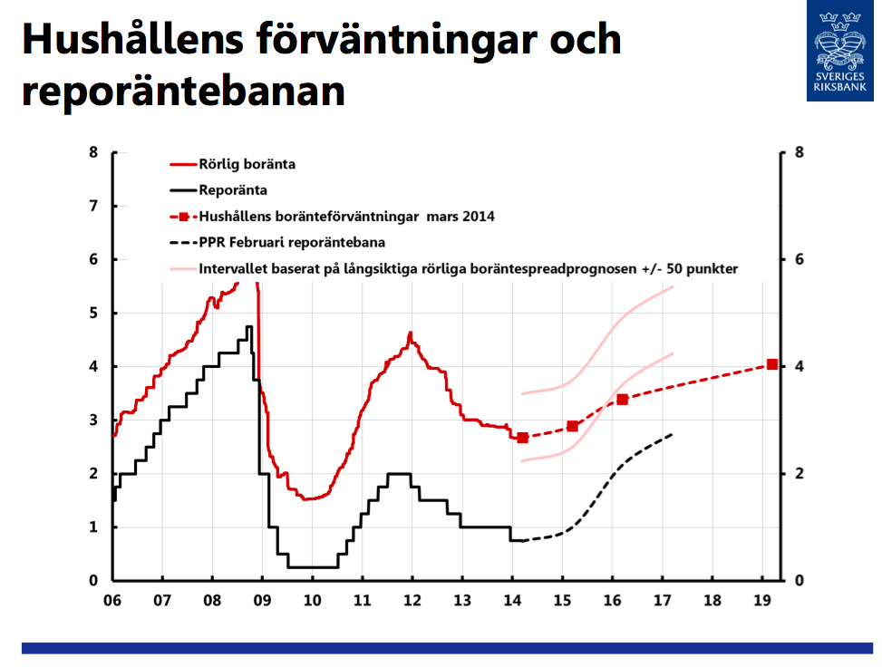
Household expectations and Riksbank policy-rate path
Source: Flodén, “Monetary policy and macroprudential policy” (in Swedish),
LO, 2014-03-27

Slide 45
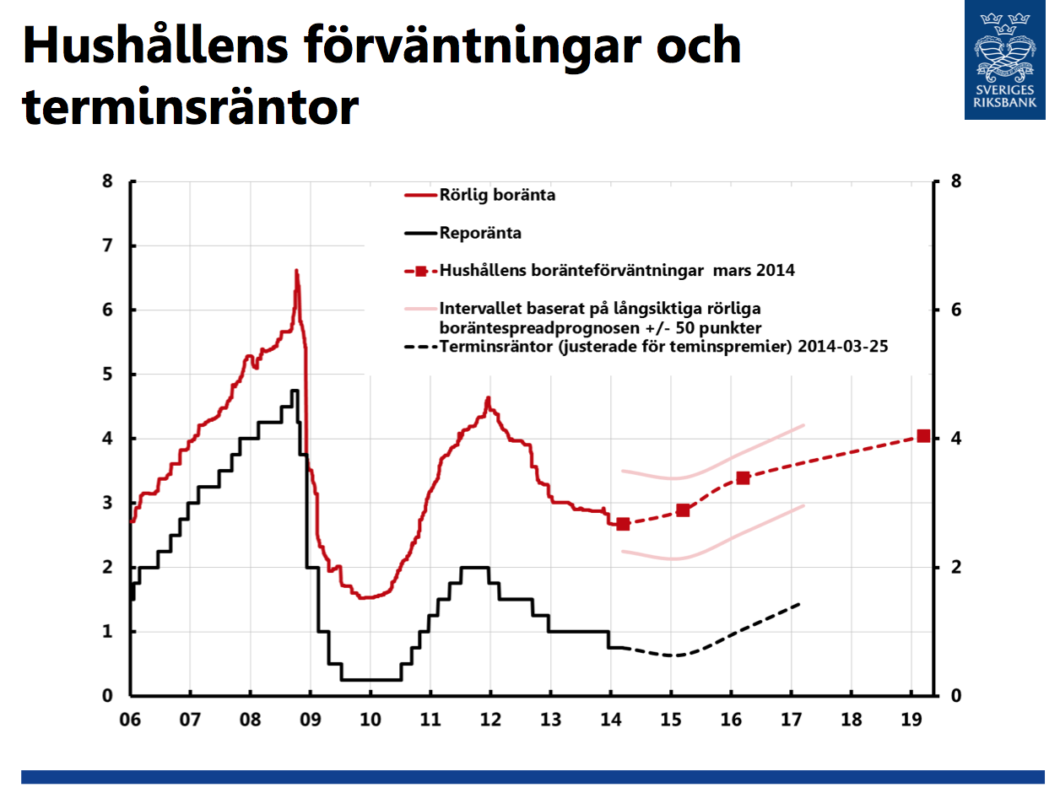
Household expectations and market expectations
Source: Flodén, “Monetary policy and macroprudential policy” (in Swedish),
LO, 2014-03-27

Slide 46
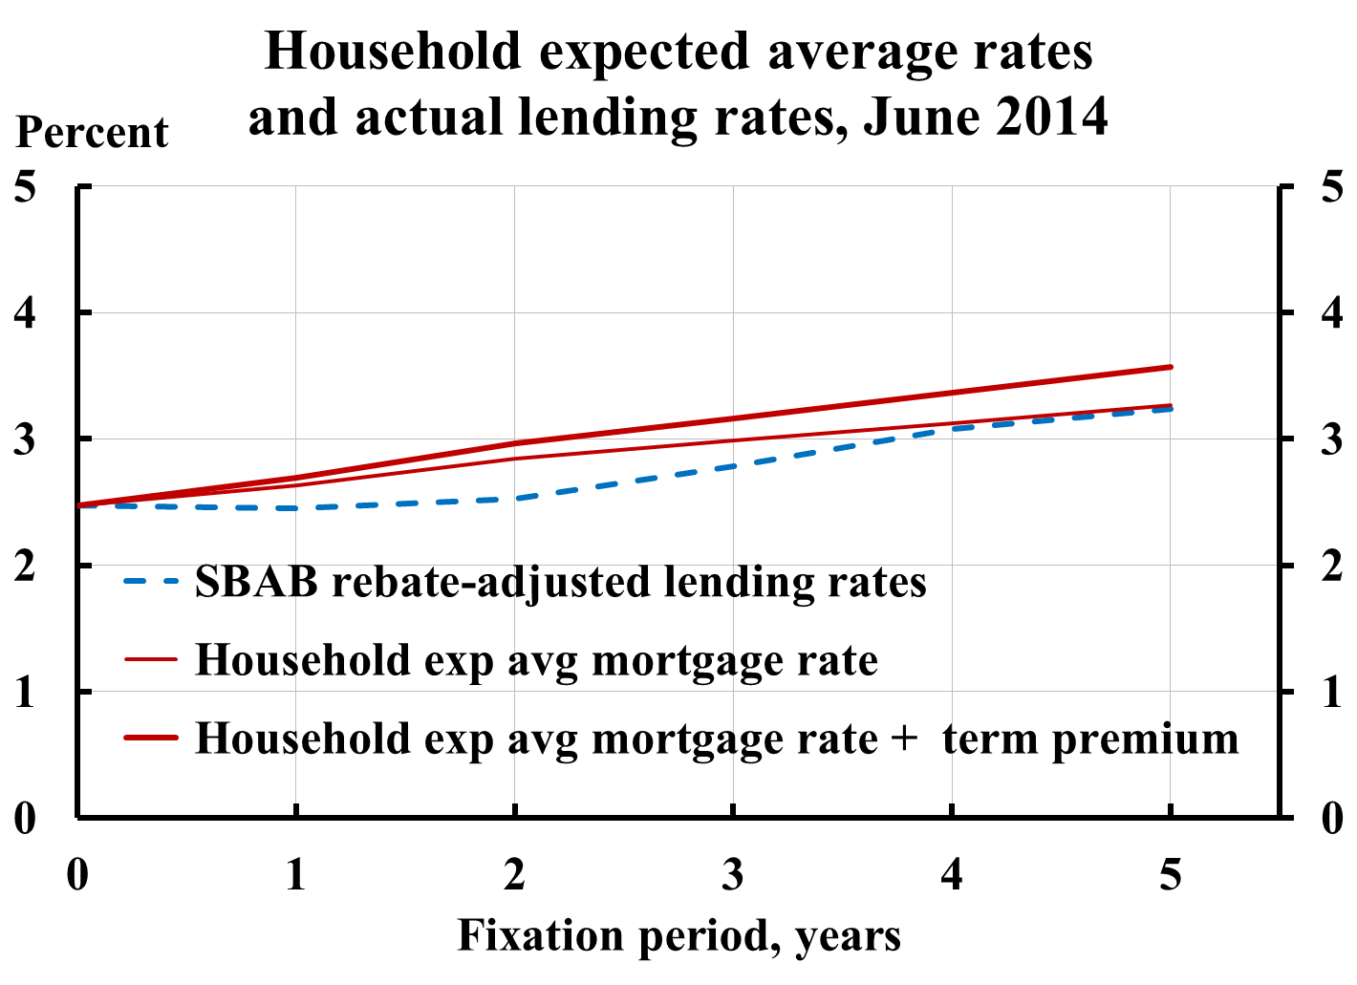
Households’ expected mortgage-rate costs and actual yield curve

Slide 47
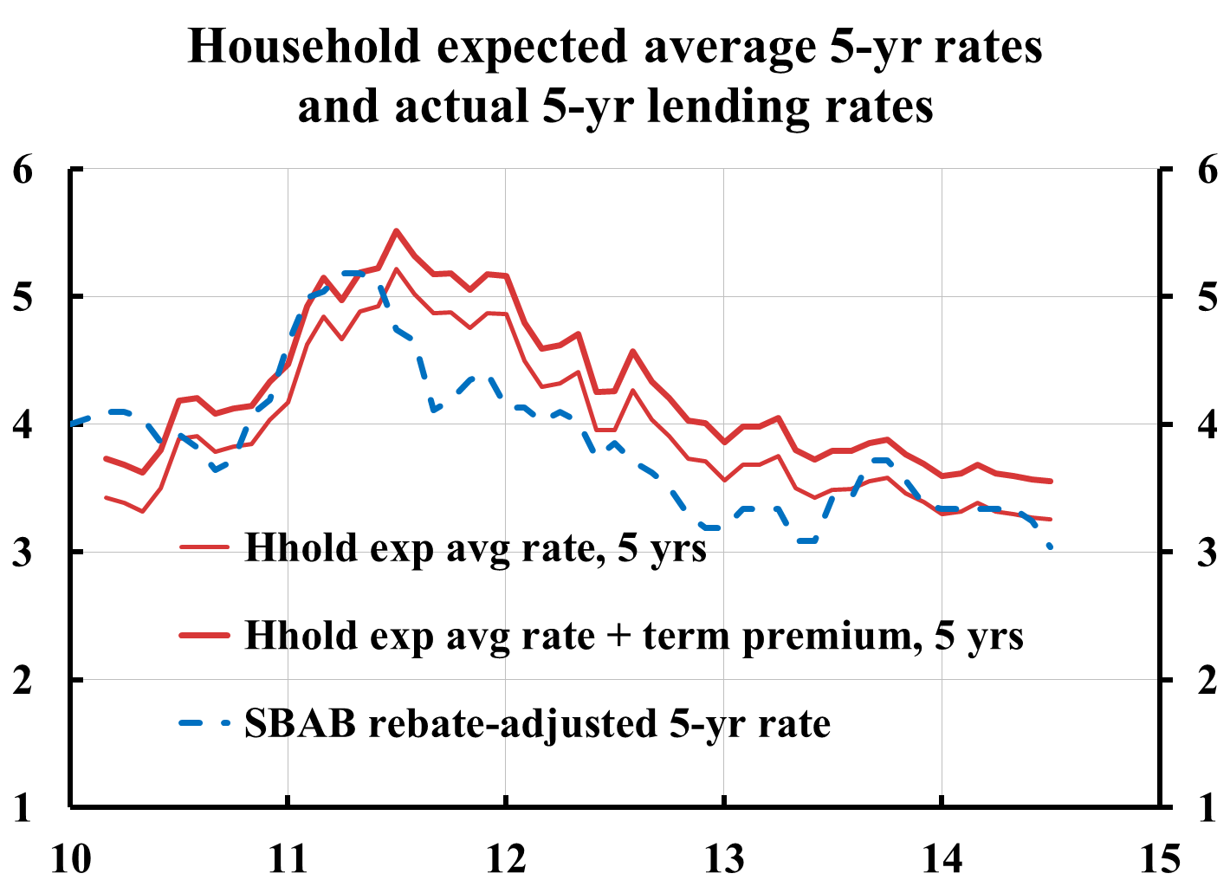
Households’ expected 5-year mortgage-rate costs and actual 5-year mortgage rate

Slide 48
Riksbank III: Households’ mortgage-rate expectations are too low
Households’ expectations of mortgage rates in 5 years are low compared to a normal policy rate of 4% and a normal spread
  But who believes in “normal” interest rates in 5 years?
Households’ mortgage-rate expectations are low relative to the Riksbank’s policy-rate path
  But what credibility does the policy-rate path have?
At a closer examination, no evidence of too low mortgage-rate expectations

Slide 49
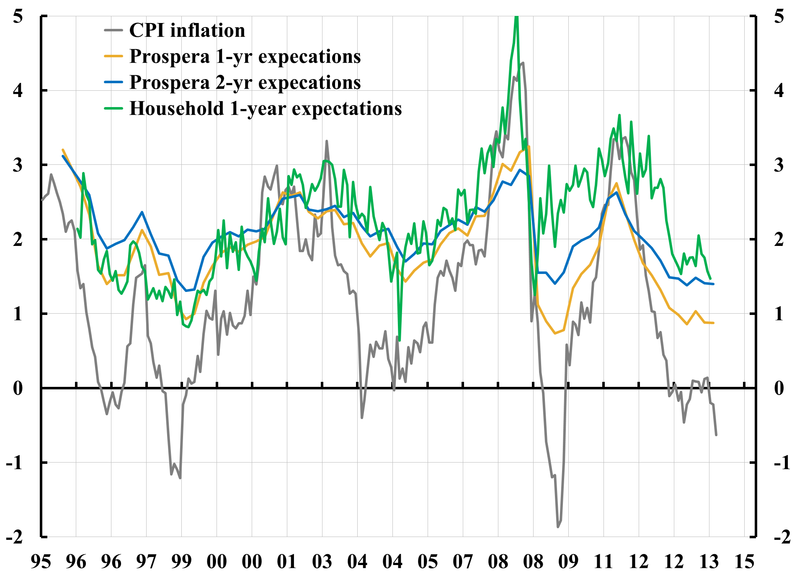
Inflation expectations close to target, in spite of low inflation

Slide 50
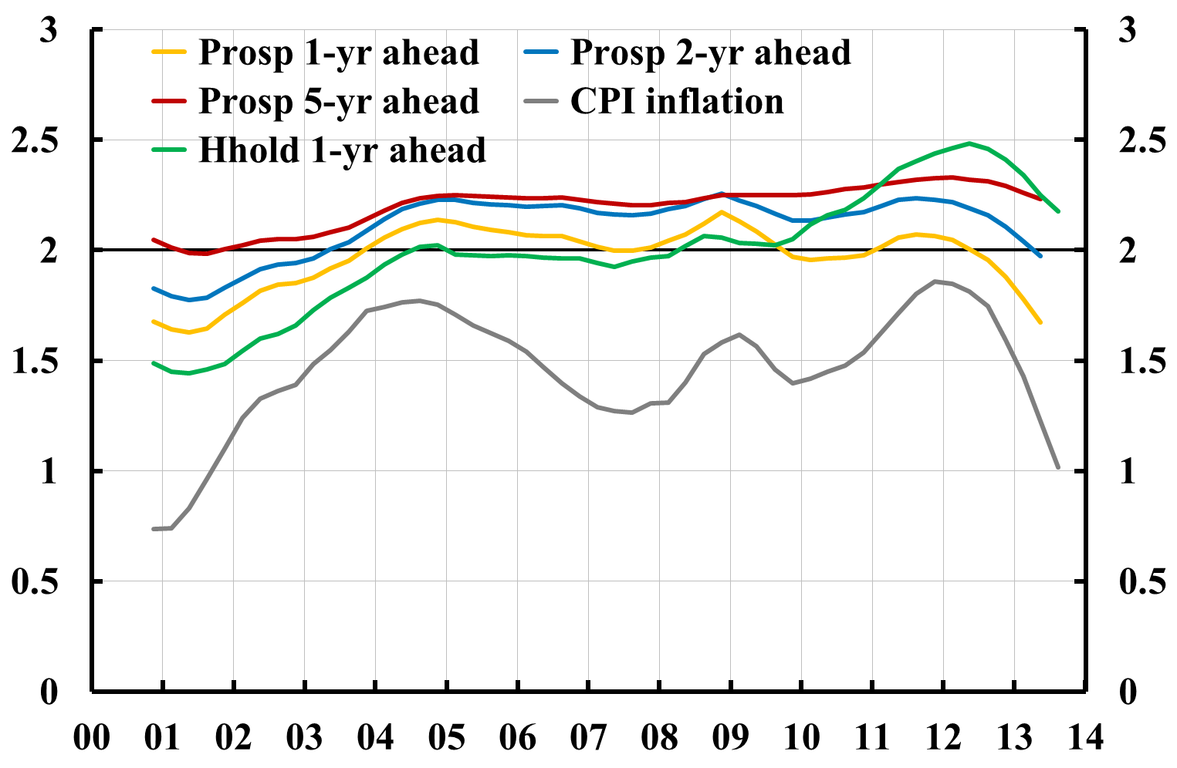
Inflation expectations close to target, in spite of low inflation
5-year trailing moving averages

Slide 51
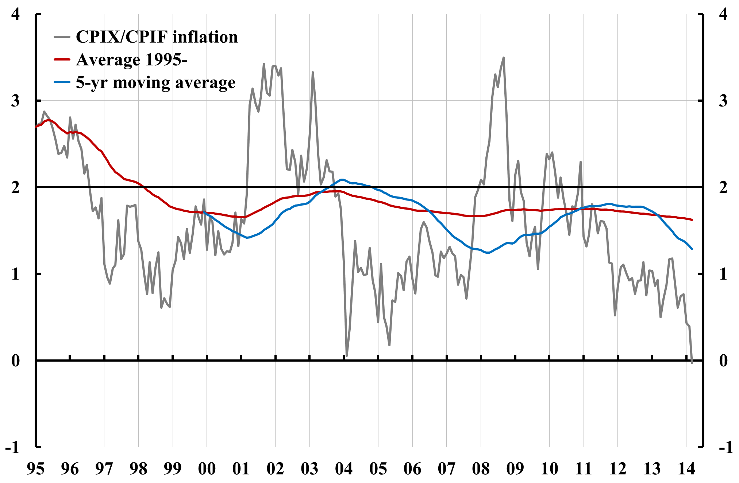
Average CPIX/CPIF inflation also below target
Note: CPIX inflation through March 2008, CPIF inflation from April 2008.

Slide 52
Average inflation in Canada on target

Slide 53
Average inflation in some countries:
Sweden an outlier
Country | Target | Index | Period | Average | Deviation
Sweden | 2 (1995-) | CPI | 1997-2011 | 1.4 | - 0.6
 | 2 (1995-) | CPI | 1997-2007 | 1.3 | - 0.7
Australia | 2-3 (1993-) | CPI | 1997-2011 | 2.7 | 0.2
Canada | 2 (1995-) | CPI | 1997-2011 | 2.0 | 0.0
UK | 2.5 (1992-2003) | RPIX | 1997-2003 | 2.4 | - 0.1
 | 2 (2004-) | CPI | 2004-2007 | 2.0 | 0.0
 | 2 (2004-) | CPI | 2008-2011 | 3.4 | 1.4
Euro zone | (< 2) (1999-) | HICP | 2000-2011 | 2.1
USA | (≤ 2) (2000-) | core CPI | 2000-2011 | 2.0
 |  | core PCE | 2000-2011 | 1.9

Slide 54
On average 0.8 percentage point higher unemployment since 1997 (downward-sloping long-run Phillips curve)
Unemployment and CPI inflation1976-2012, long-run Phillips curve 1997-2012
0.6 p.e.
0.8 p.e.
Source: Svensson , Lars E.O. (2013), "The possible unemployment cost of average inflation below a credible target", www.larseosvensson.net.

Slide 55
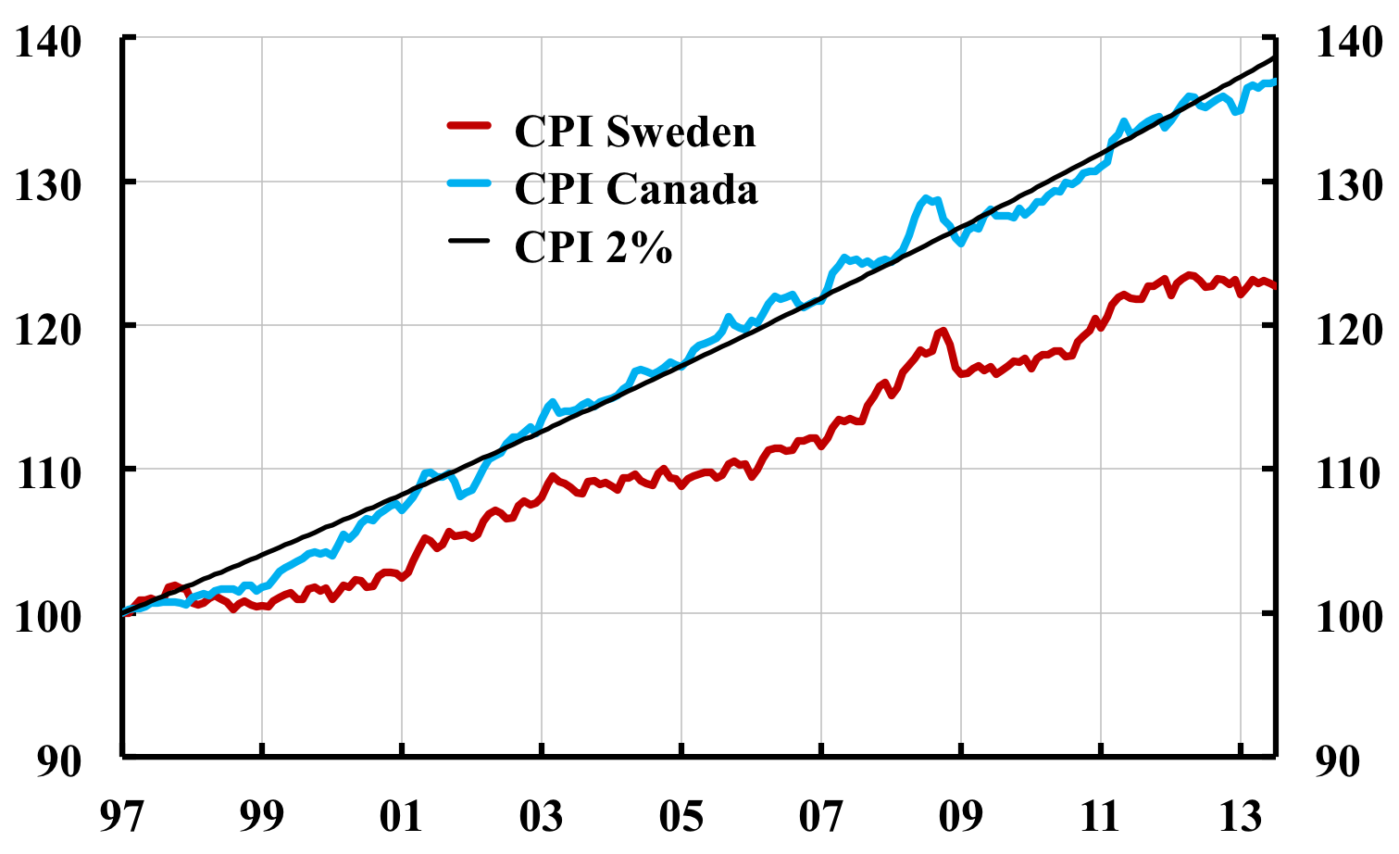
Long-run effect on real debt:
Price level lower than expected

Slide 56
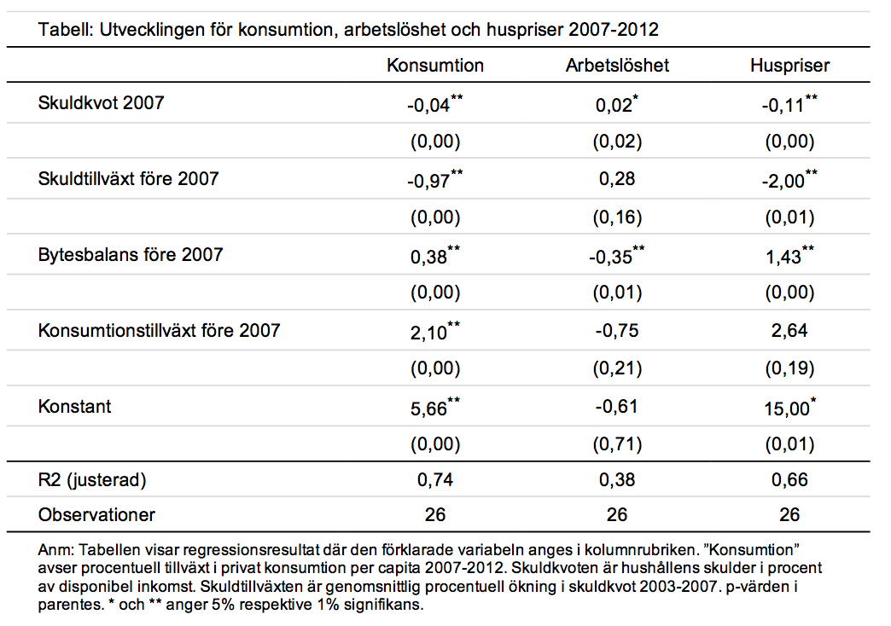
Flodén (2014), very small effect of debt ratio on increase in unemployment rate in crisis (not statistically significant for subsample of countries with falling housing prices)

Slide 57
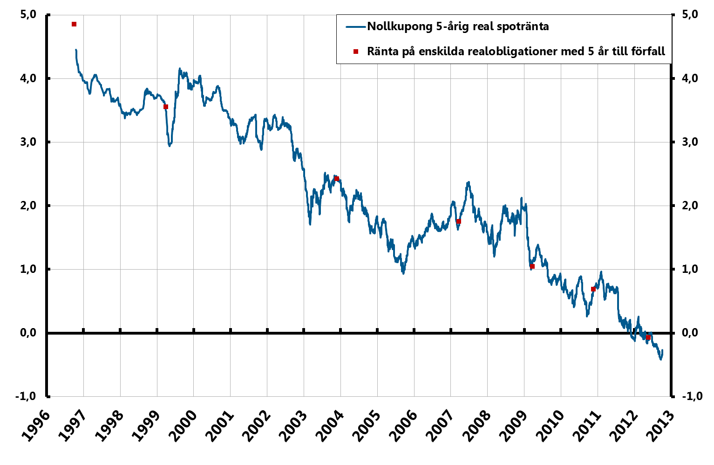
Swedish 5-year zero-coupon real rate
Source: Riksbank and National Debt Office

Slide 58
Capital to assets for households, som large listed companies, and Swedish banks
Percent
Källor: Dagens Industri (soliditeten 2011 för börsbolag och svenska banker) och Riksbanken (hushållens soliditet).

Slide 59
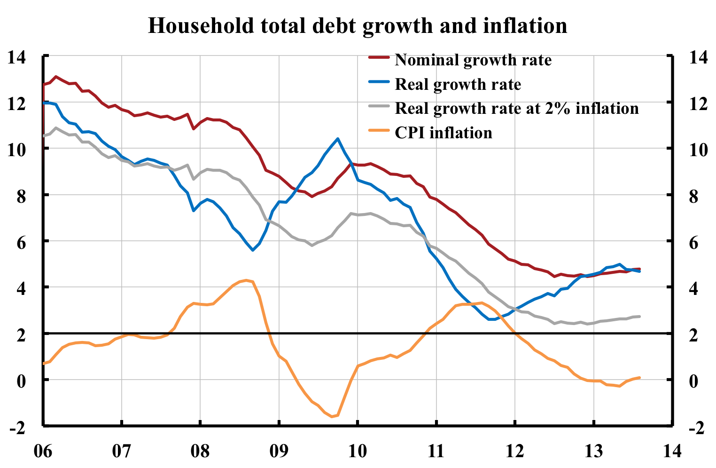
Debt growth: Real debt growth higher with low inlflation

Slide 60
Short- and long-run effects on debt
Real debt is a ratio:
Nominal debt/Price level
Debt ratio:
Nominal debt/Nominal disposable income
LTV ratio:
Nominal debt/Nominal value of housing
One (and the Riksbank!) must not forget the denominator, and the effect of monetary policy on it
Reala housing prices is a relative price:
Nominal housing price/Price level (nom. price on consumption)

Slide 61
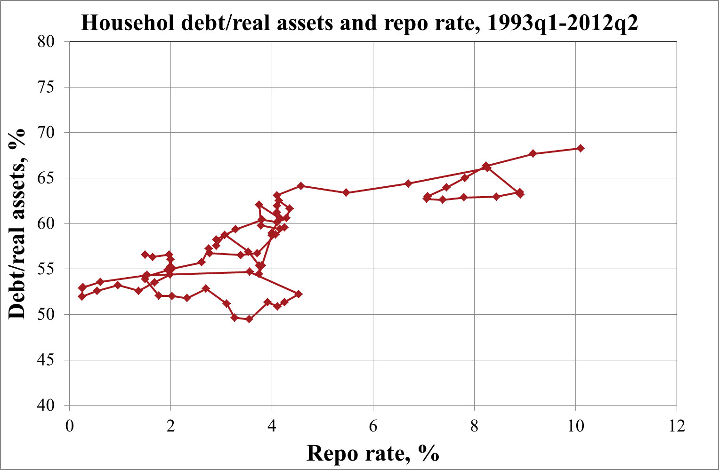
Household debt/real assets and repo rate:
No negative correlation
Percent
Sources: The Riksbank and Statistics Sweden

Slide 62
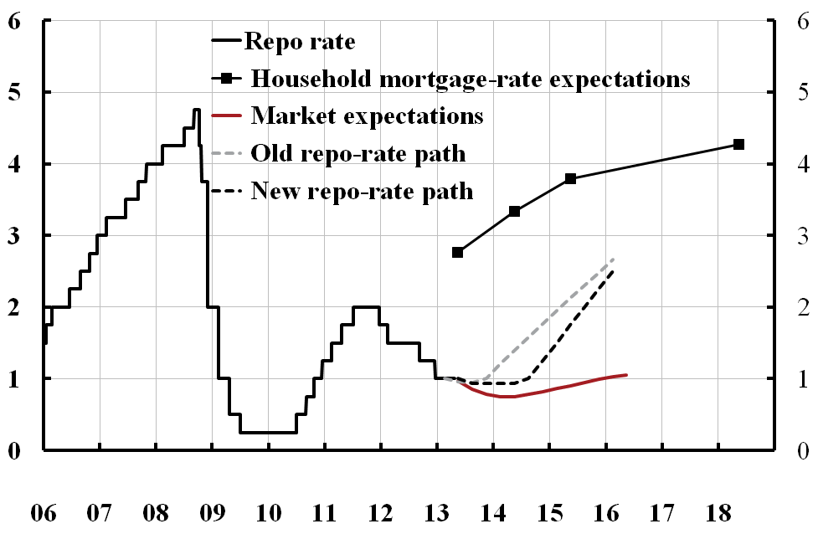
Policy rate, policy-rate path, market expectations, and household expectations: April 2013

Slide 63
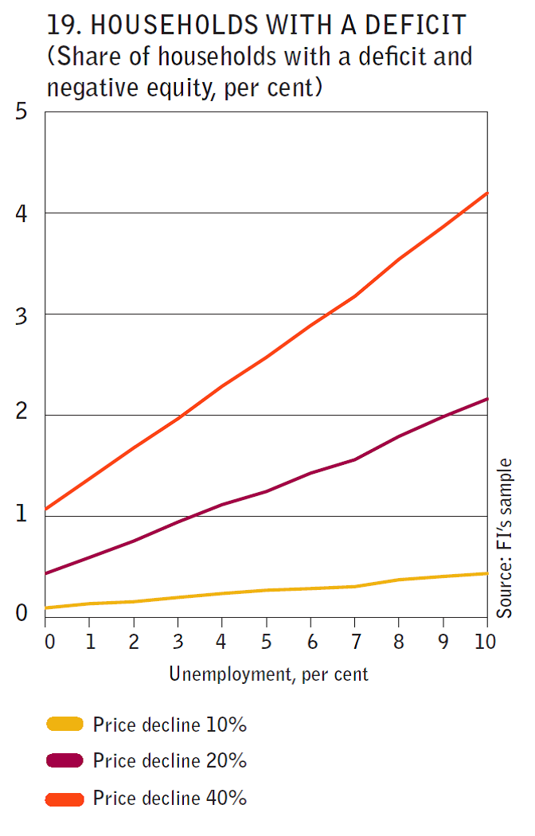
Stress test of new borrowers
Source: Finansinspektionen (Swedish FSA) (2014), “Mortgage market report”

Slide 64
Amortization hysterics?
Why amortize?
Depends exclusively on the individual borrower’s situation
  Amortization is fixed saving
  Comparison of mortgage rate with the return on alternative investments, plus any liquidity needs
  It may be better to build up a liquidity buffer and/or invest in other assets (diversify)
  SBAB:s price of liquidity: about 0.27 percentage points
Besides, 2% inflation and 2% real growth imply considerable automatic amortization
  Nominal disposable income increase by 4 %/year
  Doubles in 18 years, halves the debt ratio without nominal amortization
  Assume real housing prices grow with real disposable income, 2 %/year
  Nominal housing prices grow by 4 %/year
  Doubles in 18 years, halves the LTV ratio without nominal amortization

Slide 65
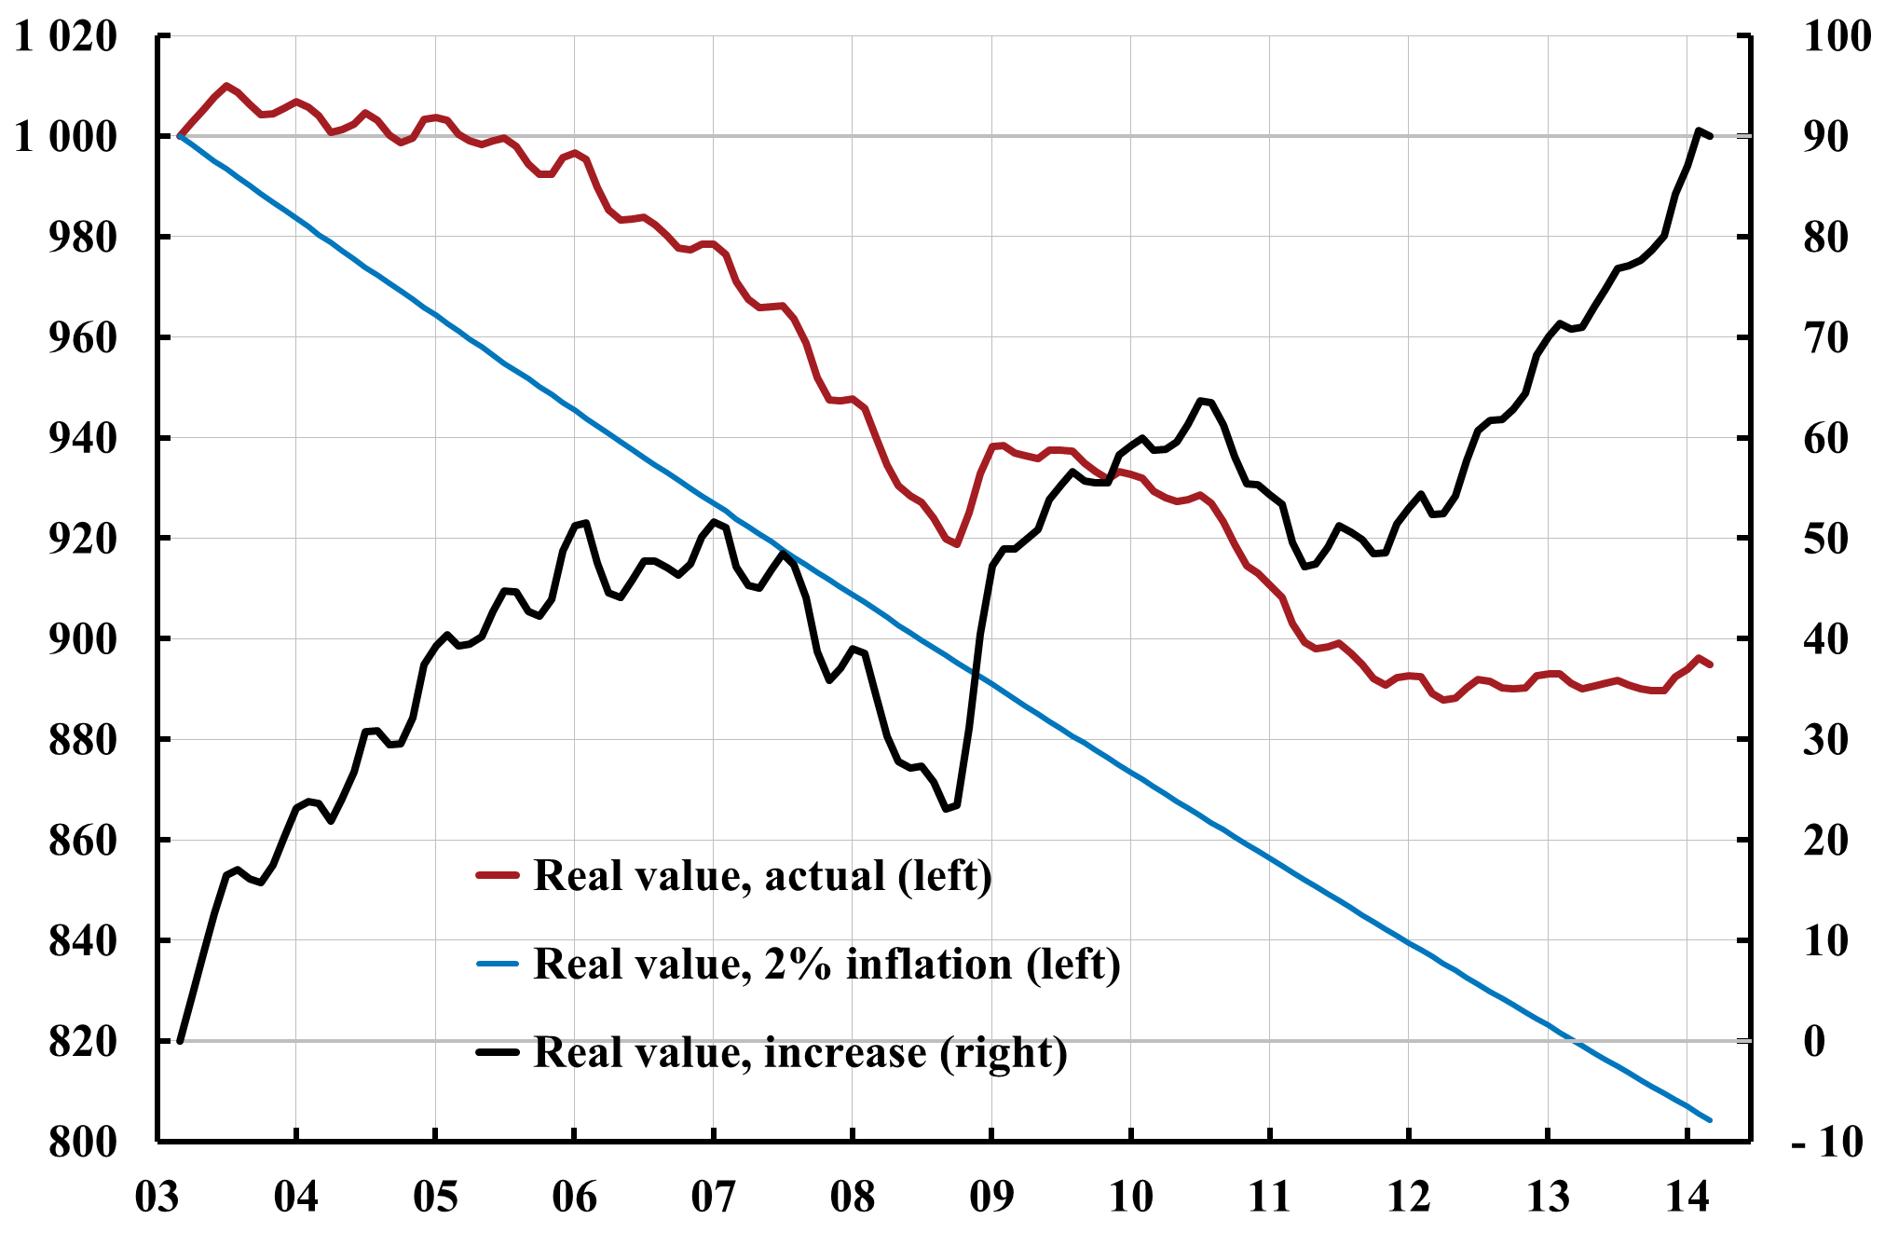
SEK 1 million loan, taken out in March 2003:
Real value of loan: Actual and for 2% inflation
Incease in real value: Actual compared to 2% inflation
SEK Thousand
SEK Thousand

Slide 66
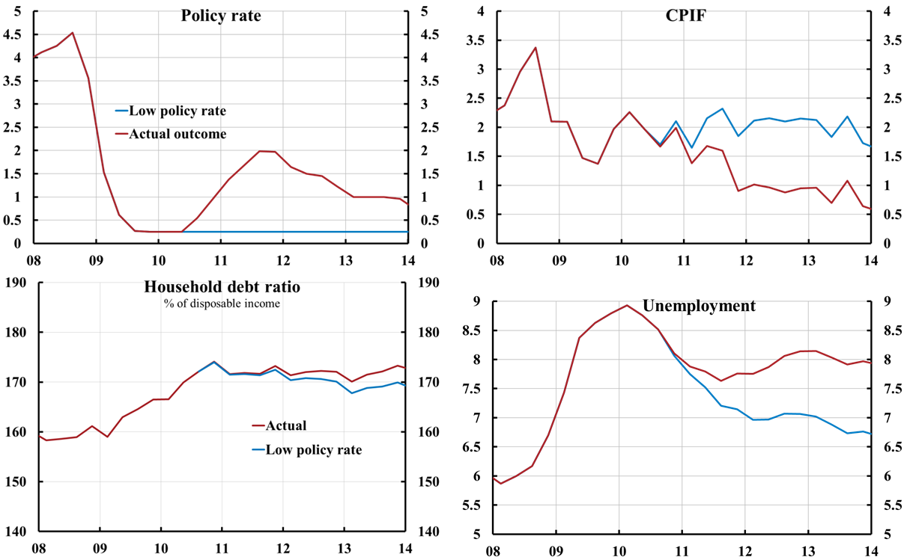
Policy-rate increases from summer of 2010 have led to inflation below target and higher unemployment (and probably a higher debt ratio)
LTV cap
Cont.
Source: Svensson (2013), “Unemployment and monetary policy – update for the year 2013,”
Svensson (2013), “Leaning against the wind increase (not reduces) the household debt-to-GDP ratio”,
posts on larseosvensson.se.

Slide 67
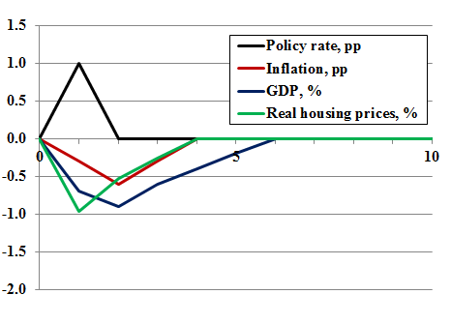
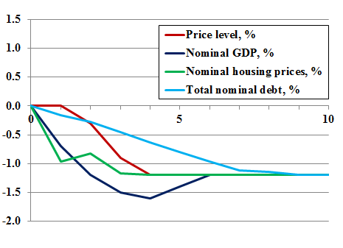
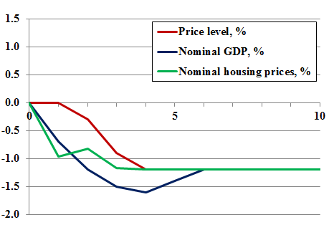
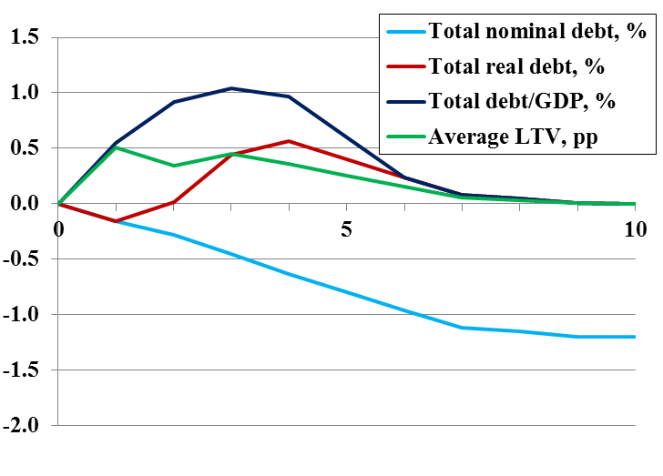
Impulse responses to 1 percentage point higher policy rate during year 1
Deviations from baseline

Slide 68
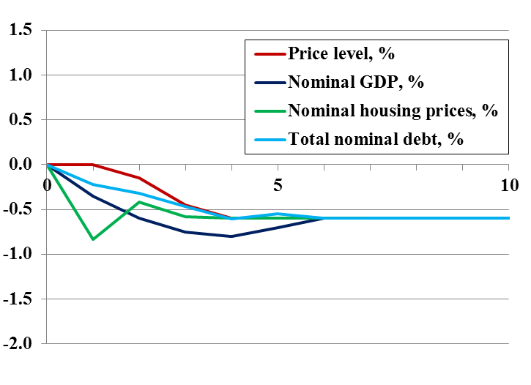
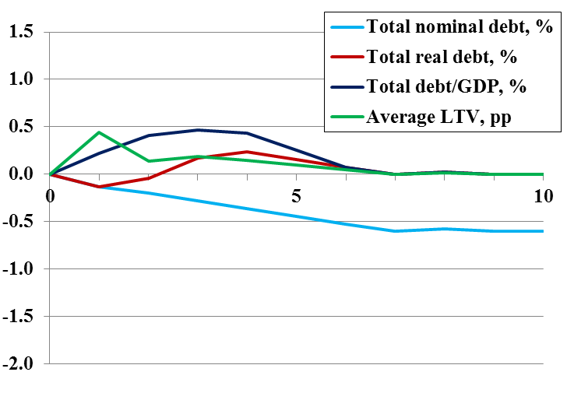
Robustness: T = 4 years, inflation and GDP responses half of Ramses

Slide 69
