Slide 1
Credit-Induced Boom and Bust
Marco Di Maggio (Columbia) and Amir Kermani (UC Berkeley)
Conference on Housing and Monetary Policy
September 5, 2014

Slide 2
Motivation
The Great Recession was preceded by a large expansion of credit and followed by a collapse in housing prices, employment, and consumption.
The US flow of funds: stock of household mortgage liabilities more than doubled from 2000 to 2006, increasing by 5.7 trillion dollars.
The employment decline was greater than that of any recession of recent decades, peaking at 10% in Oct .09.
Regions that accumulated more debt during this period experienced a larger boom in house prices and consumption which was followed by a larger bust in subsequent years.

Slide 3
Households’ Liabilities, House Prices and Employment

Slide 4
Research Question
How much of the boom and the bust in the real economy were due to an outward shift in the credit supply?
Specifically, due to lending to riskier borrowers?
Challenges:
• Identifying the causal effect of credit is challenging:
  Counties that experience higher growth are going to increase their consumption and drive house prices up, but are also going to have higher demand for credit.
  As a result, house price and employment increases will be strongly correlated with the supply of credit, even if credit has no direct effect on house prices and consumption.

Slide 5
Identification Strategy
We take advantage of important changes to banking regulation in the U.S. during the early 2000s.
Starting in 1999 several states adopted anti-predatory laws (APL): several restrictions such as requiring verification of borrowers repayment ability, limits on fees, rates and prepayment penalties.
  Most importantly, many states included purchase loans to APL.
In 2004 the OCC enacted a preemption rule, which barred the application of state anti-predatory laws to national banks.
  National banks and subsidiaries became exempt from APL laws and state enforcement.
We employ this as a positive shock to credit supply in counties with higher fraction of national banks and in states with local APL.

Slide 6
Main Results
Credit Supply: if we compare counties in the top versus the bottom decile of presence of national banks in states with anti-predatory laws the OCC preemption resulted in:
  18% increase in annual loan issuance in years 2004-2006.
  Followed by a similar decline in years 2007-2010.
House Prices: using this as an instrument for the supply of credit, we find that a 10% increase in annual loans origination is associated with a 3% increase in annual house price growth rate or a total of 10% increasein house prices from 2004-2006.
Employment: a 10% increase in loan origination leads to a 2-3% increase in employment in the non-tradable sectors.
Delinquencies: a 15% decrease in delinquencies during the boom period, and 30% more delinquencies during the Great Recession.
Heterogeneous Effects: The Boom-Bust pattern is more pronounced in Subprime regions, regions with less affordable housing, and regions with less elastic supply of housing.
Robust to several alternative hypothesis.

Slide 7
Outline
1. Our Contribution
2. Regulatory Framework
3. Data and Research Design
4. Main Results
5. Heterogeneous Effects
6. Robustness Checks
7. Conclusion

Slide 8
Our Contribution
  Growing literature on the role played by credit supply during the crisis
Most of the existing literature investigates how an underlying increase in the credit supply propagates through the economy by using static regional variations, such as the elasticity of housing supply developed by Saiz (2010).
In contrast,
We provide an instrument aimed to directly capture an outward shift in the credit supply, which allows us to investigate how lending to riskier borrowers affects real economic activity, controlling for regional differences.
  Our paper shows its effect on the boom and bust cycle experienced in several sectors of the economy.

Slide 9
Related Literature
Studies on the great recession: Mian and Sufi (2009, 2014), Kermani (2012).
  We complement these studies by exploiting exogenous variation to identify the effect of an outward shift in the credit supply on house prices, employment, and delinquency rates.
Literature on credit booms and financial crisis: Kiyotaki and Moore (1997), Justiniano et al. (2014), Rajan and Ramcharan (2012) , Schularick & Taylor (2012) , Jordà, Schularick & Taylor (2013)
Papers that study the interplay between credit and real economic activity: Mian et al. (2011), Greenstone and Mas (2012), Jiménez et al.(2012), Adelino et al. (2012) and Chodorow-Reich (2014).
  Our paper shows the effect of an increase in lending on the boom and bust cycle experienced in several sectors of the economy.
Role of APL: Keys et al. (2010), Ho and Pennington-Cross (2006), Agarwal et al. (2013), Ding et al. (2012).
  We use this evidence to motivate the use of APL as source of variation, but to gauge the effect of the credit supply in the aggregate and on real economic activity.

Slide 10
Regulatory Framework
In the U. S. national banks are supervised by the OCC.
Federal thrifts by the OTS.
Independent mortgage companies by HUD
State banks and thrifts chartered at the state level are supervised by either the Federal Reserve System (FRS) or the Federal Deposit Insurance Corporation (FDIC) or by their chartering state.
Credit unions by the National Credit Union administration (NCUA).

Slide 11
Anti-predatory laws
In 1994, Home Ownership and Equity Protection Act (HOEPA):
  restrictions on lending terms and practices for mortgages with high prices, based on either the APR or the total points and fees imposed.
  However, high cost mortgages only accounted for one percent of residential mortgages.
  It only covered refinance loans.
Many states adopted stronger anti-predatory lending regulations than federal law requires. The first law was passed in 1999 by North Carolina.
As of January 2007, 20 states and the District of Columbia had anti-predatory laws in effect.
We focus on the ones that were not replication of Federal Anti-Predatory law.

Slide 12
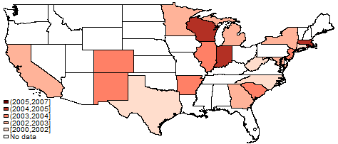
Timing of adoption of state APLs

Slide 13
Do APLs Matter?
Ding et al. (2012): APLs associated with a 43% reduction in prepayment penalties; 40% decrease in ARMs; significant reduction in likelihood to default. Stronger for subprime regions.
Ho and Pennington-Cross (2006): subprime loans originated in APL states had lower APRs than in unregulated states.
Keys et al. (2010): employ the APL as an instrument for the ease of securitization.
Evidence from Rating Agencies: they require credit enhancement, "to the extent that potential violations of APL reduce the funds available to repay RMBS investors, the likelihood of such violations and the probable severity of the penalties must be included in Moody’s overall assessment".

Slide 14
Preemption Rule
On January 7, 2004 the OCC preempted a broad range of state laws attempting to regulate the “terms of credit” from applying to national banks’ activities.
Specifically, the OCC preempted all regulations pertaining the following:
  Loan-to-value ratios;
  The terms of credit: repayment of principal and interest, amortization, balance, payments due, minimum payments, or term to maturity of the loan;
  The aggregate amount of funds that may be loans upon the security of real property;
  Access to, and use of, credit reports;
  Disclosure and advertising;
  Processing, origination, servicing, sale or purchase of, or investment or
  participation in, mortgages;
  Rates of interest on mortgage loans;

Slide 15
Data
• “Home Mortgage Disclosure Act” (HMDA) data set from 1999 through 2011: flow of new mortgage loans originated every year.
• It records each applicant's final status (denied/approved/originated), purpose of borrowing (home purchase/refinancing/home improvement), loan amount, race, sex, income, and home ownership status.
• We obtain data on the fraction of loans securitized from Blackbox Logic.
• The New York Fed Consumer Credit Panel: county level information on loan amounts, mortgage delinquency rates and the fraction of households with FICO scores below 620.
• County Business Pattern: employment data (non tradable sectors).
• Our county--level house price data from 1999 to 2011 come from Zillow.com
• We also add county--level data on demographics, income, and business statistics through the Census.
• Anti-Predatory measure from White, Reid, Ding and Quercia (2011)

Slide 16
Research Design

Slide 17
Research Design (1)
The introduction of APL might be correlated with other policies or with unobserved characteristics of the local mortgage market.

Slide 18
Research Design (2)
The source of funding and its growth for national banks and independent mortgage lenders were significantly different.

Slide 19
Research Design (3)

Slide 20
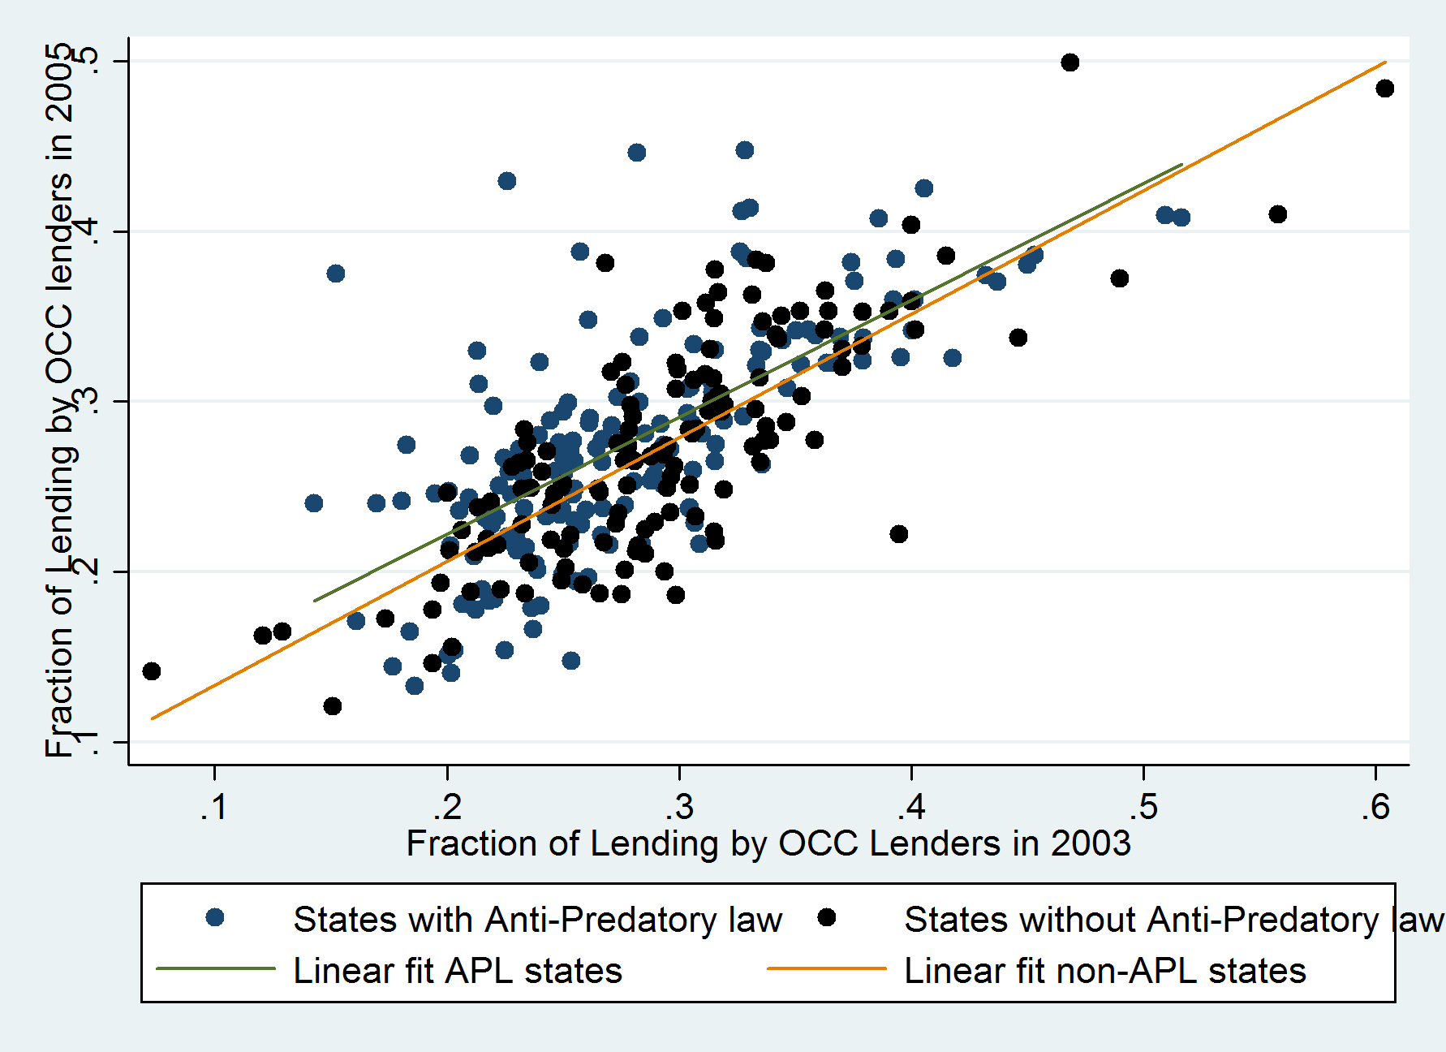
Presence of National Banks
Over Time

Slide 21
Main Results

Slide 22
Summary Statistics
 |  |  | States without Anti-Predatory Law |  | States with Anti-Predatory Law
 |  |  |  |  |  |  | Diff-in-Diff
 |  |  | Below Median | Above Median | Below Median | Above Median
 | Fraction of OCC lenders in 2003 |  | 0.219 | 0.349 | 0.230 | 0.345 | -0.015
 | Elasticity of housing supply |  | -1.568 | -2.083 | -1.575 | -1.775 | 0.315
 | Log Population in 2003 |  | 10.58 | 10.66 | 10.70 | 10.73 | -0.050
 | Log Median Income in 2003 |  | 12.51 | 12.09 | 13.26 | 12.60 | -0.240
Change from 2003-2005 | Median Income |  | 0.0727 | 0.0549 | 0.103 | 0.0835 | -0.002
 | Population |  | 0.0306 | 0.0220 | 0.0212 | 0.0171 | 0.005
 | Fraction of Loans Securitized |  | 0.204 | 0.162 | 0.238 | 0.194 | -0.002
 | Loan amounts |  | 0.710 | 0.443 | 0.455 | 0.428 | 0.240 | ***
 | House prices |  | 0.450 | 0.250 | 0.359 | 0.289 | 0.130 | *
 | Employment in non-tradables |  | 0.0725 | 0.0471 | 0.0508 | 0.0441 | 0.019 | *
Change from 2008-2010 | Median Income |  | -0.00495 | -0.0108 | -0.00595 | -0.00928 | 0.003
 | Population |  | 0.00583 | 0.00728 | 0.00583 | 0.00724 | 0.000
 | Loan amounts |  | -0.265 | -0.202 | -0.179 | -0.210 | -0.094 | ***
 | House prices |  | -0.170 | -0.0744 | -0.112 | -0.0929 | -0.077 | **
 | Employment in non-tradables |  | -0.0567 | -0.0409 | -0.0403 | -0.0481 | -0.024 | **
Change from 2001-2003 (Pre-trends) | Median Income |  | 0.0302 | 0.0257 | 0.0146 | 0.00803 | -0.002
 | Population |  | 0.00803 | 0.0102 | 0.0178 | 0.0150 | -0.005
 | Loan amounts |  | 0.379 | 0.280 | 0.372 | 0.286 | 0.013
 | House prices |  | 0.207 | 0.154 | 0.275 | 0.150 | -0.072
 | Employment in non-tradables |  | 0.0450 | 0.0196 | 0.0454 | 0.0138 | -0.006

Slide 23
Loan Amounts by Agency
 | Log of loan amount | Log (Loan Amounts / Loan Amounts in 2000)
APL x Post x OCC | 0.09*** | 0.11*** | 0.11***
 | (0.03) | (0.03) | (0.03)
County-Agency Fixed Effects | Yes
Year Fixed Effects | Yes | Yes
County Fixed Effects |  | Yes
County-Year Fixed Effetcs |  |  | Yes

Slide 24
Outward Shift in Supply of Credit
 | Log of Loan amount
 | Full Sample |  |  | Counties with Elasticity and FICO Measure
APL X Post X Fraction OCC | 0.449*** | 0.472*** |  | 0.949*** | 0.915*** | 0.717***
 | (0.133) | (0.120) |  | (0.223) | (0.189) | (0.182)
Log(Median Income) |  | 1.552*** |  | 1.725*** | 1.731*** | 1.431***
 |  | (0.142) |  | (0.157) | (0.143) | (0.156)
Log(Population) |  | 1.191*** |  | 1.196*** | 1.180*** | 1.293***
 |  | (0.156) |  | (0.184) | (0.174) | (0.164)
Fraction Subprime X Post |  |  |  |  | 0.804*** | 1.017***
 |  |  |  |  | (0.112) | (0.112)
Elasticity X Post |  |  |  |  |  | -0.0658***
 |  |  |  |  |  | (0.00867)
Year Fixed Effect | Yes | Yes |  | Yes | Yes | Yes
County Fixed Effect | Yes | Yes |  | Yes | Yes | Yes
Observations | 21,564 | 15,533 |  | 5,348 | 5,348 | 5,348
R-squared | 0.020 | 0.147 |  | 0.233 | 0.233 | 0.267
Number of counties | 3,085 | 2,219 |  | 764 | 764 | 764

Slide 25
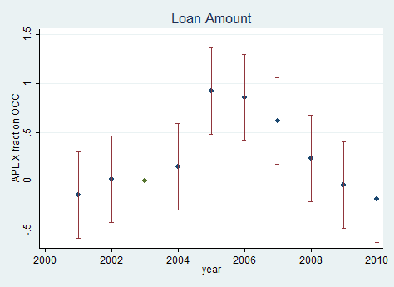
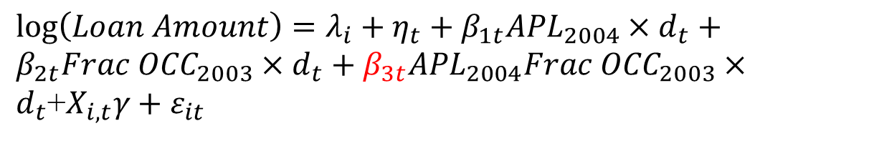
Boom and Bust: Credit Supply
APL X Fraction OCC | 0.890*** | 0.728*** |  | -1.016*** | -0.852***
 | (0.214) | (0.197) |  | (0.349) | (0.314)
Fraction of Subprime | 0.568*** | 0.728*** |  | -0.566*** | -0.820***
 | (0.0948) | (0.0980) |  | (0.168) | (0.185)
Elasticity |  | -0.0521*** |  |  | 0.0669***
 |  | (0.00802) |  |  | (0.0149)
$\log\left(Loan Amount\right)=λ_{i}+η_{t}+β_{1t}{APL}_{2004}×d_{t}+β_{2t}{Frac OCC}_{2003}×d_{t}+β_{3t}{APL}_{2004}{Frac OCC}_{2003}×d_{t}$+$X_{i,t}γ+ε_{it}$

Slide 26
Impact on House Prices
 | Full Sample |  |  | Counties with Elasticity Measure
APL X Post X Fraction OCC | 0.247*** | 0.215*** |  | 0.273*** | 0.273*** | 0.236***
 | (0.0547) | (0.0484) |  | (0.0643) | (0.0643) | (0.0617)
Fraction of Subprime X Post |  |  |  | 0.193*** | 0.193*** | 0.233***
 |  |  |  | (0.0370) | (0.0370) | (0.0378)
Elasticity X Post |  |  |  |  |  | -0.0124***
 |  |  |  |  |  | (0.00312)
Log(Median Income) |  | 0.200*** |  | 0.239*** | 0.239*** | 0.190***
 |  | (0.0443) |  | (0.0510) | (0.0510) | (0.0517)
Log(Population) |  | 0.219** |  | 0.162 | 0.162 | 0.220*
 |  | (0.111) |  | (0.129) | (0.129) | (0.115)
Year Fixed Effect | Yes | Yes |  | Yes | Yes | Yes
County Fixed Effect | Yes | Yes |  | Yes | Yes | Yes
Observations | 6,244 | 5,322 |  | 3,258 | 3,258 | 3,258
R-squared | 0.063 | 0.077 |  | 0.113 | 0.113 | 0.128
Number of counties | 892 | 887 |  | 543 | 543 | 543

Slide 27
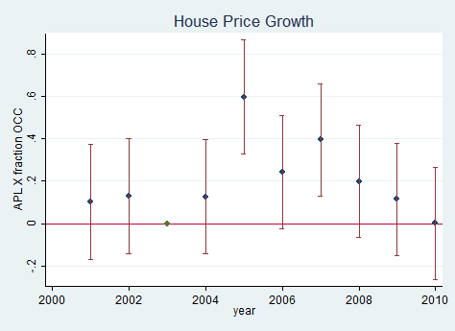
Boom and Bust: House Prices
APL X Fraction OCC | 0.563*** | 0.348* |  | -0.650*** | -0.518***
 | (0.208) | (0.191) |  | (0.198) | (0.182)
Fraction of Subprime | 0.0431 | 0.221*** |  | -0.110 | -0.252***
 | (0.0753) | (0.0795) |  | (0.0799) | (0.0772)
Elasticity |  | -0.0568*** |  |  | 0.0415***
 |  | (0.00891) |  |  | (0.00531)

Slide 28
Impact on Employment in
Non-tradable Sector
 | Full Sample |  |  | Counties with Elasticity Measure
APL X Post X Fraction OCC | 0.207*** | 0.161*** |  | 0.179** | 0.179** | 0.152**
 | (0.0698) | (0.0596) |  | (0.0707) | (0.0707) | (0.0714)
Fraction of Subprime X Post |  |  |  | 0.101*** | 0.101*** | 0.128***
 |  |  |  | (0.0352) | (0.0352) | (0.0393)
Elasticity X Post |  |  |  |  |  | -0.008***
 |  |  |  |  |  | (0.00298)
Log(Median Income) |  | 0.287*** |  | 0.310*** | 0.310*** | 0.273***
 |  | (0.0443) |  | (0.0488) | (0.0488) | (0.0470)
Log(Population) |  | 0.893*** |  | 0.954*** | 0.954*** | 0.965***
 |  | (0.0741) |  | (0.0814) | (0.0814) | (0.0815)
Year Fixed Effect | Yes | Yes |  | Yes | Yes | Yes
County Fixed Effect | Yes | Yes |  | Yes | Yes | Yes
Observations | 5,362 | 5,362 |  | 3,693 | 3,693 | 3,693
R-squared | 0.014 | 0.226 |  | 0.287 | 0.287 | 0.291
Number of counties | 790 | 790 |  | 537 | 537 | 537

Slide 29
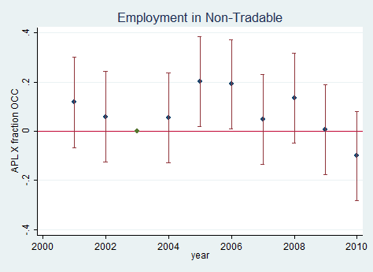
Boom and Bust: Employment
APL X Fraction OCC | 0.176** | 0.159** |  | -0.241** | -0.220**
 | (0.0750) | (0.0752) |  | (0.0989) | (0.103)
Fraction of Subprime | 0.0828*** | 0.0976*** |  | 0.0620 | 0.0392
 | (0.0307) | (0.0321) |  | (0.0425) | (0.0475)
Elasticity |  | -0.00470* |  |  | 0.00657**
 |  | (0.00276) |  |  | (0.00323)

Slide 30
Impact on Delinquencies
 | Full Sample |  |  | Counties with Elasticity Measure
APL X Post X Fraction OCC | -0.874*** | -0.869*** |  | -1.830*** | -1.830*** | -1.580***
 | (0.328) | (0.309) |  | (0.442) | (0.442) | (0.435)
Fraction of Subprime X Post |  |  |  | -0.843*** | -0.843*** | -1.113***
 |  |  |  | (0.304) | (0.304) | (0.322)
Elasticity X Post |  |  |  |  |  | 0.0834***
 |  |  |  |  |  | (0.0221)
Log(Median Income) |  | -1.930*** |  | -2.316*** | -2.316*** | -1.935***
 |  | (0.325) |  | (0.372) | (0.372) | (0.421)
Log(Population) |  | -0.827* |  | -0.865* | -0.865* | -1.008**
 |  | (0.435) |  | (0.515) | (0.515) | (0.503)
Year Fixed Effect | Yes | Yes |  | Yes | Yes | Yes
County Fixed Effect | Yes | Yes |  | Yes | Yes | Yes
Observations | 15,533 | 15,533 |  | 5,348 | 5,348 | 5,348
R-squared | 0.007 | 0.022 |  | 0.074 | 0.074 | 0.086
Number of counties | 2,219 | 2,219 |  | 764 | 764 | 764

Slide 31
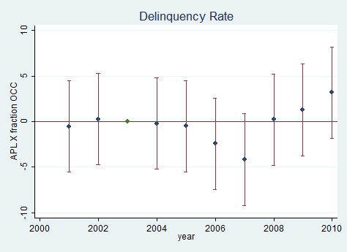
Boom and Bust: Delinquencies
APL X Fraction OCC | -1.874*** | -1.788*** |  | 7.838** | 5.757*
 | (0.498) | (0.501) |  | (3.795) | (3.355)
Fraction of Subprime | -1.085*** | -1.171*** |  | 2.625* | 5.412***
 | (0.234) | (0.252) |  | (1.373) | (1.418)
Elasticity |  | 0.0278 |  |  | -0.819***
 |  | (0.0193) |  |  | (0.108)

Slide 32
Heterogeneous Treatment Effect

Slide 33
Heterogeneous Treatment Effect
 | Change in Loan Amount in 2003-2005 | Change in Loan Amount in 2007-2009 | Change in House Prices in 2003-2005 | Change in House Prices in 2008-2010 | Change in Employment in Non-Tradable Sector in 2003-2005 | Change in Employment in Non-Tradable Sector in 2008-2010 | Change in Delinquency Rates in 2003-2005 | Change in Delinquency Rates in 2008-2010
Subprime County X APL X Fraction OCC | 1.342*** | -1.78*** | 0.566* | -1.15*** | 0.288** | -0.355* | -2.062* | 16.98***
 | (0.361) | (0.676) | (0.314) | (0.316) | (0.136) | (0.205) | (1.083) | (6.366)
Prime County X APL X Fraction OCC | 0.325 | -0.284 | 0.181 | -0.142 | 0.0762 | -0.163 | -1.322** | -0.249
 | (0.240) | (0.307) | (0.226) | (0.144) | (0.0903) | (0.105) | (0.540) | (3.199)
Inelastic County X APL X Fraction OCC | 1.471** | -3.330** | 0.985 | -1.43*** | 0.277 | -0.556* | -0.162 | 25.01*
 | (0.663) | (1.562) | (0.598) | (0.388) | (0.212) | (0.305) | (1.561) | (12.77)
Elastic County X APL X Fraction OCC | 0.717*** | -0.564** | 0.323* | -0.309 | 0.191** | -0.146* | -2.03*** | 4.309
 | (0.245) | (0.263) | (0.187) | (0.228) | (0.0878) | (0.0815) | (0.554) | (3.113)

Slide 34
Robustness Checks
Diff-in-Diff
Securitization
State Borders
CRA Lending
BHC Agency
Loan-Level Evidence
Others:
Only APL States
JP Morgan Chase
Aggregate Impact

Slide 35
Robustness I: Diff-in-Diff
 | (1) | (2) | (3) | (4)
 | Log of Loan amount | House Prices Growth | Employment in the Non-Tradable Sector | Delinquency Rates
Post X Fraction OCC | 0.519*** | 0.146** | 0.128** | -0.978**
 | (0.138) | (0.0620) | (0.0614) | (0.398)
County-Level Controls | Yes | Yes | Yes | Yes
Year Fixed Effect | Yes | Yes | Yes | Yes
County Fixed Effect | Yes | Yes | Yes | Yes
Observations | 2,359 | 1,820 | 1,719 | 2,359
R-squared | 0.507 | 0.128 | 0.434 | 0.131
Number of Counties | 337 | 260 | 252 | 337

Slide 36
Robustness II : Securitization
 | Change in Loan Amount in 2003-2005 | Change in Loan Amount in 2007-2009 | Change in House Prices in 2003-2005 | Change in House Prices in 2008-2010 | Change in Employment in Non-Tradable Sector in 2003-2005 | Change in Employment in Non-Tradable Sector in 2008-2010 | Change in Delinquency Rates in 2003-2005 | Change in Delinquency Rates in 2008-2010
APL X Fraction OCC | 0.821*** | -0.998*** | 0.525** | -0.561*** | 0.175** | -0.210** | -1.979*** | 6.652**
 | (0.207) | (0.349) | (0.240) | (0.199) | (0.0744) | (0.0969) | (0.536) | (2.998)
Securitization boom between 2003-2005 | 0.954*** |  | 0.427 |  | 0.122*** |  | -0.199
 | (0.129) |  | (0.348) |  | (0.0335) |  | (0.307)
Securitization boom between 2002-2006 |  | -0.514** |  | -0.802*** |  | -0.106*** |  | 9.663***
 |  | (0.256) |  | (0.108) |  | (0.0367) |  | (1.560)

Slide 37
Robustness III: State Borders
Looking at Census-Tracts within 10-15 miles from state-borders
 | Change in Loan Amount in 2003-2005 | Change in House Prices in 2003-2005 | Change in Loan Amount in 2007-2009 | Change in House Prices in 2008-2010
APL X Fraction OCC | 0.290*** | 0.232*** | -0.265** | -0.0516**
 | (0.0994) | (0.0444) | (0.116) | (0.0248)
State Fixed Effect | Yes | Yes | Yes | Yes
State-Border Fixed Effect | Yes | Yes | Yes | Yes

Slide 38
Robustness IV: CRA Lending
 | Change in CRA Lending in 2003-2005 | Change in CRA Lending in 2007-2009 | Change in House Prices in 2003-2005 | Change in House Prices in 2008-2010 | Change in Employment in Non-Tradable Sector in 2003-2005 | Change in Employment in Non-Tradable Sector in 2008-2010 | Change in Delinquency Rates in 2003-2005 | Change in Delinquency Rates in 2008-2010
APL X Fraction OCC | -1.242*** | -0.242 | 0.510* | -0.537** | 0.154** | -0.204* | -1.812*** | 5.099
 | (0.288) | (0.272) | (0.266) | (0.261) | (0.0786) | (0.107) | (0.563) | (3.212)
Change in CRA lending |  |  | -0.0381 | 0.0956** | -0.0166* | 0.0251 | 0.167** | -3.520***
 |  |  | (0.0393) | (0.0422) | (0.00953) | (0.0163) | (0.0710) | (0.492)

Slide 39
Robustness V: Bank-Holding Company
 | (1) | (2) | (3) | (4) | (5) | (6) | (7) | (8)
 | Change in Loan Amount in 2003-2005 | Change in Loan Amount in 2007-2009 | Change in House Prices in 2003-2005 | Change in House Prices in 2008-2010 | Change in Employment in Non-Tradable Sector in 2003-2005 | Change in Employment in Non-Tradable Sector in 2008-2010 | Change in Delinquency Rates in 2003-2005 | Change in Delinquency Rates in 2008-2010
APL X Fraction OCC | 0.820*** | -1.001*** | 0.523** | -0.565*** | 0.174** | -0.209** | -2.002*** | 6.701**
 | (0.207) | (0.350) | (0.239) | (0.199) | (0.0741) | (0.0969) | (0.536) | (2.998)
APL | -0.356*** | 0.335*** | -0.227*** | 0.202*** | -0.0625*** | 0.0648** | 0.765*** | -2.804***
 | (0.0661) | (0.119) | (0.0721) | (0.0642) | (0.0215) | (0.0305) | (0.168) | (1.006)
Fraction OCC | -0.510*** | 1.127*** | -0.269 | 0.418*** | -0.0762 | 0.0158 | 1.611*** | -7.948***
 | (0.149) | (0.231) | (0.181) | (0.153) | (0.0579) | (0.0526) | (0.371) | (2.048)
Change in Median Income | 1.240*** | 1.056*** | 1.824*** | 0.273 | 0.0874 | 0.165 | -1.518*** | -1.936
 | (0.173) | (0.317) | (0.516) | (0.181) | (0.0563) | (0.118) | (0.433) | (2.437)
Change in Population | 1.785*** | 1.125* | 1.094*** | 0.351 | 0.919*** | 0.258 | -1.251** | -17.42***
 | (0.250) | (0.575) | (0.250) | (0.518) | (0.0949) | (0.215) | (0.605) | (5.636)
Elasticity | -0.00492 | 0.0206 | -0.0327** | -0.0180** | 0.00154 | 0.00225 | -0.00767 | -0.201**
 | (0.00773) | (0.0163) | (0.0136) | (0.00713) | (0.00287) | (0.00289) | (0.0198) | (0.0806)
Securitization boom between 2003-2005 | 0.954*** |  | 0.427 |  | 0.122*** |  | -0.199
 | (0.129) |  | (0.348) |  | (0.0335) |  | (0.306)
Securitization boom between 2002-2006 |  | -0.514** |  | -0.802*** |  | -0.106*** |  | 9.660***
 |  | (0.256) |  | (0.108) |  | (0.0367) |  | (1.558)
Observations | 769 | 769 | 459 | 478 | 532 | 538 | 769 | 769
R-squared | 0.478 | 0.250 | 0.535 | 0.478 | 0.246 | 0.066 | 0.118 | 0.463

Slide 40
Robustness VI: Loan-Level Evidence
 | 1 | 2 | 3
 | Log of loan amount | Log (Loan Amounts / Loan Amounts in 2004)
APL X OCC | 0.39*** | 0.17*** | 0.17***
 | (0.07) | (0.05) | (0.05)
APL | -0.13* | -0.10*
 | (0.07) | (0.06)
Year Fixed Effects | Yes | Yes
County Fixed Effects |  | Yes
Agency Fixed Effects |  | Yes | Yes
County-Agency Fixed Effects | Yes
County-Year Fixed Effetcs |  |  | Yes
Observations | 85,328 | 51,312 | 51,312
R-squared | 0.91 | 0.48 | 0.53

Slide 41
Aggregate Impact
How much of the increase in house prices can be attributed to a direct effect of an outward shift in the credit supply?
We can integrate our estimated effect to compute the economy wide magnitude of our results.
Compute the ratio between “Fraction OCC x APL” in the loan amount and in the house prices estimations.
For each county, we compute the increase in loan amount minus the 10% decile.
That increase in loan amount times the ratio gives the effect on house prices and then take the average across counties.
For boom of 2003 to 2005: our channel explains 52% of boom in house prices
For bust of 2008 to 2010: our channel explains 67% of decline in house prices
Similarly for employment and delinquency rates.
If consider only the increase in subprime lending, it explains about 20%-25% of boom and bust of house prices.
Similarly, if we consider only the APL states

Slide 42
Conclusion
A change in banking regulation with differential effects on APL states versus the ones without, and on counties with a different presence of national banks provides us with a novel identification strategy to investigate the role of the supply of credit on the boom and bust cycle.
Credit expansion (especially to riskier borrowers) may induce a boom-bust cycle in the real economy.
Time inconsistency of financial regulation: short-term consequences can be very different from long-term ones.

