Slide 1
Ajello, Laubach, López-Salido, and Nakata, “Financial Stability and Optimal Interest-Rate Policy”
Discussion by Lars E.O. Svensson Stockholm School of Economics and IMF
Web: larseosvensson.se
“The New Normal for Monetary Policy” The Federal Reserve Bank of San Francisco March 27, 2015
The views expressed in these is presentation are those of the author and do not necessarily represent those of the IMF or IMF policy.

Slide 2
Issue
Monetary policy and financial stability
Assume that a higher policy rate (leaning against the wind) somehow reduces the probability of a future financial crises
What are the tradeoffs between current costs and future benefits of leaning?
What is the optimal monetary policy?

Slide 3
Results of the paper
Optimal policy implies very small policy-rate increase in standard case
Somewhat larger policy-rate increase if uncertainty about parameters taken into account
Robust policy (worst-case policy) implies larger policy-rate increase

Slide 4
Comments
Little theoretical and empirical support for an economically significant policy-rate effect on the probability of a financial crisis
Mechanism? Very indirect and very weak.
“Good” and “bad” credit growth should have different effects
Monetary policy is the deviation from the neutral rate, not the general level of interest rates.
Direction of effect? Tighter policy may affect price level and disposable income faster than the stock of debt, thereby increasing real debt and debt-to-income, or at least have very small effects (Svensson 2014, Gelain, Lansing, Natvik 2014)

Slide 5
Comments
The probability and consequences of a crisis depends on the resilience of the financial system and the magnitude and nature of disturbances
The resilience of the financial system depends directly on supervision and regulation (macroprudential policy)
Macroprudential policy therefore has a much bigger and direct effect on the probability and consequences of a crisis than the policy rate
Thus, use macroprudential policy rather than monetary policy for achieving and maintaining financial stability

Slide 6
Comments
Nevertheless, one may want to have an idea of the tradeoffs from using monetary policy
Estimate tradeoff between current and expected future macroeconomic outcomes for policy-rate changes
Cost and benefit in terms of unemployment (linear calculation, marginal rate of transformation)
Cost and benefit in terms of quadratic loss function
First-order conditions for optimal policy: Benefit ≥ Cost

Slide 7
Other comments
Inherent problem with robust optimal control
Optimal policy often on boundary of assumed feasible set of models/parameters
Optimal policy hence very sensitive to assumptions (not robust at all)
Any probability assigned to boundary of feasible set very small
Very unlikely outcomes determine policy
Not practical
Instead, Bayesian optimal control

Slide 8
The Riksbank’s case for leaning against the wind
A higher policy rate (leaning) implies lower household debt
Lower debt implies (1) a lower probability of a future crisis and/or (2) a less deep future crisis if it occurs
Benefit of leaning: Better expected macroeconomic outcome in the future
Cost of leaning: Worse macroeconomic outcome in the next few years
Riksbank assumption (gut feeling): The benefit exceeds the cost
Is that assumption true?
The answer can be found in the Riksbank’s own boxes in MPRs July 2013 and February 2014, plus Schularick and Taylor (2012) and Flodén (2014)
This involves putting numbers on the cost and benefit of leaning (Svensson 2015, Inflation targeting and leaning against the wind)

Slide 9
Intertemporal tradeoff faced by Riksbank (Svensson): Simple linear calculation in terms of unemployment
Should have been ≥ 100%

Slide 10
Intertemporal tradeoff faced by Riksbank (Svensson): Simple quadratic calculation in terms of unemployment
FOC: Cost/Benefit = 1 (adjusted for lengths of periods 1 and 2 and discounting)

Slide 11
Intertemporal tradeoff faced by central bank (figure 1 in paper): Simple linear calculation in terms of output
-0.025 pp
- 0.00008 pp/qtr
0.1 pp

Slide 12
Intertemporal tradeoff faced by central bank (figure 1 in paper): Simple linear calculation in terms of output

Slide 13
Intertemporal tradeoff faced by central bank (paper) : Simple quadratic calculation in terms of output
FOC: Cost/Benefit = 1 (adjusted for lengths of periods 1 and 2 and discounting)

Slide 14
Intertemporal tradeoff faced by central bank (paper)
Quadratic loss function does not make much difference (benefits are mainly linear)
Uncertainty and Bayesian optimal policy does not make much difference
Robust (worst-case) optimal policy simply assumes worst feasible outcome. But very sensitive to assumed feasible set. If probability to outcomes assigned, very unlikely outcomes determine policy

Slide 15
Conclusion
Do not let monetary policy lean against the wind for financial-stability purposes
There is no choice but to use macroprudential policy to achieve and maintain financial stability

Slide 16
Additional slides

Slide 17
A detail: The financial-stability mechanism

Slide 18
Cost of 1 pp higher policy rate: 0.5 pp higher unemployment rate
Source: MPR July 2013, chapt. 2; Svensson, post on larseosvensson.se, March 31, 2014.

Slide 19
Benefit (1) of 1 pp higher policy rate: Lower probability of a crisis
Schularick & Taylor (2012): 5% lower real debt in 5 yrs implies 0.4 pp lower probability of crisis (average probability of crises about 4%)
Riksbank, MPR Feb 2014, box:
1 pp higher policy rate leads to 0.25% lower real debt in 5 years
Lowers probability of crises by 0.25*0.4/5 = 0.02 pp
Assume 5 pp higher unemployment in crisis (Riksbank crisis scenario, MPR July 2013, box):
Benefit (1): Expected lower future unemployment: 0.0002*5 = 0.001 pp
Cost: Higher unemployment rate now: 0.5 pp
Source: Svensson, post on larseosvensson.se, March 31, 2014.

Slide 20
Benefit (2) of 1 pp higher policy rate: Smaller increase in unemployment if crisis
Flodén (2014): 1 pp lower debt ratio may imply 0.02 pp smaller increase in unemployment rate in crisis
Riksbank MPR Feb 2014, box:
1 pp higher policy rate leads to 0.44 pp lower debt ratio in 5 yrs
Smaller increase in unemployment in crisis: 0.44*0.02 = 0.009 pp
With probability of crisis as high as 10%, divide by 10 (Shularick & Taylor: 4%)
Benefit (2): Expected lower future unemployment: 0.0009 pp
Cost: Higher unemployment now: 0.5 pp
Source: Svensson, post on larseosvensson.se, March 31, 2014.

Slide 21
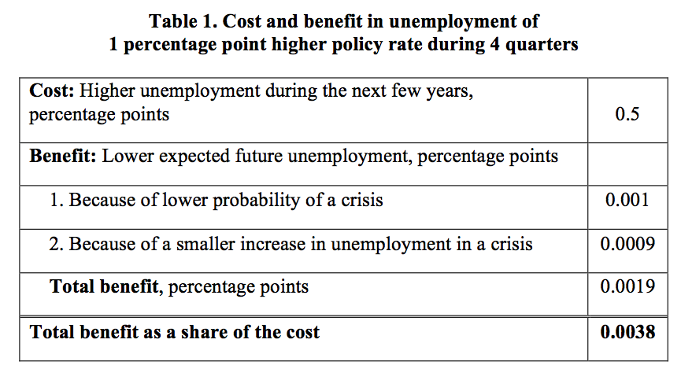
Summarize cost and benefit of 1 pp higher policy rate
Should have been > 1!
Riksbank’s case does not stand up to scrutiny

Slide 22
The leaning: Policy rates in Sweden, UK, and US; Eonia rate in euro area

Slide 23
The leaning: Inflation in Sweden, euro area, UK, and US

Slide 24
The leaning: Real policy rate in Sweden, UK, and US, real Eonia rate in euro area

Slide 25
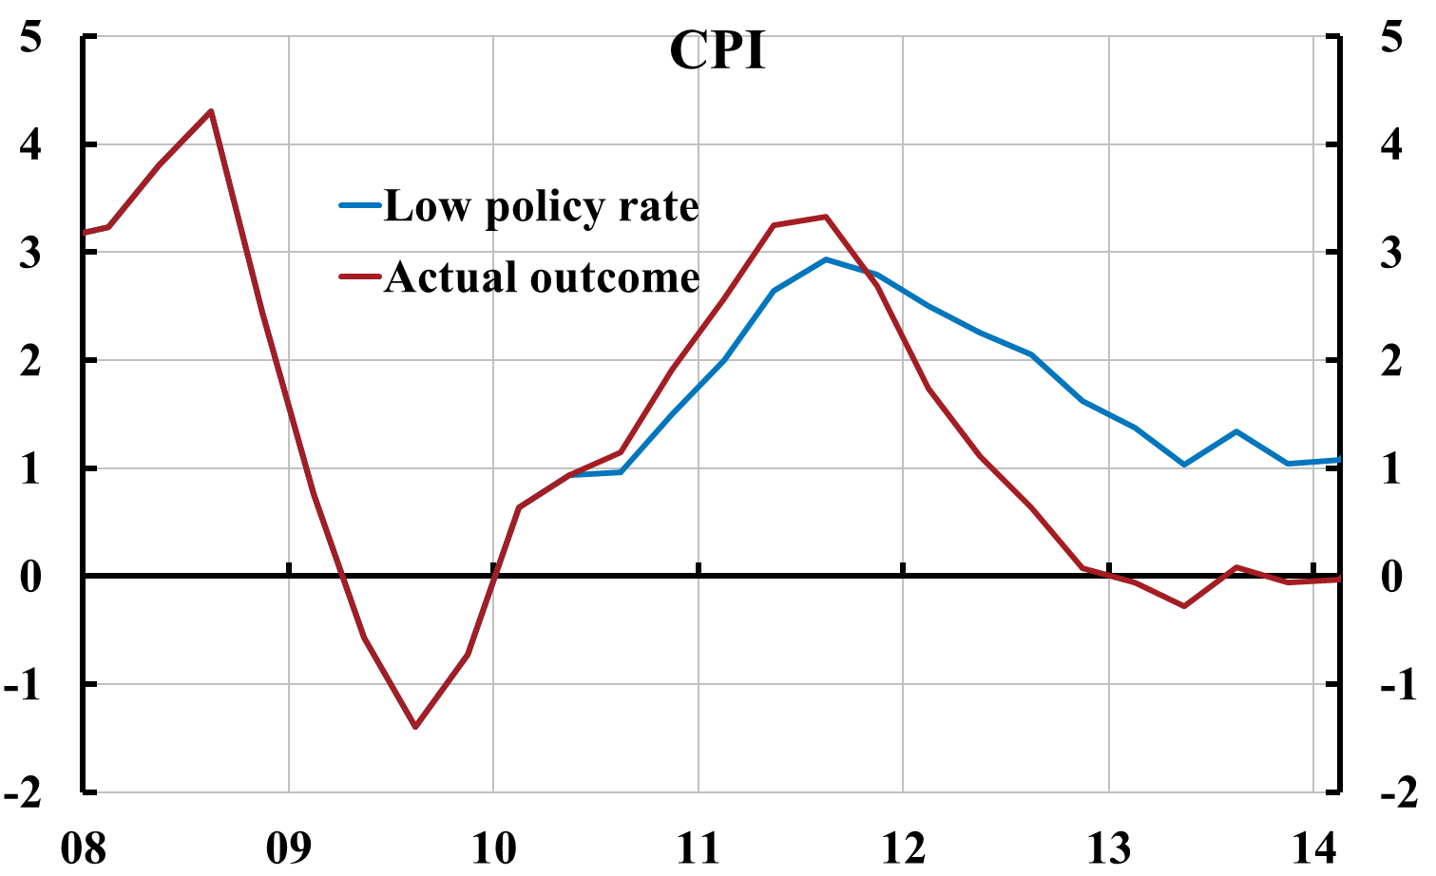
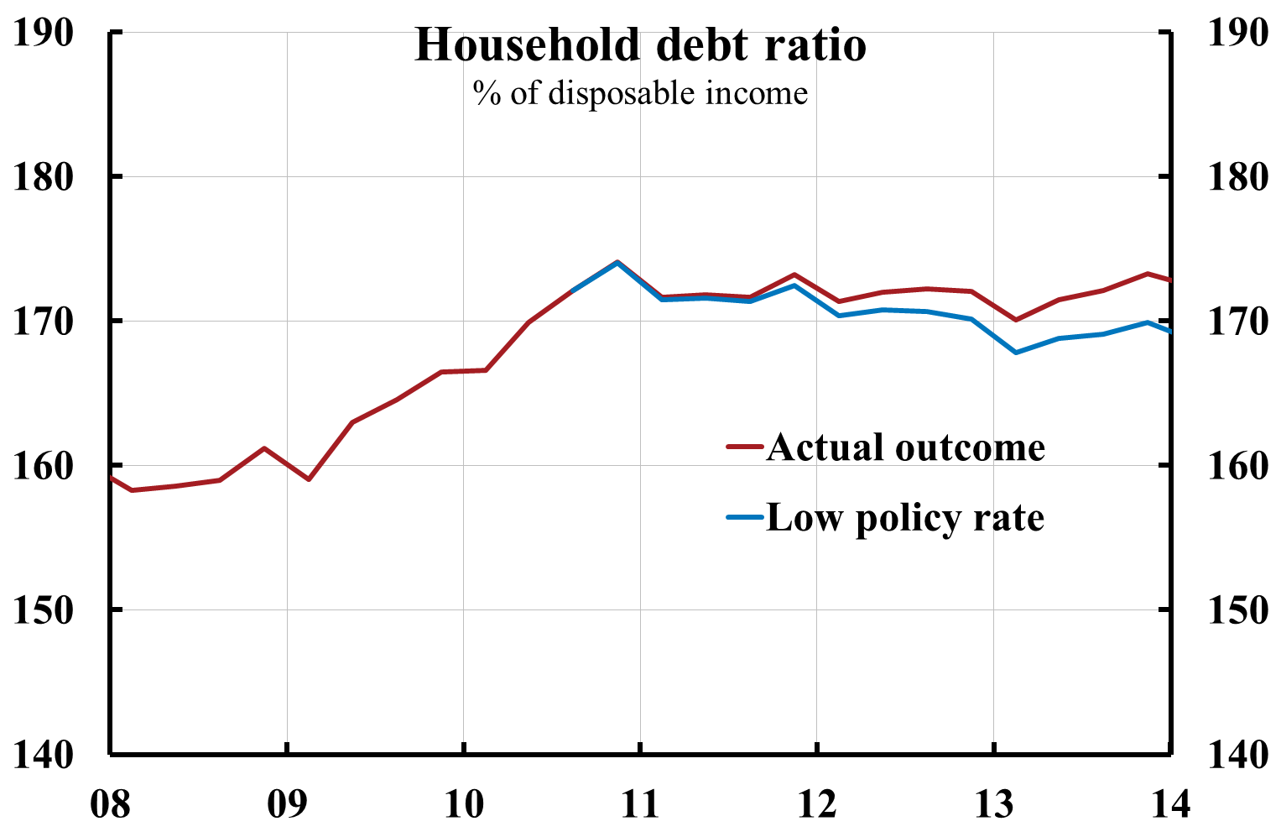
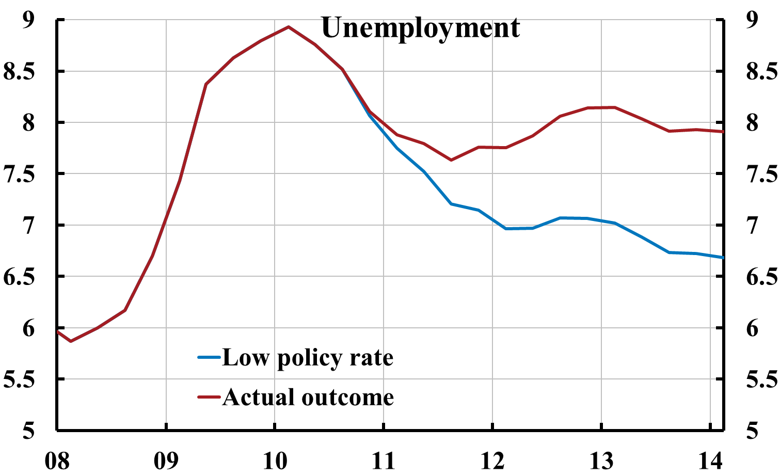
Ex post evaluation: Riksbank policy-rate increases from summer of 2010 have led to inflation below target and higher unemployment (and probably a higher debt ratio)
85% LTV cap
Source: Svensson (2013), “Unemployment and monetary policy – update for the year 2013,” Svensson (2013), “Leaning against the wind increase (not reduces) the household debt-to-GDP ratio”, posts on larseosvensson.se.

